Slide 2













Agenda
Welcome
  Why we became a Blandin Broadband Community
  Jayne Gibson (Austin Aspires), chair/leader
The Intelligent Community Framework
  Blandin Team
Community Discussions
  By Intelligent Community Element
Group Reporting
  Assets and Gaps
  Desired Outcomes
Next Steps
Adjourn

Slide 3
Community Opportunity

Slide 4
Achieving BBC Success
Amazing Results
Ideas
Resources
Leadership

Slide 5
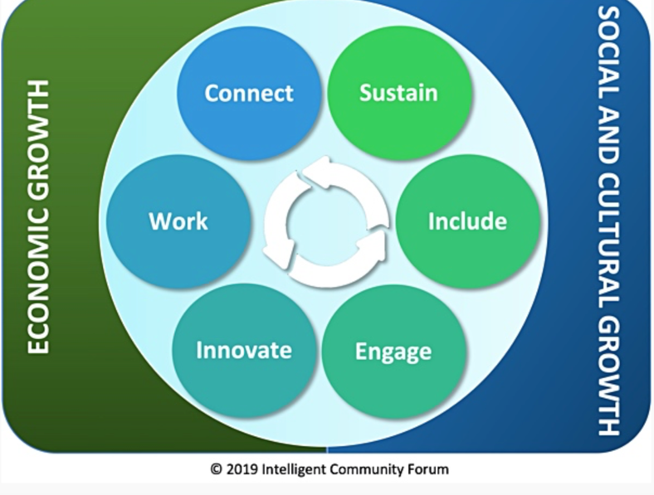
The Intelligent Community Framework

Slide 7
Broadband Discussion
How is your broadband?
  In the cities and towns
  In the rural countryside
  For schools, governments and health care
  For business
  Via cellular
Where is Wi-Fi available?
Who are the key players in this discussion?

Slide 8

Our Broadband Story
Julie Clinefelter
2019/2021 Broadband Service Inventory
  School reports many kids outside city limits
Free Wifi availability
  Library- grant based
  School- grant based
  Community
Future opportunities
Key issue may be affordability, not availability

Slide 9
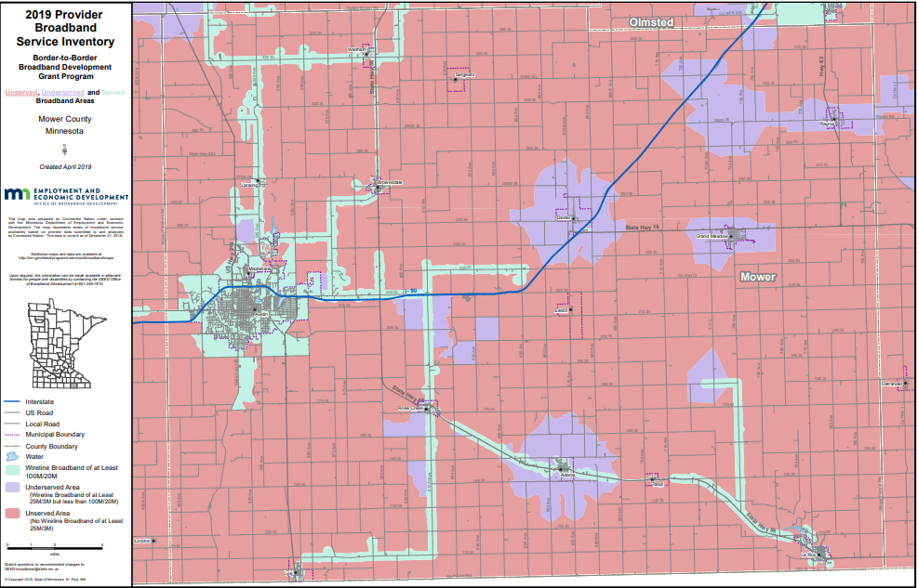
Our Broadband Story

Slide 10
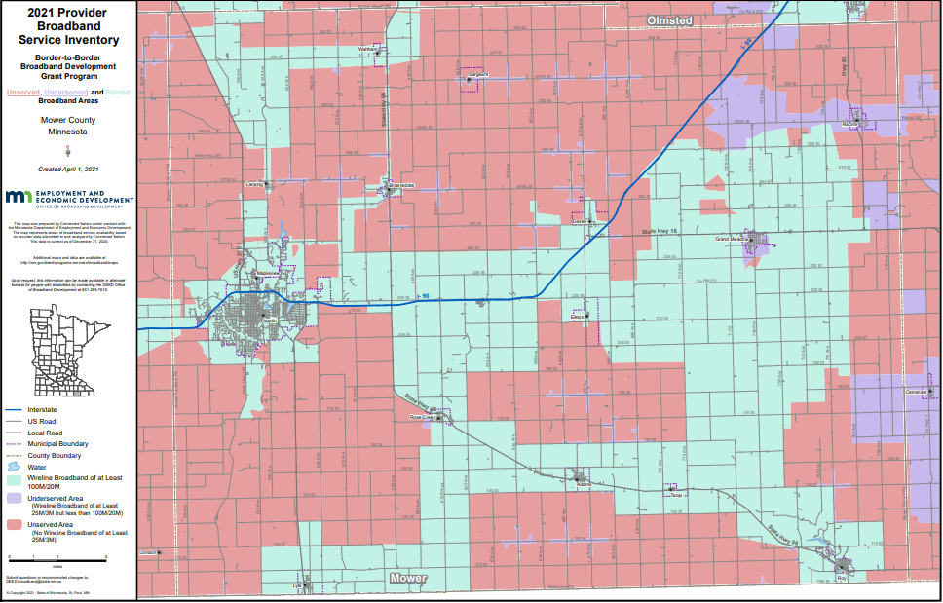
Our Broadband Story

Slide 11
Community Survey Response
We do a lot with digital outreach through social media, our webpage, and utilize online and cloud-based resources, so a broadband connection is necessary.
Interrupted connection or important stakeholders who do not have access are unable to collaborate and share voice
I have internet access to my home, but it is impacted by demand. Certain times of the day it is very slow.
We use Spectrum for our Internet services and rely on this service to run our server and POS workstations. We have experienced outages and other problems that affect our business.
We are not hindered but our monthly expense is high
There would be no working from home without it. There would be no way to communicate in a timely manner with medical, mental health and school needs. We cannot function efficiently or effectively without it.

Slide 12


Slide 13
Knowledge Workforce Discussion
How would you describe your local workforce?
What are the strengths?
What are the shortcomings?
What assets do you have for improving workforce skills and availability?
Who are the key players in this discussion?

Slide 14
Our Workforce Story
Mike Postma
We have a growing business community in town
  Hormel Foods, Mayo Clinic, Nu –Tek
  All are cutting edge industries with need for broadband
We have a workforce shortage & the only solution is to add more people to Mower County
  Need to have the amenities they are looking for
  Coworker who moved back from Ashville, NC to but family homestead in rural Mower, couldn't get internet

Slide 15
Our Workforce Story
Mike Postma
Broad disparity when broken down by race
90% of all population in Mower homes have a PC
  10% of those don't have broadband
Black population of 1115: 87% have a PC
  24% don't have broadband
Multi race population of 860: 99% have a PC
  37% of them don't have broadband
Source MNDEED 2019

Slide 16
Our Workforce Story
Mike Postma
Job applications are almost all online
Having internet access with working email key to getting and responding to companies looking to hire
Technology literacy is constantly evolving
  taking even a year or 2 off from having internet can result in world passing you by
Think about how many new tech habits you've developed since March 2020

Slide 17
Community Survey Response
I don't know about it but I know we need it.
Systems and structures are in place, but a sustainable platform to create great connection will accelerate the work
Austin has a growing school system with ongoing investment in facilities and support for education beyond high school. This can hopefully lead to more high school graduates staying in the area.
The Austin area is positioned well by having a fortune 500 company in its town, community support and the Hormel Foundation to help support and have a high-quality of workforce. There is also a variety of workforce opportunities ranging from lower to higher level positions and degrees.
Austin has many opportunities in the workforce, many of which are high-quality.

Slide 18

Include
Digital equity means computers, skills, and access for all!

Slide 19
Digital Equity Discussion
Who in the community is being left behind on technology?
What are the biggest challenges?
  Internet connectivity
  Computers and devices
  Skills
How can the responses made during the pandemic be carried forward?

Slide 20


Our Digital Equity Story
Kristi Beckman and Nitaya Jandragholica
Access to internet and devices
  Mower County Senior Center report many seniors don’t have access to broadband
Digital Literacy
  Classes being offered in Spanish at Austin Public Library
  Community Tech Navigator from Austin Aspires

Slide 21
Digital Equity/Digital Literacy in the Justice Program
How does digital equity and digital literacy impact people who are navigating the criminal justice system either as a defendant or a victim?
Does access and digital literacy play any role in justice outcomes?

Slide 22
Mower County Court Hearings 2020
Pre pandemic 4 % of hearings were remote - Post pandemic 71%
Jails are set up to hold Zoom hearings to minimize transport and COVID exposure.
We do have one or more Zoom Rooms and tablets within each courthouse that allows a person without technology to come to the courthouse and use that tablet to attend their hearing.

Slide 23
Community Survey Response
My wife is a teacher and I know access was a challenge during the earlier part of the pandemic when kids were communicating with teachers from home. My wife's EL students in particular struggled.
There are families who do not have access to internet, or the service does not meet their needs, the schools and Austin Public Library have been provided hundreds of hotspot to student so that they could be educated.
Often financial limitations are the cause of unequal access to technology and the internet. I also see older people who can afford it but lack the skills to use it to it's potential.....
Technology is very expensive. There are many families that cannot afford internet. This makes it hard for families to receive communications sent via email from businesses, schools etc. This creates a divide because much information is sent this way.
Yet the proportion of U.S. adults with no computer experience is much higher for immigrants, the Program for the International Assessment of Adult Competencies (PIAAC) found, at almost 21% compared to approximately 5% for non-immigrants.

Slide 24

Innovation
Innovation refers to doing new things and doing old things in new and better ways

Slide 25
Innovation Discussion
Which people or organizations in the community are doing great things with technology?
Which sectors/organizations are falling behind?
What are we doing to support entrepreneurs?
How does our community handle change?

Slide 26
Our Innovation Story
John Garry, Wendy Anderson, Juan Molina

Slide 27
Community Survey Response
Mayo, the schools and other businesses in Austin have utilized tech systems such as Zoom and Schoology during the pandemic in order to provide services families and elders.
Mental and physical health providers provide telehealth appointments which reduces stress for those who need transportation and mobility support.
The EAT DRINK SHOP Austin Facebook page is a good example of businesses banding together to promote what they have, build each other up and support each other for the good of the community.
Quality inexpensive internet is not an option anymore. All businesses need it.
I don't think there's anything particularly innovative about how Austin area businesses and industries use technology. It would be interesting to have a competitions/contests -- 1) best current innovative use of technology by a small business 2) best new idea for innovative use of technology by a small business. Brainstorming here...this would help us understand what the issues and ideas are.

Slide 28
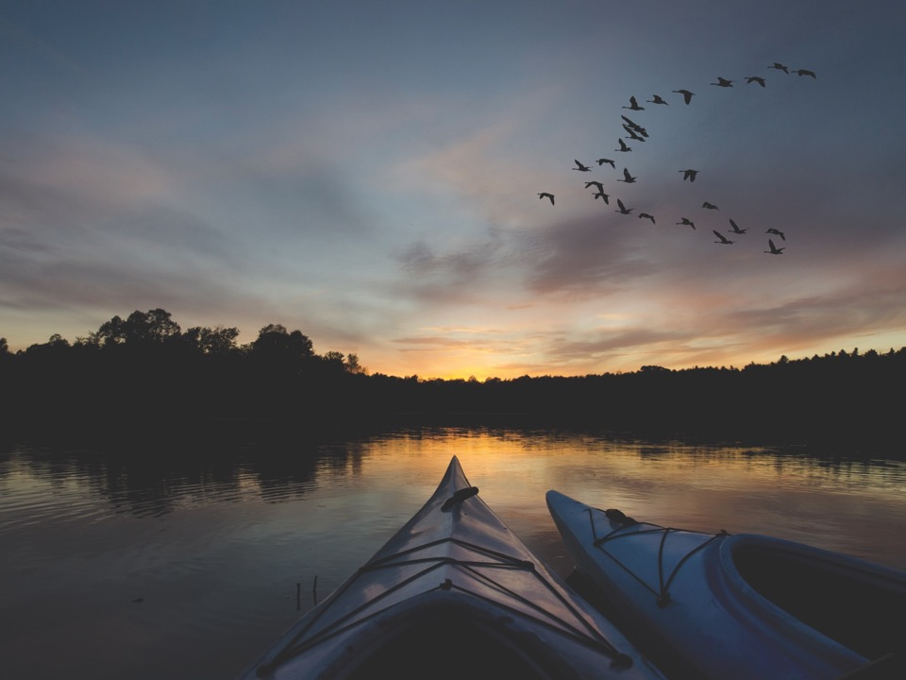
Sustainability is economic development with the future in mind

Slide 29
Sustainability Discussion
Has the community had conversations about sustainability as an important goal?
Which local organizations have included sustainability in their operating practices, including ongoing measurement of energy use, carbon footprint or waste reduction?

Slide 30
Our Sustainability Story
Luke Reese
Hormel Nature Center
  What the HNC has done:
    Solar panels, geothermal HVAC, and bird glass
    Land management:
      Local, watershed, and regional contexts
    Environmental education
  Future opportunities:
    DC fast chargers for EVs
    Replace lost trees – 1 to 1

Slide 31
Community Survey Response
The Utilities has many programs to help people improve energy efficiency and lower water use. I think cost, knowledge of the programs, and a lack of understanding of why they are necessary are all barriers.
Solar power is one way; however, this can make it hard as well as many solar panels are needed to keep businesses running.
I have not heard of any

Slide 32

Engage

Slide 33
Community Engagement Questions
How do local organizations communications with community members? Is this a two-way discussion? How is technology used?
What are the messages, and through which means are they transmitted, is the community sending out to the world to attract people and investment?

Slide 34
Our Community Engagement Story
Austin Public Schools

Slide 35
Community Survey Response
We use print advertising, weekly radio, social media, our website, and a semiannual newsletter to communicate with the Austin area.
Our diversity is our strength. Have the young train the old on tech and the internet. Have the young observe and work with the middle aged in careers to gain exposure and experience. Have those that speak the language mentor those that are new to our culture/language and traditions.
We need to make sure Austin area has affordable access to technology and investments should be in that area. Having areas such as the library, maybe YMCA etc be places or hubs for people to go to access technology easily.
Greater access to resources and community connection
Quality and affordable housing, childcare

Slide 36
Small Group Discussion
What are our strengths in this area?
Where are our gaps in this area?
What could we hope to accomplish in the next 18 months (our desired outcomes) that would really make a positive difference in our community?

Slide 37
Discussion Group Reporting

Slide 38
Next Steps
Brainstorm Meeting
THURSDAY, DECEMBER 2ND
11:00-12:30
Project voting and volunteering
Project development and budgeting
Blandin grant application
Implementation

Slide 39
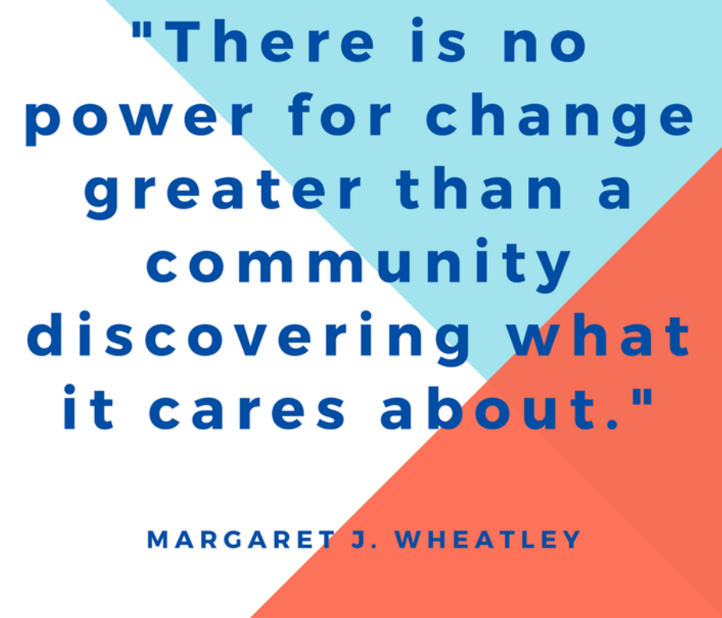
Adjourn
See you on Thursday, December 2nd 11:00-12:30 for the Brainstorming Session!

