Slide 1
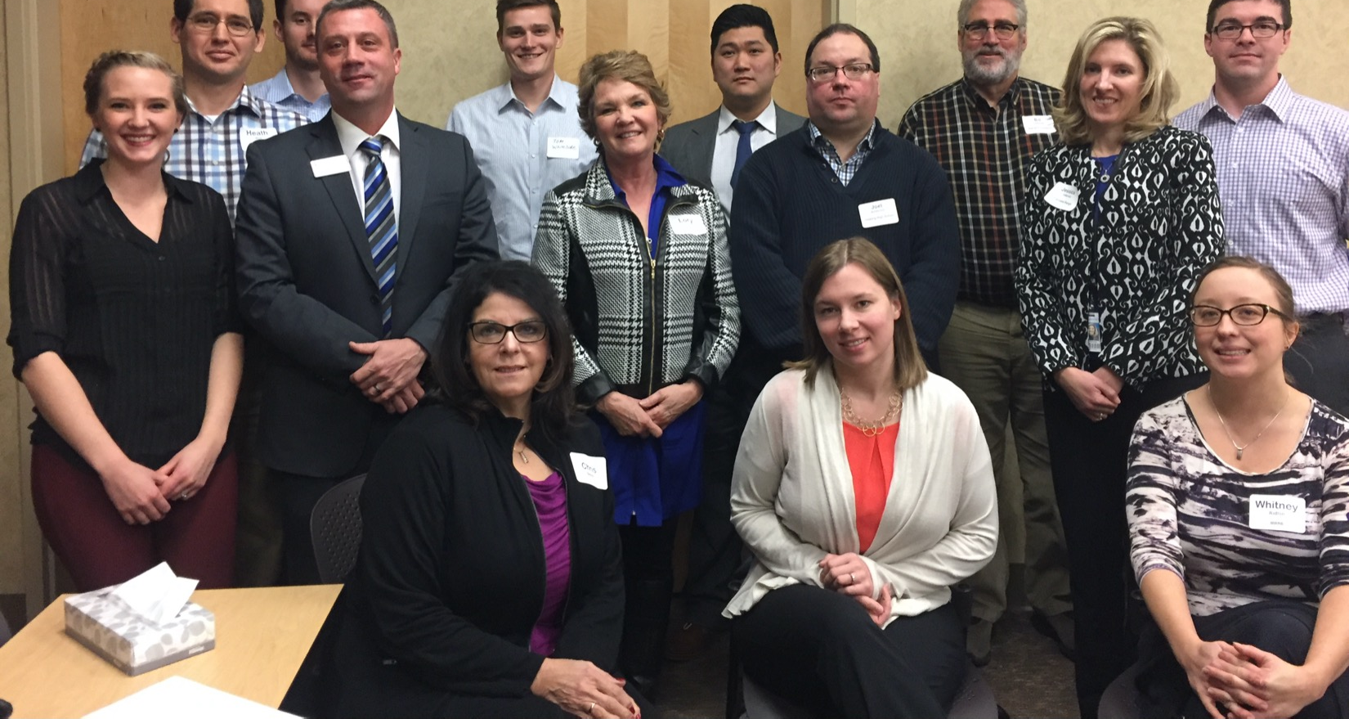
Blandin Broadband Communities
People + Process

Slide 2
BBC Success Pyramid
Amazing Results
Ideas
Resources
Leadership

Slide 3
Program Goals
If you have great broadband, this is a process to:
  Identify gaps and barriers to full community participation
  Make full use of the broadband asset
If you are seeking great broadband, this is a process to:
  Build a team to pursue improve connectivity, plus
  Identify gaps and barriers to full community participation
  Make full use of the broadband asset

Slide 4
Blandin Commitment
Proven framework
Facilitation
Up to $75,000 for project funding
Active learning
  Experts
  Other communities

Slide 5
The BBC Process
Increasing your confidence -
Vision Meeting – two hours, followed by Brainstorm meeting
*Engaging the community, determining priorities, creating projects
Steering Team Orientation – 2 hours
*Working together, planning the Vision Meeting -
Grant submission and approval
*Project implementation
Project Development Meeting – 90 minutes
*Coordinating and finalizing projects

Slide 6
Proven Success Strategies
Vision Meeting
Always over-invite rather than exclude
Turnout at the Vision meeting critical
A crowded room creates excitement
Projects
Many smaller projects more impactful than fewer larger projects
Collaborative projects are most visible, sustainable and successful
Projects that include two or more Intelligent Community elements are most innovative

Slide 7
Project Design Process
Brainstorm
Design and Budget
Implement
Form Project Teams
Allocate Funds

Slide 8
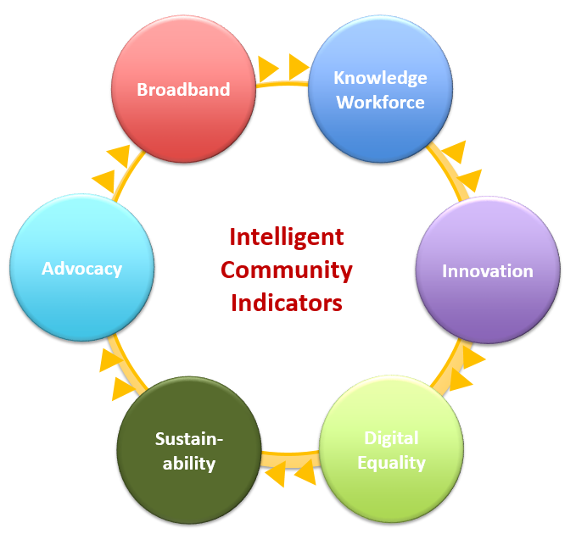
Intelligent Community Framework
www.intelligentcommunity.org

Slide 9
Here to help!
Mary Magnuson – Grants questions
  Broadband Program Administrator
  memagnuson@blandinfoundation.org
  218-327-8738
Bill Coleman – Process and projects questions
  Community Technology Advisors
  bill@communitytechnologyadvisors.com
  651-491-2551

