Slide 2
Brainstorm Meeting Agenda
Welcome
  Lisa Graphensteen
  Bernadine Joselyn
Vision Meeting Report
  Bill Coleman
Additional Input
  Open discussion
Project Idea Generation
  In small groups
Group Reporting
  Round robin reporting by group leaders
Additional Ideas and Discussion
Next Steps
Adjourn

Slide 3
Community Opportunity

Slide 4
Achieving BBC Success
Amazing Results
Ideas
Resources
Leadership

Slide 5
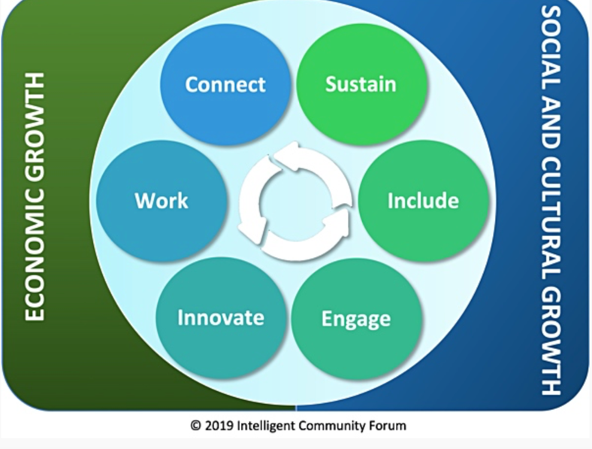
The Intelligent Community Framework

Slide 7
Our Broadband Story
In 2014 Border-to-Border grant w/Federated Telephone Cooperative
In 2018, Big Stone County moved to top 10 state ranking
Now ranked 9 of 87 with 98.6% broadband access.
Our ranking has slipped slightly as other counties have been doing better and we have stalled.

Slide 8
Community Survey Response
Allows people to live where they want to live and work where they want to work.
Expands remote work opportunities.
Businesses, health related organizations, school districts and others voiced that quality broadband improves access to services, allows their business to operate more efficiently, and increases educational opportunities.
We have a reverse challenge in our County. Rural areas have fiber, hear about more challenges in Clinton and Graceville with their providers and coverage. Frequent internet disruptions in Clinton are a challenge for businesses.

Slide 9
Broadband Discussion
Assets | Barriers / Gaps
Well connected Multiple – ISPs, easy to communicate with | Price Cellular Carriers lacking in the area Grant funding where 25/3 is met makes it hard for competition between vendors Having the hardware/device Knowledge of grant programs Community mindset of in-person/remote
Desired Outcomes
Usable internet, reliable.
Affordable internet
Grant Program Awareness for users
Determine need for community Wi-Fi locations and need
AG Wireless options, feasibility
Increased telehealth / Meeting devices for locations?
Community education of how to use the internet

Slide 10


Slide 11
Our Workforce Story
At 4.5%, Big Stone Co. had a lower unemployment rate than the state in 2020. Due to the pandemic recession, our unemployment rate increased slightly from 2019, but was lower than the 6.5% rate posted in 2010.
The number of unemployed workers actively seeking work in Big Stone Co. increased over the past year.
Big Stone Co. has a higher rate of adults with at least a high school diploma (92.7%), but a lower rate of people with an Associate's or a Bachelor's degree or higher.
Labor force growth has slowed in recent years. Moving forward, Big Stone Co. is expected to see a labor force decline from 2020 to 2030
The labor market has grown extremely tight in recent years, with typically less than 1 jobseeker per vacancy. By the fourth quarter of 2020, job vacancies brought back challenges in finding new workers.

Slide 12
Community Survey Response
We are currently attracting employees that were formerly from this area and want to move back.
Well positioned with a high-quality workforce.
Need a slow, but steady, increase in the workforce.
Emphasize our assets and promote our quality of life here more.
Many respondents highlighted the importance of broadband to their remote work and business needs.

Slide 13
Knowledge Workforce
Assets | Barriers / Gaps
MNbump Natural Assets (lake, hunting, fishing) Broadband availability Excellent Health Care Family Services Growing our own (like OAHS) Reasonable Housing Fish & Ride (like organizations) Fish frys, pancake breakfasts – all well attended – people connecting & stepping up Rural – sense of safety – everyone looking out for each other. | Recruitment of higher education – wide range of staff needs Market rate rental properties (step up from college) What to do… younger – what could that look like to attract. Helping to bridge a gap there. Connecting/from around here… Less opportunities – like JCs lots of civic groups Child care providers! Liking town/-- cleanup eyesores on main street – beautification on Main Street.
Desired Outcomes
Attracting & retaining knowledgeable workforce
Pay people what they are worth – competitive wages across the state to attract people – how to help make our business more competitive.

Slide 14

Include
Digital equality means computers, skills, and access for all!

Slide 15
Our Digital Equity Story
Broadband Access
 | 2021 | 2020 | 2019 | 2018 | 2017
100/20 (2026 goal) | 98.6 | 98.6 | 98.91 | 98.91 | 70.12
25/3 (2022 goal) | 99.48 | 99.48 | 99.58 | 98.91 | 70.12
Computer Access
County | Households with computer | …with desktop or laptop | …with ONLY smartphone | …with a tablet et al
State of MN | 93.6% | 80.6% | 7.7% | 63.8%
Big Stone | 92.4 | 80.6 | 4.1 | 55.5
Big Stone County was ranked #68 of 87 for County median income in 2014-2018. This was a drop from our 65th place ranking in 2010-2014.

Slide 16
Community Survey Response
Lack of computer literacy among older adults. This can impede access to services (eg Veterans) and connectivity to people.
Tools are there, but divide is growing between people who utilize it and those who do not.
Distance learning and remote work have made digital inequity more apparent.
Monthly cost and equipment are hinderances to some.
The pandemic has shown us that unequal access to technology among our school-aged kids creates a clear imbalance in education.

Slide 17
Digital Equity
Assets | Barriers / Gaps
Great availability of broadband throughout the County. Technology skills is “first nature” to many Mobile community van for outreach to older population. Active 4H with knowledgeable kids who could teach items Covid taught us all how to access technology at a higher level – being able to connect in new ways. | Available but not affordable. Some people need improved knowledge/skills. People are not aware of resource Knowing what to teach them - at what level. Equipment, training, income, knowledge Awareness of wifi locations within the County

Slide 18
Digital Equity
Desired Outcomes
Way to make it affordable – subsidy
Connect the high users with the ones who need help
Outreach to a variety of populations – money isn’t always the issue
Central spot where people can interact with community – more interactive instead of just information out. Options for connections “community landing page” – someone to talk to help figure it out.

Slide 19

Innovation & Sustainability
Innovation refers to doing new things and doing old things in new and better ways
Sustainability is economic development with the future in mind

Slide 20
Our Innovation Story
Since COVID-19, some services such as mental health and substance use services are being delivered via telehealth.
Mnbump as a workforce recruitment tool highlights the people, places, and events of the County.
Mobile community center and nutrition services bus offered by Prairie Five CAC.
Big Stone Memory Loss Connection Group – ipads for older adults to borrow.
Precision agriculture.

Slide 21
Community Survey Response
We have a lot of great resources, the use of telehealth provides the opportunity for new providers and workforce without the need to relocate.
We are well positioned with Mnbump to continue attracting people to move rural.
Slow, but progress with online media and advertising.
Need outdoor wifi.
Quality internet helps our agricultural community with their crop data, equipment needs, direct marketing of farm products, and staying informed of cutting-edge agronomy knowledge. It has also enabled family members to work remotely while helping with planting and harvest. We have several farms in the county harnessing a wide array of digital tools to expand our market access beyond what has ever been available to our rural community.

Slide 22
Our Sustainability Story
Technology has allowed organizations and companies to have more online meetings, reducing travel/carbon footprint.
Farming practices are bringing in new climate-friendly crops and changing farming practices to promote carbon sequestration and healthy soils.

Slide 23
Community Survey Response
Big Stone County take pride in the land and personally knowing people. Businesses and residents work more intimately than large communities so sustainability and ethics are at the forefront.
The use of telehealth allows us to bring providers to the area without relying on them being physically present. Finding trained mental health professionals is highly challenging, especially in rural Minnesota .
Is cost a prohibitive factor in sustainability efforts?
Some businesses, farming operation, etc are working to use sustainable practices, but definitely more education around this subject needed.

Slide 24
Innovation & Sustainability
Assets | Barriers / Gaps
School system’s ability to implement distance learning and provide 1:1 devices. Ag community and our access to info. (marketing crops, new markets, direct markets) allows us to make the best decisions and creates economic opportunities. Our technology has also allowed more professional development via online resources and reduced the need to travel in the state or nation to get high quality professional development. Telehealth. It was noted that trips to Essentia have greatly been reduced for some residents as they can telehealth from Graceville. Local food markets. | COVID highlighted the disparities for children without access to internet. Ag Community has fiber at home but in the field, cellular service not great. Lack of dependable wifi in some of our towns. Clinton has major issues with reliable service and recently had a 24 hour outage. Group was unsure of energy retrofits/ rebates offered by energy providers. Possibly look at what is offered and promote this opportunity. County has a strong art/maker community. Creating online shopping platforms and online visibility take time, resources and expertise. Find more ways to connect makers to customers in support of these entrepreneurs.

Slide 25
Innovation & Sustainability
Desired Outcomes
Identify some options for creating more equal access. Possibly a community space or other options that provide places for kids and others to go if they do not have reliable internet at home.
Better cellular access.
Improve broadband in Clinton.
Business mentorship program that connects and teaches innovative and sustainable practices.
Increase online visibility of our art/maker community. Increase opportunities for online shopping to connect our makers to customers.

Slide 26

Engage

Slide 27
Our Community Engagement Story
With solid internet connections, there are opportunities to connect schools to businesses and community. Career readiness programs, field trips, connecting to elderly in nursing homes, etc.
Schools have created strong communication systems for quickly distributing messages/information.
Mnbump is a vehicle to connect people to our area.

Slide 28
Community Survey Response
More important than ever that our business community understands technology available to them and build an online presence.
Information tends to be a one-way discussion (newspaper, radio, Facebook) more than two-way communication.
Show corporations and businesses we have the resources to make their business succeed here, we are more than a small town in a rural area.
Need classes directed specifically at an older generations with content pertinent to their needs and wants.

Slide 29
Community Engagement
Assets | Barriers / Gaps
MNBump Existing fiber network – top 10% Active and involved community members Good resources – Family Service Center, Someplace Safe, Woodland Centers, Prairie Five, Memory Loss Connection, Health Care (Ortonville and Graceville), Cenex Harvest States, young farming community, Pioneer Library System, Local newspapers, Radio Hardworking, independent, and creative people | Inequality - Some with incredible resources vs some that cannot afford Older population – can be less savvy with technology Not as many resources as larger populated areas – turn it from a bug to a feature

Slide 30
Community Engagement
Desired Outcomes
Raising awareness beyond Big Stone County of what we are doing AND raising awareness of what is available within Big Stone County
  Multigenerational learning program
  Wi Fi on buses (Prairie Five and schools)
  Keep putting things out on MNBump, using the Radio and newspapers
  Awareness of access to checking out Wi-Fi at the library, lending IPads through Prairie Five and Big Stone Memory Loss Connection

Slide 31
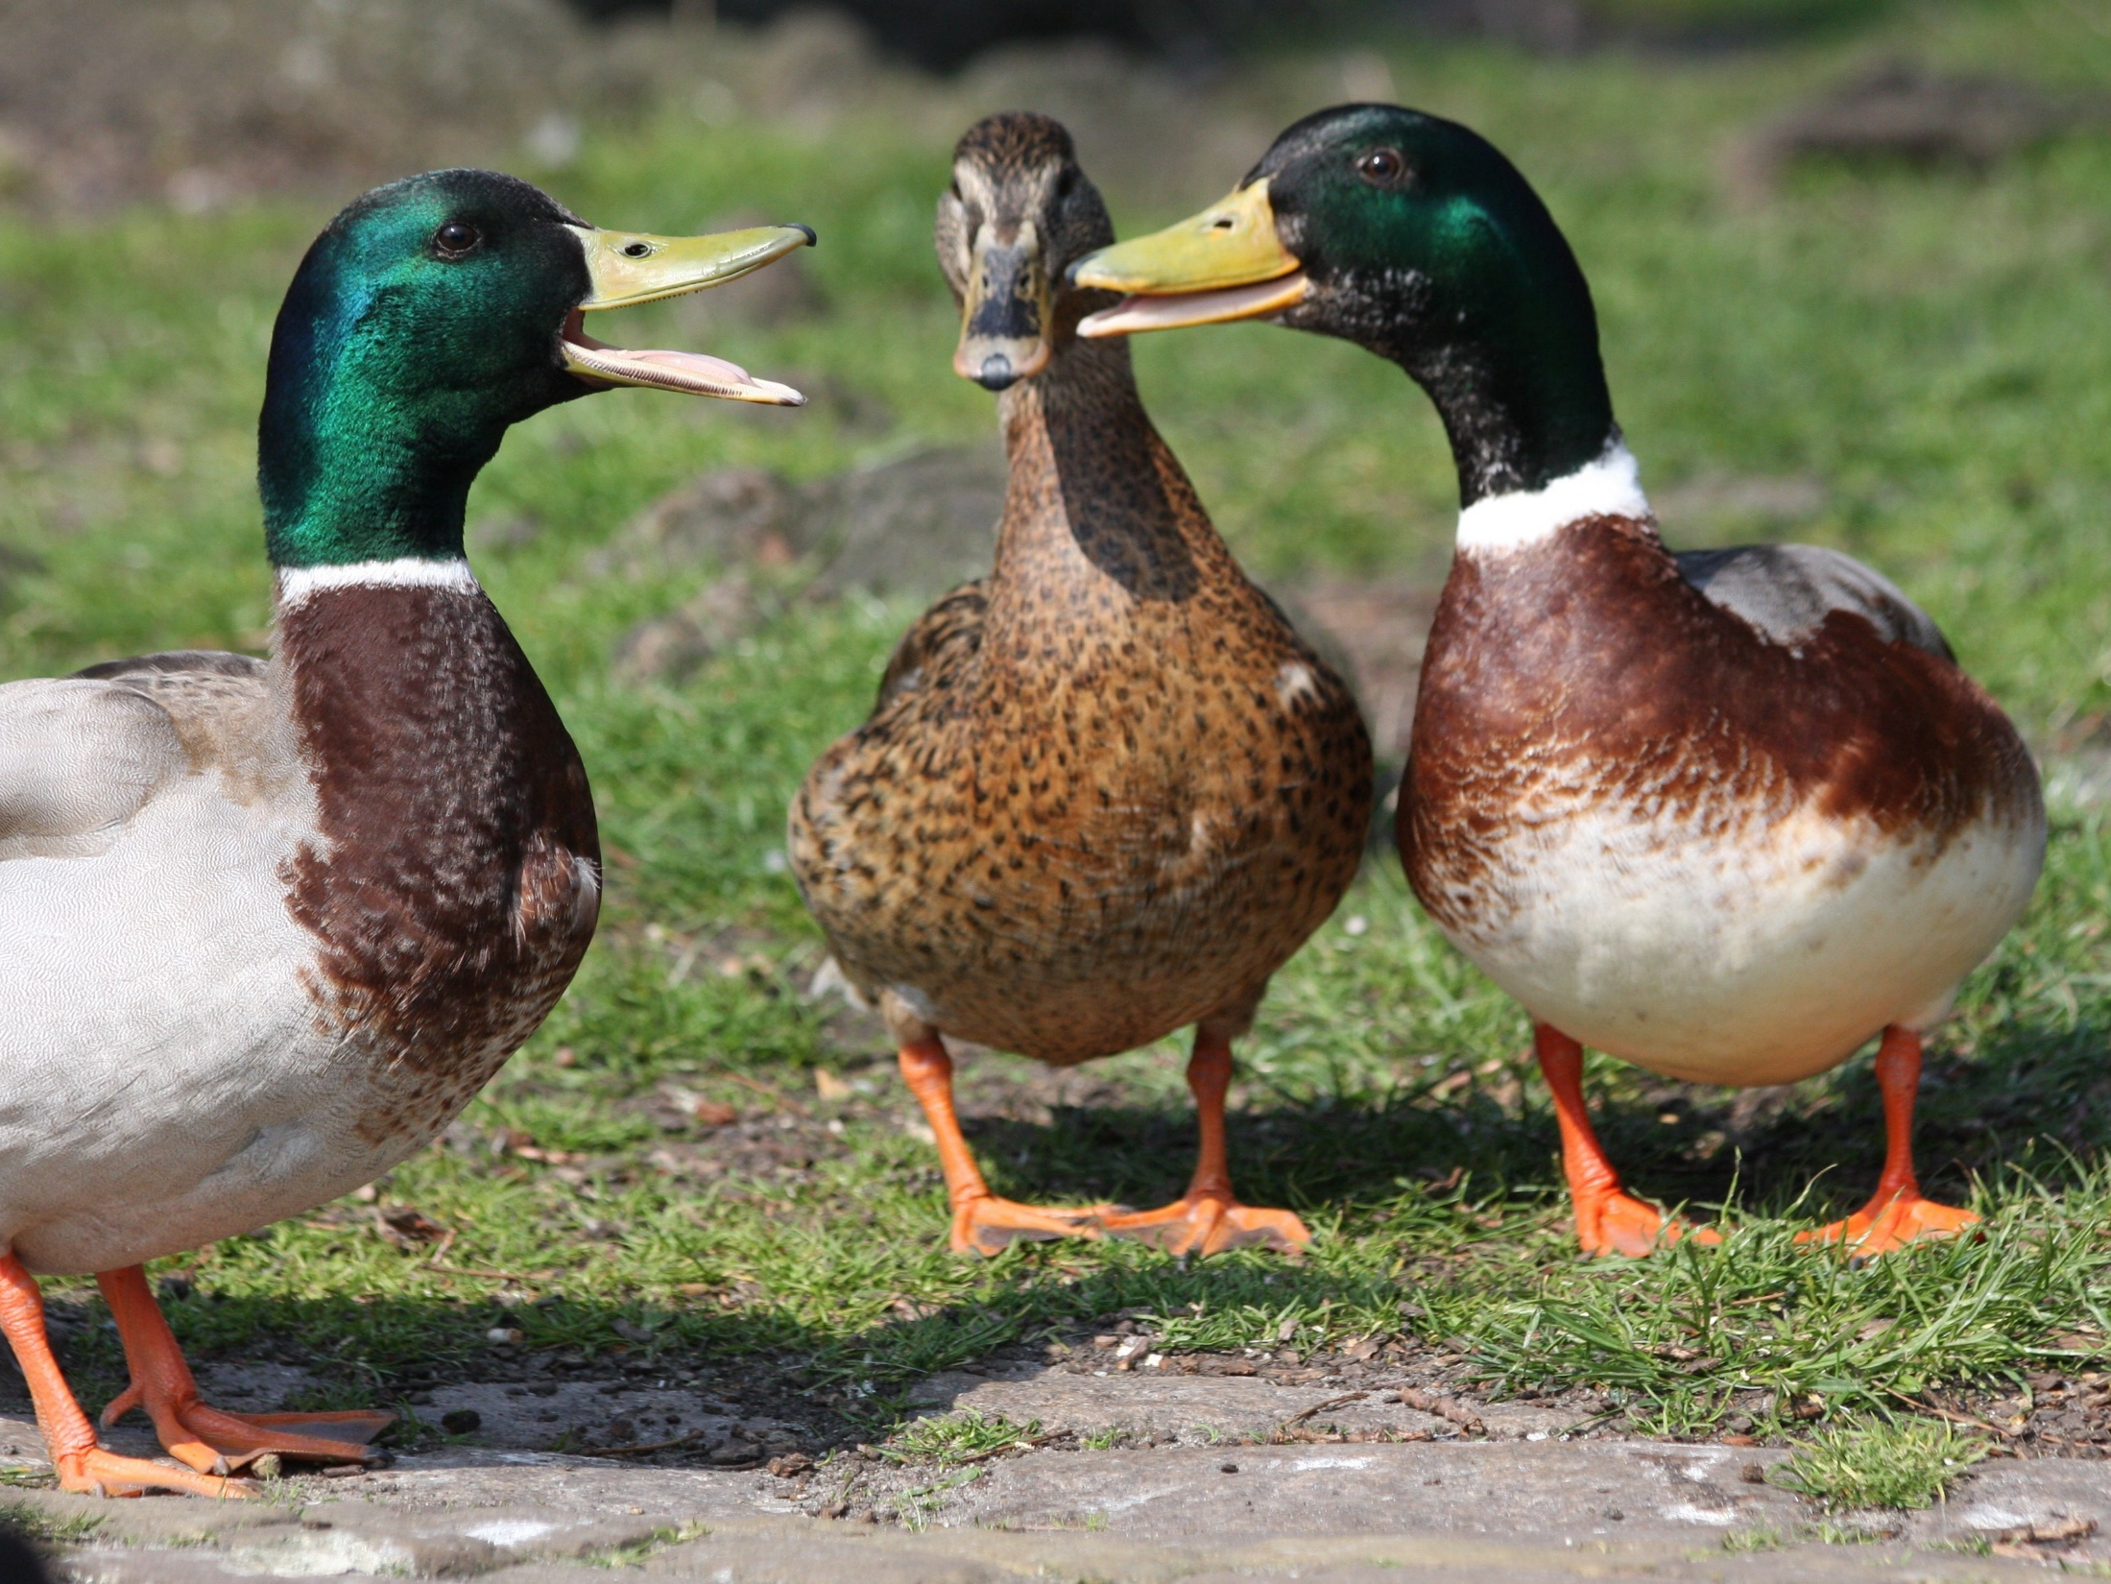
Additional Input

Slide 32

Project Idea Generation
Small Group Discussion
  Appoint a chair
  Appoint a recorder/reporter
Rules
  Project ideas can be for any Intelligent Community element
  We want as many ideas as possible
  We just want the basic idea
    Not the justification
    Not the implementation details
    Not the barriers
  Take turns

Slide 33

Discussion Group Reporting
Round Robin Reporting
Two ideas per group per round
No repetition please
  Adding detail/variations OK
We just want the basic idea
    Not the justification
    Not the implementation details
    Not the barriers

Slide 34
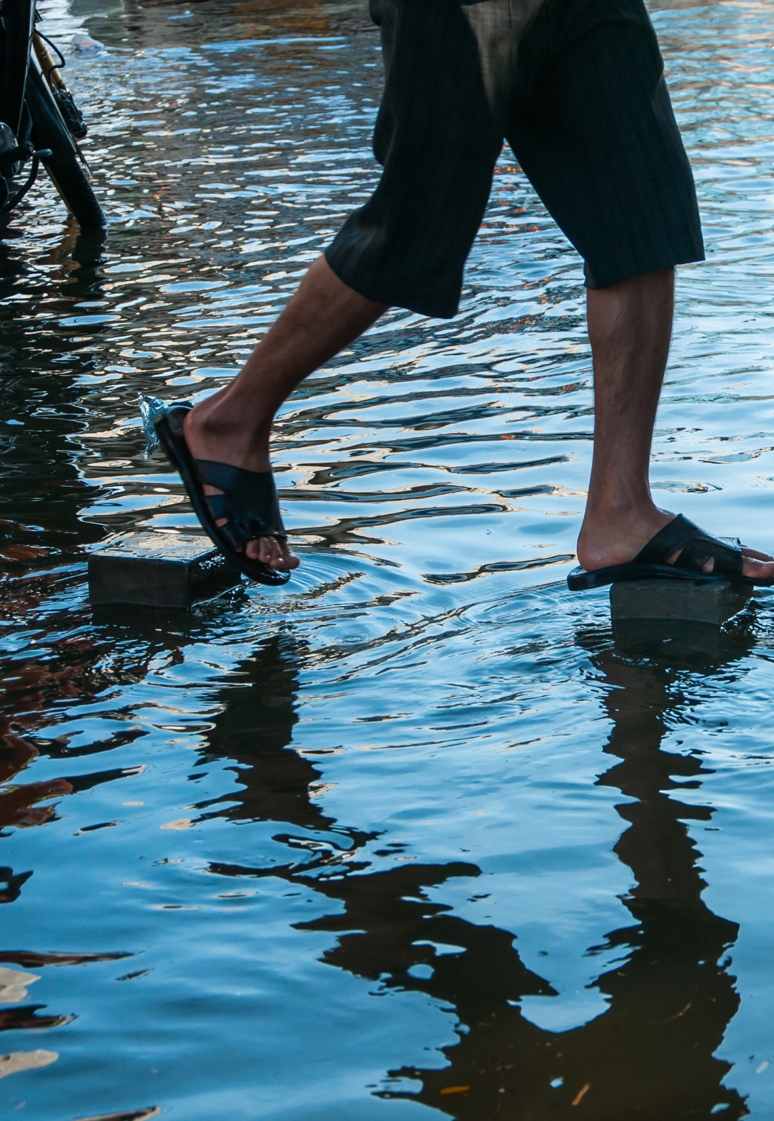
Next Steps
Organizing ideas
Project team champions & volunteering/recruiting
Online project voting
Further project development
Budgets and allocations
Blandin grant application by early January
Grant approval
Project implementation
Additional project development

Slide 35
Adjourn

