Slide 2
Agenda
Welcome
  Why we became a Blandin Broadband Community
  Lisa Graphenteen, Big Stone Area Growth
The Intelligent Community Framework
  Blandin Team
Community Discussions
  By Intelligent Community Element
Group Reporting
  Assets and Gaps
  Desired Outcomes
Next Steps
Adjourn

Slide 3
Community Opportunity

Slide 4
Achieving BBC Success
Amazing Results
Ideas
Resources
Leadership

Slide 5
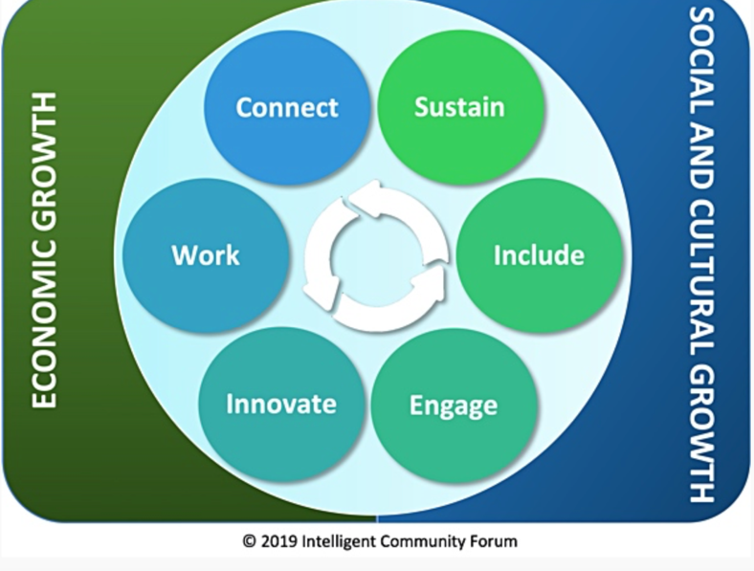
The Intelligent Community Framework

Slide 7
Broadband Discussion
How is your broadband?
  In the cities and towns
  In the rural countryside
  For schools, governments and health care
  For business
  Via cellular
Where is Wi-Fi available?
Who are the key players in this discussion?

Slide 8
Our Broadband Story
In 2014 we received a Border to Border grant to partner with Federated Telephone Cooperative to expand broadband access.
In 2018, Big Stone County moved to top 10 ranking for access to 100/20 Mbps broadband.
We are currently ranked 9 of 87 with 98.6% broadband access.
Our ranking has slipped slightly as other counties have been doing better and we have stalled.
Are there opportunities to finish the remaining gaps?

Slide 9
Community Survey Response
Allows people to live where they want to live and work where they want to work.
Expands remote work opportunities.
Businesses, health related organizations, school districts and others voiced that quality broadband improves access to services, allows their business to operate more efficiently, and increases educational opportunities.
We have a reverse challenge in our County. Rural areas have fiber, hear about more challenges in Clinton and Graceville with their providers and coverage. Frequent internet disruptions in Clinton are a challenge for businesses.

Slide 10


Slide 11
Knowledge Workforce Discussion
How would you describe your local workforce?
What are the strengths?
What are the shortcomings?
What assets do you have for improving workforce skills and availability?
Who are the key players in this discussion?

Slide 12
Our Workforce Story
At 4.5%, Big Stone Co. had a lower unemployment rate than the state in 2020. Due to the pandemic recession, our unemployment rate increased slightly from 2019, but was lower than the 6.5% rate posted in 2010. The number of unemployed workers actively seeking work in Big Stone Co. increased over the past year.
Big Stone Co. has a higher percentage of adults with at least a high school diploma (92.7%) compared to the state. Big Stone Co. has a lower percentage of people with an Associate's degree and a lower percentage of people with a Bachelor's degree or higher.
Labor force growth has slowed in recent years. Moving forward, Big Stone Co. is expected to see a labor force decline from 2020 to 2030
The labor market has grown extremely tight in recent years, with typically less than 1 jobseeker per vacancy until the pandemic recession intervened in early 2020, and the number of unemployed workers spiked. However, even by the fourth quarter of 2020, job vacancies recovered quickly bringing back challenges in finding new workers.

Slide 13
Community Survey Response
We are currently attracting employees that were formerly from this area and want to move back.
Well positioned with a high-quality workforce.
Need a slow, but steady, increase in the workforce.
Emphasize our assets and promote our quality of life here more.
Many respondents highlighted the importance of broadband to their remote work and business needs.

Slide 14

Include
Digital equality means computers, skills, and access for all!

Slide 15
Digital Equity Discussion
Who in the community is being left behind on technology?
What are the biggest challenges?
  Internet connectivity
  Computers and devices
  Skills
How can the responses made during the pandemic be carried forward?

Slide 16
Our Digital Equity Story
Broadband Access
 | 2021 | 2020 | 2019 | 2018 | 2017
100/20 (2026 goal) | 98.6 | 98.6 | 98.91 | 98.91 | 70.12
25/3 (2022 goal) | 99.48 | 99.48 | 99.58 | 98.91 | 70.12
Computer Access
County | Households with computer | …with desktop or laptop | …with ONLY smartphone | …with a tablet et al
State of MN | 93.6% | 80.6% | 7.7% | 63.8%
Big Stone | 92.4 | 80.6 | 4.1 | 55.5
Big Stone County was ranked #68 of 87 for County median income in 2014-2018. This was a drop from our 65th place ranking in 2010-2014.

Slide 17
Community Survey Response
Lack of computer literacy among older adults. This can impede access to services (eg Veterans) and connectivity to people.
Tools are there, but divide is growing between people who utilize it and those who do not.
Distance learning and remote work have made digital inequity more apparent.
Monthly cost and equipment are hinderances to some.
The pandemic has shown us that unequal access to technology among our school-aged kids creates a clear imbalance in education.

Slide 18

Innovation
Innovation refers to doing new things and doing old things in new and better ways

Slide 19
Innovation Discussion
Which people or organizations in the community are doing great things with technology?
Which sectors/organizations are falling behind?
What are we doing to support entrepreneurs?
How does our community handle change?

Slide 20
Our Innovation Story
Since COVID-19, some services such as mental health and substance use services are being delivered via telehealth.
Mnbump as a workforce recruitment tool highlights the people, places, and events of the County.
Mobile community center and nutrition services bus offered by Prairie Five CAC.
Big Stone Memory Loss Connection Group – ipads for older adults to borrow.
Precision agriculture.

Slide 21
Community Survey Response
We have a lot of great resources, the use of telehealth provides the opportunity for new providers and workforce without the need to relocate.
We are well positioned with Mnbump to continue attracting people to move rural.
Slow, but progress with online media and advertising.
Need outdoor wifi.
Quality internet helps our agricultural community with their crop data, equipment needs, direct marketing of farm products, and staying informed of cutting-edge agronomy knowledge. It has also enabled family members to work remotely while helping with planting and harvest. We have several farms in the county harnessing a wide array of digital tools to expand our market access beyond what has ever been available to our rural community.

Slide 22

Sustainability is economic development with the future in mind

Slide 23
Sustainability Discussion
Has the community had conversations about sustainability as an important goal?
Which local organizations have included sustainability in their operating practices, including ongoing measurement of energy use, carbon footprint or waste reduction?

Slide 24
Our Sustainability Story
Technology has allowed organizations and companies to have more online meetings, reducing travel/carbon footprint.
Farming practices are bringing in new climate-friendly crops and changing farming practices to promote carbon sequestration and healthy soils.

Slide 25
Community Survey Response
Big Stone County take pride in the land and personally knowing people. Businesses and residents work more intimately than large communities so sustainability and ethics are at the forefront.
The use of telehealth allows us to bring providers to the area without relying on them being physically present. Finding trained mental health professionals is highly challenging, especially in rural Minnesota .
Is cost a prohibitive factor in sustainability efforts?
Some businesses, farming operation, etc are working to use sustainable practices, but definitely more education around this subject needed.

Slide 26

Engage

Slide 27
Community Engagement Questions
How do local organizations communications with community members? Is this a two-way discussion? How is technology used?
What are the messages, and through which means are they transmitted, is the community sending out to the world to attract people and investment?

Slide 28
Our Community Engagement Story
With solid internet connections, there are opportunities to connect schools to businesses and community. Career readiness programs, field trips, connecting to elderly in nursing homes, etc.
Schools have created strong communication systems for quickly distributing messages/information.
Mnbump is a vehicle to connect people to our area.

Slide 29
Community Survey Response
More important than ever that our business community understands technology available to them and build an online presence.
Information tends to be a one-way discussion (newspaper, radio, Facebook) more than two-way communication.
Show corporations and businesses we have the resources to make their business succeed here, we are more than a small town in a rural area.
Need classes directed specifically at an older generations with content pertinent to their needs and wants.

Slide 30
Small Group Discussion
What are our strengths in this area?
Where are our gaps in this area?
What could we hope to accomplish in the next 18 months (our desired outcomes) that would really make a positive difference in our community?

Slide 31
Discussion Group Reporting

Slide 32
Next Steps
Brainstorm Meeting
Project voting and volunteering
Project development and budgeting
Blandin grant application
Implementation

Slide 33
Adjourn

