Slide 1
Brainstorm Meeting
Otter Tail County
Blandin Broadband Community
August 25, 2020

Slide 2
Agenda
In Large Group
  Welcome
  Review of Vision Meeting Input
In Small Groups
  Introductions
  Brainstorm Project Ideas
In Large Group
  Reporting
  Explanation of Next Steps
    Voting
    Project Work Teams
    Budget Allocation
  Adjourn

Slide 3
BBC Benefits
Create goals
  Better broadband access
  More sophisticated technology use
Community coaching from the Blandin team
Develop and implement tech projects
Grant Funds
  Up to $75,000 from Blandin Foundation
  Otter Tail County CARES Act funds

Slide 4
Process
Brainstorm
Design and Budget
Implement
Form Project Teams
Allocate Funds
Vision

Slide 5
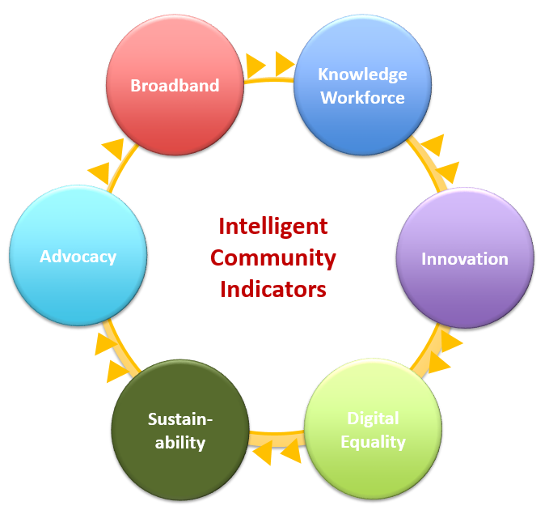
Vision Meeting Summary
By Intelligent Community Element

Slide 7
Broadband Community Input
Broadband is essential for everyday life – work, school & business
Internet can be slow and I have to rework my daily schedule around when the Internet works
I have fiber to the home and it is amazing
The lack of speed for our business connection has become very pronounced since COVID-19.

Slide 8
Broadband Assets and Gaps
Assets
Gaps
Local telecommunications companies
Industries that are heavily dependent on reliable, fast Internet (tourism, ag, etc.
Strong government partners
Lakes that are density development magnets, making broadband possible
Very difficult for schools to deliver online education in areas without broadband
Communities without broadband are not going to attract residents and businesses

Slide 9
Broadband Desired Outcomes
Increased access to families/individuals without internet access (e.g. subsidized services, centralized wi-fi, etc.)
Enhancements for kids and educational systems.
Public education around broadband, why it's important, etc.

Slide 10
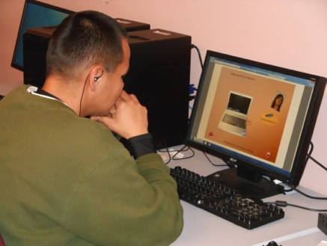
Communities will thrive on their ability to create, support and attract knowledge workers
Knowledge workers have
  Technology skills
  Post-secondary degrees and certifications
Knowledge workers
  Earn living wage salaries
  Start new companies
  Are critical to the success of all businesses and community organizations

Slide 11
Knowledge Workforce
Community Input
OTC is working hard to promote housing development necessary for workforce
OTC has good schools, a college, strong manufacturing and health care sectors
OTC has strong and unique communities
Unfilled jobs at the low end; shortage of high end jobs
Working from home is an opportunity to grow the population and economy

Slide 12
Knowledge Workforce Assets and Gaps
Assets
Gaps
Strong K-12
Active business community
M State
Build off work of RRI
Quality of place
Availability of quality broadband
Limits ability to attract residents or businesses
Speed doesn’t meet expectations of visitors - and that influences desire to come or move permanently
Limiting for education system with distance learning

Slide 13
Knowledge Workforce Desired Outcomes
Continue to recruit younger population with RRI efforts - ensure all components are in place
Access and training for displaced workers is available - M State as a partner to offer credit classes or certificates for technology skills - foundation could offer scholarships
County wide community access points / facility training and learning exist - community ed, libraries, etc.
Enhanced High School career fairs and hands on experiences - virtual support?

Slide 18
Innovation Assets and Gaps
Assets
Gaps
Telework Handbook
Willingness/acceptance/desire to embrace technology
Telework Hotel/Business Incubator
Large numbers of family business changing hands soon
Small business innovation due to the pandemic
IQ Academy
HR Culture - Online onboarding Firms/resources to provide direction
Human desire for in-person interaction
Large numbers of family business changing hands soon

Slide 19
Innovation Desired Outcomes
Brand Otter Tail County as a Telework Friendly area boosted by our natural assets
Lifestyle marketing
Awareness of Educational opportunities in Otter Tail County
Telework Hotel and Business Incubator with support to aid an entrepreneur

Slide 20
Digital Equity Community Input
Kids lacking connectivity and quality computers have a real challenge
There is a widening skills gap. People struggle to accomplish health care, education and government tasks online.
Cost and location determine people’s ability to get online.

Slide 21
Digital Equity Assets and Gaps
Assets
Gaps
Public Libraries & now offering hotspots
Community connections and support
M-State offerings/contributes to diversity
Schools that are responsive to workforce needs; helping families with connectivity issues
Local Internet Service Providers dedicated to serving local, rural communities
People creating study groups so that people without the Internet at home can access at a friends’ home
Supportive communities and community members
Lack of broadband for all residents
Some residents have not experienced high speed Internet which creates a knowledge gap
Broadband and technology devices not affordable for all people due to high prices and lower incomes
People who lack the necessary equipment, commuters, updated operating systems
Lack of adequate broadband “lifeline” programs
The inconvenience and inefficiency of having to drive or walk somewhere to access the Internet.
Lack of Internet causes disadvantages for
  students
  job seekers
  employers and small business owners
  community & economic

Slide 22
Digital Equity Desired Outcomes
Expanded access, even if only temporary
Access for all
Eliminate disparities in quality of access
Gigabit connectivity for all
Devices and skills for all
All students can learn remotely
Some people willing to have less so that others can have some

Slide 24
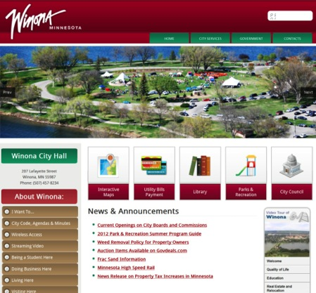
Advocacy
Advocacy is the communication strategy that your community uses to motivate positive change.
Marketing is needed to attract people and investment
Advocacy is targeted internally to promote community buy-in

Slide 25
Advocacy Assets and Gaps
Assets
Gaps
Chamber of Commerce- committee on advocacy could present; Chamber Cafe & YPN
Otter Tail County
Otter Tail Lakes Country Association
CARES funding- $125,000 to Broadband, $75,00 to Viking Library, $200,000 to OTCLC
Leighton Broadcasting
Daily Journal/ other local papers
PEG Access
Park Region Telephone’s TV studio
Community Ed & partners- direct outreach efforts
Social media
Jean Bowman’s Signature Events
Capacity
Social media
Changes in print habits- no longer daily, rising cost of print media

Slide 26
Advocacy Desired Outcomes
Reach beyond our community and entice people to believe that they can relocate in OTC and have business opportunities and make community connections
All people in the county have the necessary skills to access broadband
Integrated information infrastructure
Wi-fi for all

Slide 27
Small Group Discussion Format (20 minutes)
Join a small group
Ensure that you have a facilitator and recorder
Introduce yourselves quickly
In round robin fashion, take turns sharing your ideas for projects alphabetically by first name
  Share one project, then move to the next person
  Projects can address one or more Intelligent Community elements
PRIMARY TASK – get complete list of project ideas recorded
  Do not share why you think the project is needed
  Do not share how you think the project should be implemented.
Once you run out of ideas, you can informally discuss project ideas in more detail until you are returned to the Main Group

Slide 28
Project Listing
PRIMARY TASK – Get all ideas on the table
Group spokespeople will share one idea at a time in round-robin fashion
  If your idea has already been listed, move on to the next idea on your group’s list
  Or, if your idea is additive to an existing idea, say “I would like to add this idea to that idea” (we will sort & combine later)

Slide 29
Next Steps
Blandin and OTC staff will create consolidated list of projects
Projects will be inserted into a survey
Voting will start Friday August 31 and end Friday September 4.
  Watch for an email with the link Friday morning
Please vote only once
Spread the voting link among Otter Tail County residents and businesses
Votes are cast in two ways
  Allocate your dollar anyway you want
    (For example, $.50 to project 1, .25 to project 2, .20 to project 6, .05 to project 8.)
  Sign up to participate on one or more project teams
    Without volunteers, projects do not really exist

Slide 30
Adjourn

