Slide 1
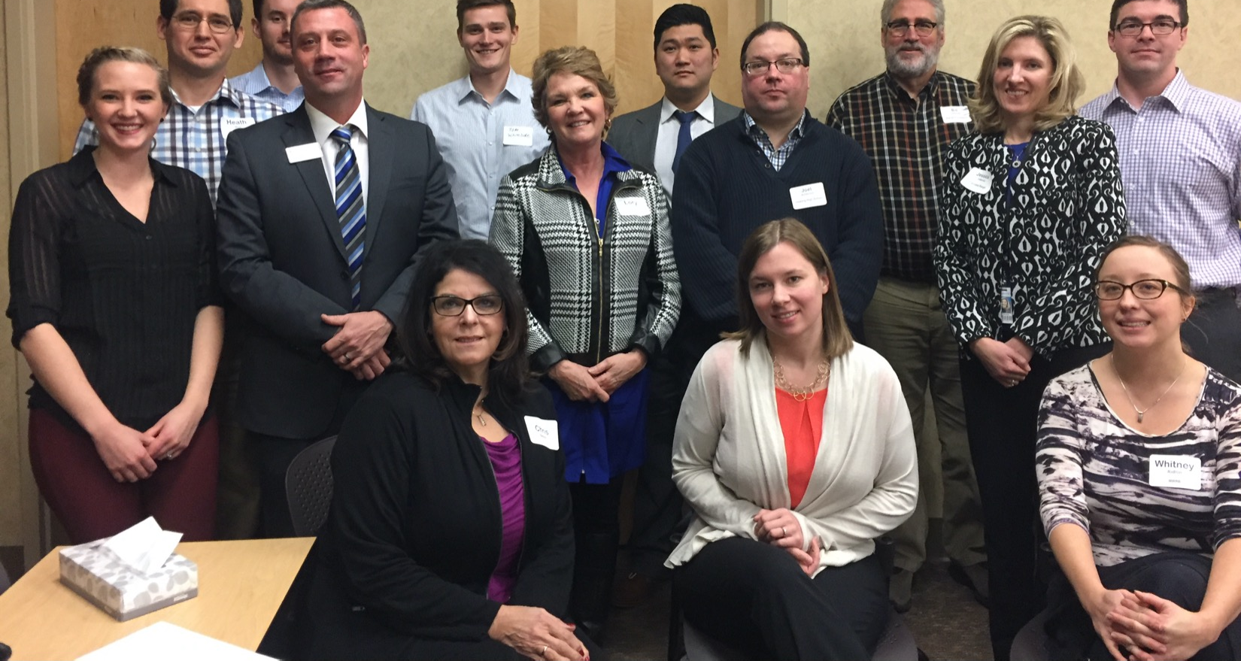
Blandin Broadband Communities
People + Process

Slide 2
BBC Success Pyramid
Amazing Results
Ideas
Resources
Leadership

Slide 3
The New Online BBC Process
February – Increasing your confidence - COMPLETE
June – Vision and Brainstorm Meetings
*Engaging the community, determining priorities
July – Project Development Meeting – 90 minutes
*Coordinating and finalizing projects
May – Steering Team Orientation – 2 hours
*Working together, planning the Vision Meeting – Today!
March - April COVID 19!

Slide 4
Technology Plan
(see separate document)
Gather
Gather community input via Survey Monkey
Survey
Survey respondents continue to registration process for Vision and Brainstorm meetings
Conduct
Conduct community meetings via Zoom
Project
Online project voting process via Survey Monkey
Project
Project development meetings via Zoom and social distancing
Zoom
Zoom steering team meeting to consider project proposals and allocate funds

Slide 5
Proven Success Strategies
Vision Meeting
Always over-invite rather than exclude
Turnout at the Vision meeting critical
A crowded room creates excitement
Projects
Many smaller projects more impactful than fewer larger projects
Collaborative projects are most visible, sustainable and successful
Projects that include two or more Intelligent Community elements are most innovative

Slide 6
Project Design Process
Brainstorm
Design and Budget
Implement
Form Project Teams
Allocate Funds

Slide 7
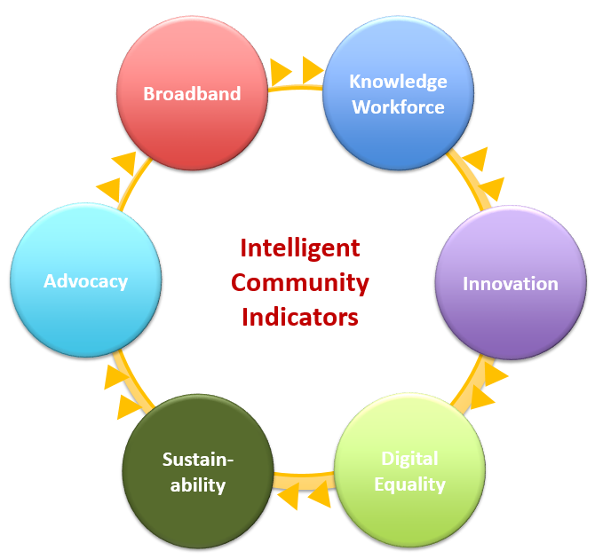
Intelligent Community Framework
www.intelligentcommunity.org

Slide 8
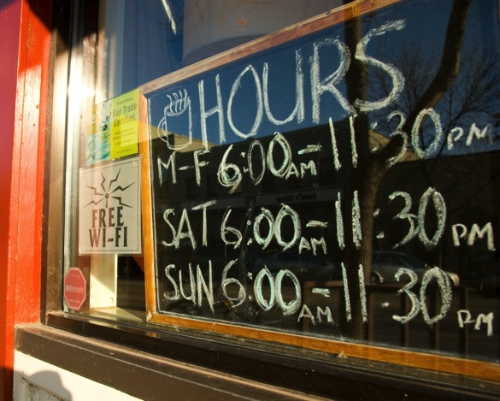
Broadband
Communities need a broadband that supports a globally competitive economy
Broadband is:
  A marketing term
  Refers to capacity, not a technology type
  Can be delivered via fiber, copper or wireless
Broadband goals
  Federal FCC
    25 Mb/3 Mb
  Minnesota
    25 Mb/3 Mb by 2022
    100 Mb/20 Mb by 2026
Understand the differences between
  Wired
  Wireless

Slide 9
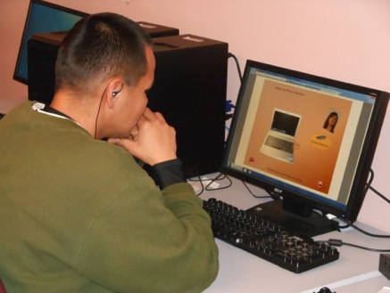
Knowledge Workforce
Communities will thrive on their ability to create, support and attract knowledge workers
Knowledge workers have
  Technology skills
  Post-secondary degrees and certifications
Knowledge workers
  Earn living wage salaries
  Start new companies
  Are critical to the success of all businesses and community organizations

Slide 10
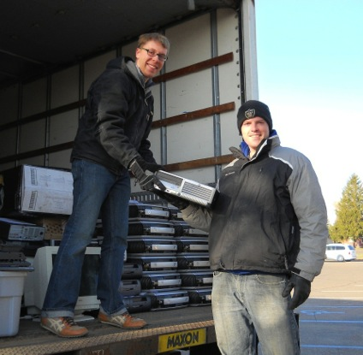
Digital Equality
Digital equality means that everyone will have a computer, know how to use it and and will have access to the network.
Increasingly, people cannot effectively participate in community without a network connection
Health, education and government strategies to improve services and cut costs require the use of technology.

Slide 11

Innovation
Innovation refers to doing new things and doing old things in new and better ways
Innovation allows people to do things more effectively and efficiently
Local innovation can focus on “catching up” as well as moving ahead

Slide 12

Sustainability
Economic development with the future in mind
Fewer resources used means improved competiveness
Cleaner air and water
Improved quality of life

Slide 13
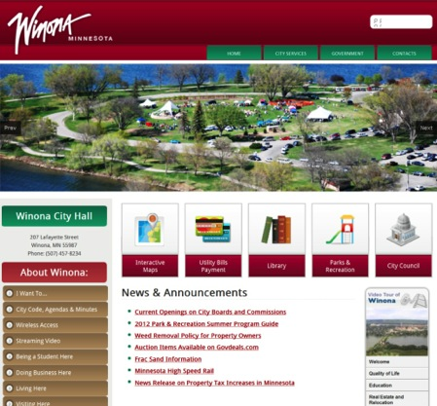
Advocacy
Advocacy is the communication strategy that your community uses to motivate positive change.
Marketing is needed to attract people and investment
Advocacy is targeted internally to promote community buy-in

Slide 14
Community Self-Assessment
www.intelligentcommunity.org

Slide 15
Key Vision Meeting Task
For each element, form a small team to review and discuss the assessment questions
Conduct a brief SWOT analysis
  Strengths, weaknesses, opportunities & threats
Create one or two slides
Select speaker to talk for no more than five minutes on key points at Vision meeting
Send slide(s) to Bill prior to Vision meeting

Slide 16
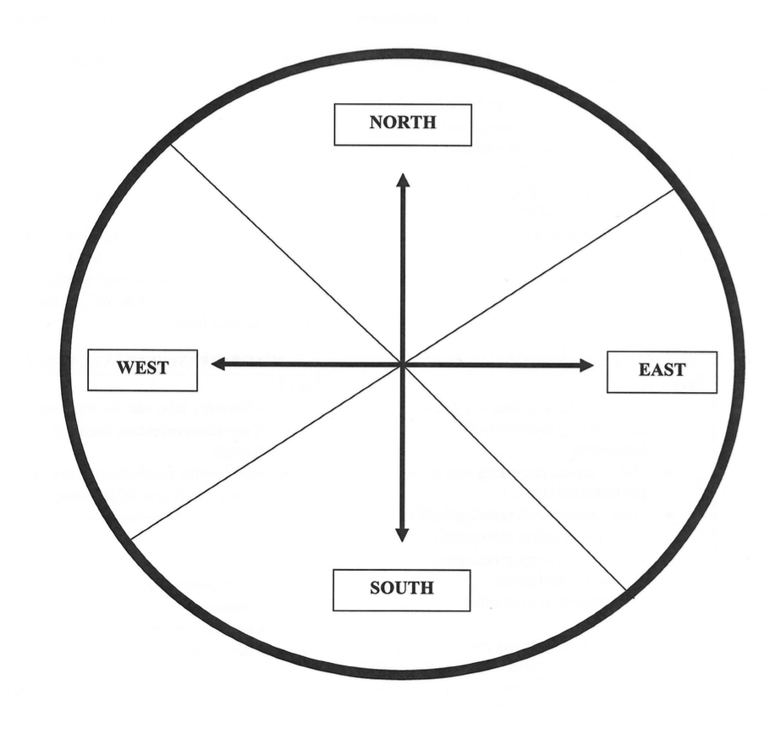
Personal Style Compass

Slide 17
Steering Team Checklist
Do we have folks…
  With a passion for:
    Community vitality
    Technology enhancement
  From a range of ages and targeted populations
  Who are doers?
Are we ready to?
  Cheerlead through the process
  Prepare for and host April Steering Team meeting
  Serve as project champions
  Allocate grant dollars smartly and fairly

Slide 18
Vision and Brainstorm Meetings
Invites and Logistics

Slide 19
Engage Your Community
Target Audiences
Established leaders/organizations
Tech experts (recognized and hidden)
Creative doers
Emphasis
Broadband use, not just improved broadband
This is something our community creates
An opportunity to make a real difference
Publicize
Print
Online
Personal!

Slide 20
Applying for the Blandin Funds
A simple process!

Slide 21
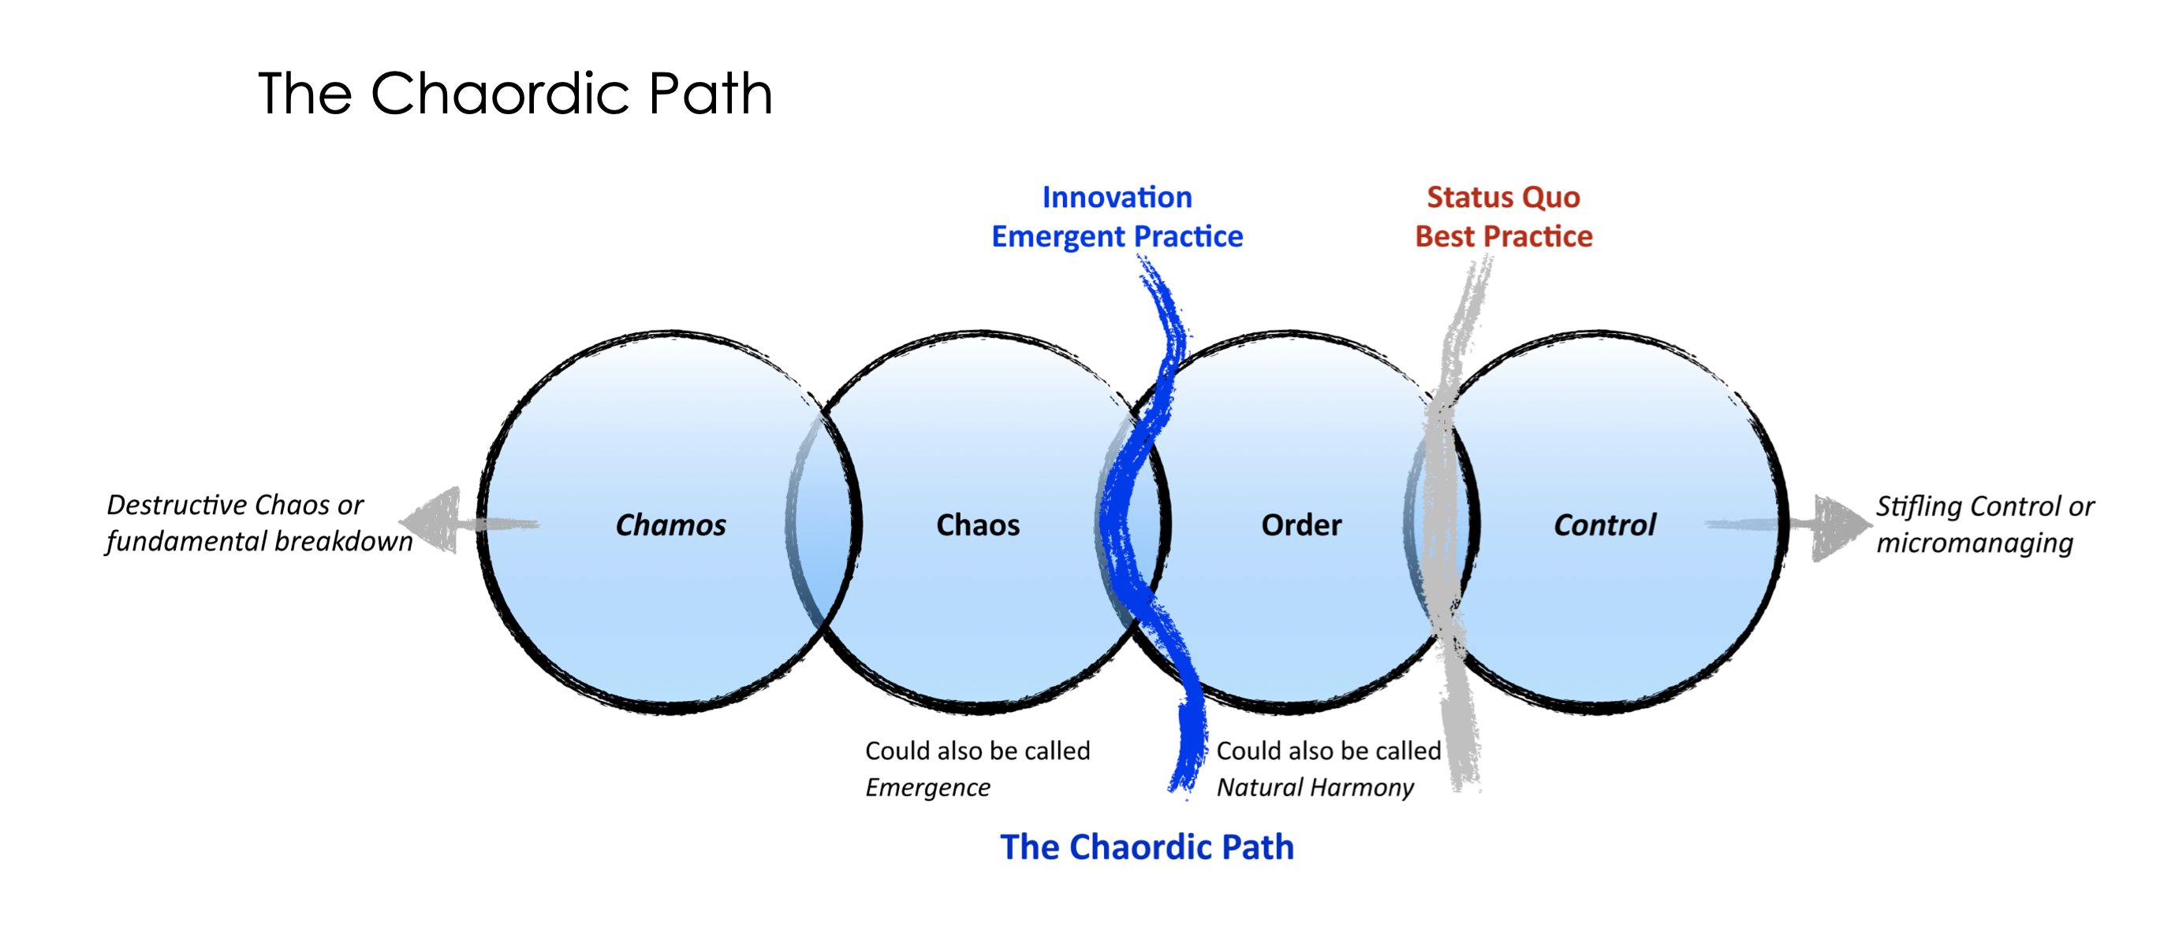
Don’t worry…
Control is over-rated; accept a little chaos!
“If you aren’t having fun, you’re doing it wrong!”
  Bernadine Joselyn
www.artofhosting.org

Slide 22
Here to help!
Mary Magnuson – Grants questions
  Broadband Program Administrator
  memagnuson@blandinfoundation.org
  218-327-8738
Bill Coleman – Process and projects questions
  Community Technology Advisors
  bill@communitytechnologyadvisors.com
  651-491-2551

