Slide 1
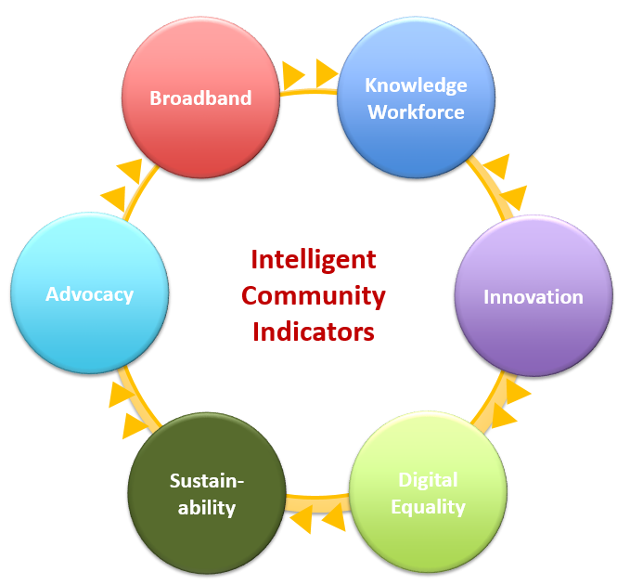
Otter Tail County
Blandin Broadband Communities
Vision Meeting

Slide 2
Agenda
Blandin Broadband Community Program
Introduce Intelligent Community
  Concepts
  Le Sueur County perspective
Community Discussion in small groups
  Assets and Gaps
  Desired Outcomes
Group reports
Closing
Adjourn

Slide 3
BBC Benefits
Create goals
  Better broadband access
  More sophisticated technology use
Community coaching from the Blandin team
Develop and implement tech projects
Up to $75,000 in grant funds

Slide 4
Process
Brainstorm
Design and Budget
Implement
Form Project Teams
Allocate Funds
Vision

Slide 5
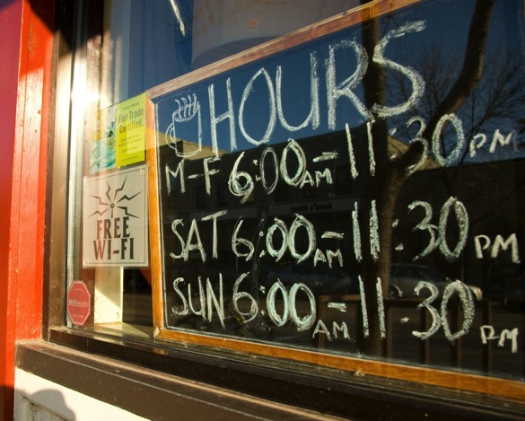
Broadband
Communities need a broadband that supports a globally competitive economy
Broadband is:
  A marketing term
  Refers to capacity, not a technology type
  Can be delivered via fiber, copper or wireless
Broadband goals
  Federal FCC
    25 Mb/3 Mb
  Minnesota
    25 Mb/3 Mb by 2022
    100 Mb/20 Mb by 2026
Understand the differences between
  Wired
  Wireless

Slide 6
Intelligent Community Framework

Slide 9
Broadband Community Input
Broadband is essential for everyday life – work, school & business
Internet can be slow and I have to rework my daily schedule around when the Internet works
I have fiber to the home and it is amazing
The lack of speed for our business connection has become very pronounced since COVID-19.

Slide 10
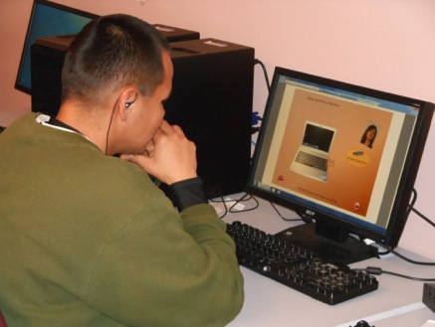
Knowledge Workforce
Communities will thrive on their ability to create, support and attract knowledge workers
Knowledge workers have
  Technology skills
  Post-secondary degrees and certifications
Knowledge workers
  Earn living wage salaries
  Start new companies
  Are critical to the success of all businesses and community organizations

Slide 11
Knowledge Workforce
Communities will thrive on their ability to create, support and attract knowledge workers
Knowledge workers have
  Technology skills
  Post-secondary degrees and certifications
Knowledge workers
  Earn living wage salaries
  Start new companies
  Are critical to the success of all businesses and community organizations

Slide 12
Knowledge Workforce
Community Input
OTC is working hard to promote housing development necessary for workforce
OTC has good schools, a college, strong manufacturing and health care sectors
OTC has strong and unique communities
Unfilled jobs at the low end; shortage of high end jobs
Working from home is an opportunity to grow the population and economy

Slide 13
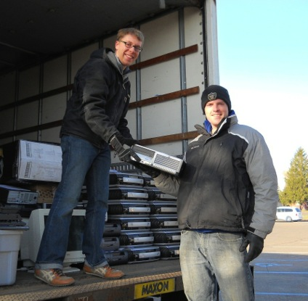
Digital Equality
Digital equality means that everyone will have a computer, know how to use it and and will have access to the network.
Increasingly, people cannot effectively participate in community without a network connection
Health, education and government strategies to improve services and cut costs require the use of technology.

Slide 14
OTC Digital Equity Overview

Slide 15
Digital Equity Community Input
Kids lacking connectivity and quality computers have a real challenge
There is a widening skills gap. People struggle to accomplish health care, education and government tasks online.
Cost and location determine people’s ability to get online.

Slide 16

Innovation
Innovation refers to doing new things and doing old things in new and better ways
Innovation allows people to do things more effectively and efficiently
Local innovation can focus on “catching up” as well as moving ahead

Slide 21
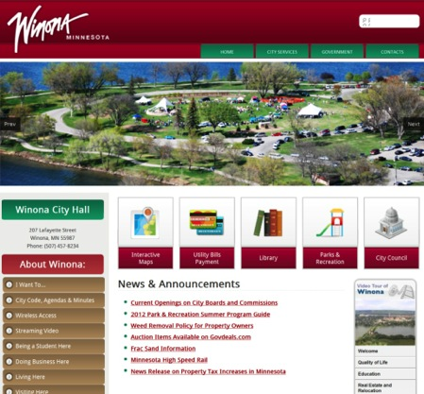
Advocacy
Advocacy is the communication strategy that your community uses to motivate positive change.
Marketing is needed to attract people and investment
Advocacy is targeted internally to promote community buy-in

Slide 23
Advocacy
Advocacy is the communication strategy that your community uses to motivate positive change.
Marketing is needed to attract people and investment
Advocacy is targeted internally to promote community buy-in

Slide 24
Thank you community presenters!

Slide 25
Next Steps
Magically, we will move into small group discussion rooms by Intelligent Community element!
Small group discussion agenda
  Introductions
  Discuss our ASSETS
    What can we build on?
  Discuss our GAPS
    What are we missing?
  Create set of Desired Outcomes
    What will be different if we are successful?

Slide 26
Discussion Rules
Don’t hog the screen time; get to your point!
Better to have a big list of assets and gaps than to talk about one item in depth
Don’t argue the point; everyone has their own perspective.

Slide 27
Intelligent Community Reports
Assets
Gaps
Desired Outcomes

Slide 28
Next Steps
Brainstorm Meeting August 25 – 4:00 – 5:30 pm
Online Project Voting August 28-September 4
Project Development and Budgeting
Grant Allocation
Project Implementation Goal – October 15

Slide 29
Closing Remarks
Thank you!

