Slide 2













Agenda
Welcome
  Jayne Gibson
  Bernadine Joselyn
Vision Meeting Report
  Bill Coleman
Additional Input
  Open discussion
Project Idea Generation
  In small groups
Group Reporting
  Round robin reporting by group leaders
Additional Ideas and Discussion
Next Steps
Adjourn

Slide 3
Community Opportunity

Slide 4
Achieving BBC Success
Amazing Results
Ideas
Resources
Leadership

Slide 5
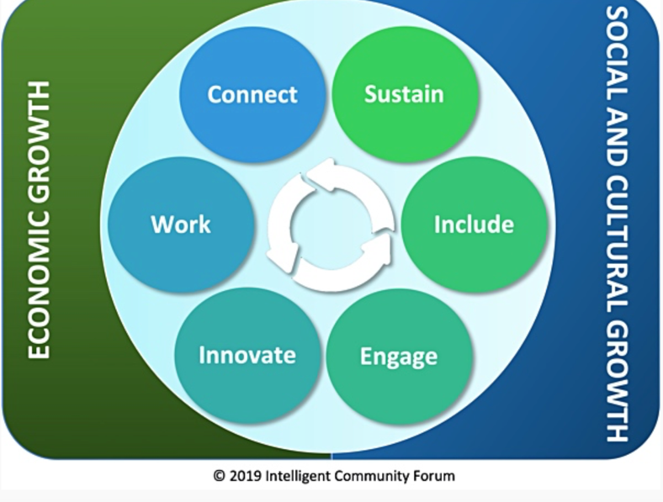
The Intelligent Community Framework

Slide 7
Our Broadband Story
Julie Clinefelter
2019/2021 Broadband Service Inventory
  School reports many kids outside city limits
Free Wifi availability
  Library- grant based
  School- grant based
  Community
Future opportunities
Key issue may be affordability, not availability

Slide 8
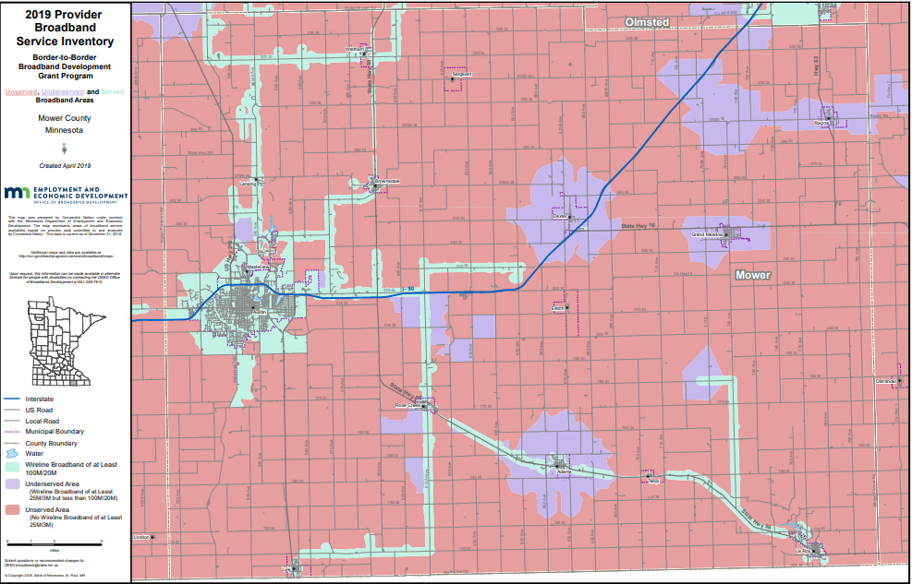
Our Broadband Story

Slide 9
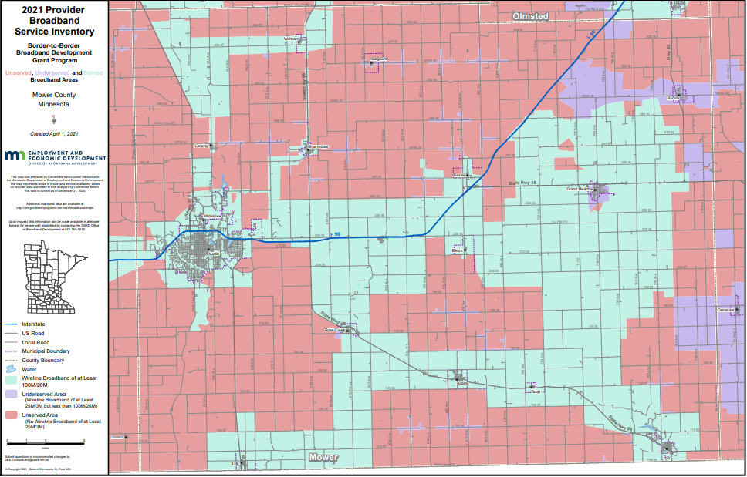
Our Broadband Story

Slide 10
Community Survey Response
We do a lot with digital outreach through social media, our webpage, and utilize online and cloud-based resources, so a broadband connection is necessary.
Interrupted connection or important stakeholders who do not have access are unable to collaborate and share voice
I have internet access to my home, but it is impacted by demand. Certain times of the day it is very slow.
We use Spectrum for our Internet services and rely on this service to run our server and POS workstations. We have experienced outages and other problems that affect our business.
We are not hindered but our monthly expense is high
There would be no working from home without it. There would be no way to communicate in a timely manner with medical, mental health and school needs. We cannot function efficiently or effectively without it.

Slide 11
Assets | Barriers / Gaps
Additional provider coming into Austin will provide competition Previous work by V2020 | Not available to everyone (not available in most rural areas) Some of what is advertised as broadband isn’t (CenturyLink) Depending on time of day (use by others) even broadband isn’t always what is promised Upload speeds aren’t good even when you have higher speed. Technical support is weak from providers Service consistency is highly variable Cellular coverage is also weak in many areas making other options not viable
Desired Outcomes
Minimum 100 Mb download and 50 Mb upload speed minimums available to everyone
  Requires coverage to everyone
  Guarantees from providers (with independent monitoring) and penalties to providers that don’t perform
Affordable price
Need to continue to add competition

Slide 12


Slide 13
Our Workforce Story
Mike Postma
We have a growing business community in town
  Hormel Foods, Mayo Clinic, Nu –Tek
  All are cutting edge industries with need for broadband
We have a workforce shortage & the only solution is to add more people to Mower County
  Need to have the amenities they are looking for
  Coworker who moved back from Ashville, NC to but family homestead in rural Mower, couldn't get internet

Slide 14
Our Workforce Story
Mike Postma
Broad disparity when broken down by race
90% of all population in Mower homes have a PC
  10% of those don't have broadband
Black population of 1115: 87% have a PC
  24% don't have broadband
Multi race population of 860: 99% have a PC
  37% of them don't have broadband
Source MNDEED 2019

Slide 15
Our Workforce Story
Mike Postma
Job applications are almost all online
Having internet access with working email key to getting and responding to companies looking to hire
Technology literacy is constantly evolving
  taking even a year or 2 off from having internet can result in world passing you by
Think about how many new tech habits you've developed since March 2020

Slide 16
Community Survey Response
I don't know about it but I know we need it.
Systems and structures are in place, but a sustainable platform to create great connection will accelerate the work
Austin has a growing school system with ongoing investment in facilities and support for education beyond high school. This can hopefully lead to more high school graduates staying in the area.
The Austin area is positioned well by having a fortune 500 company in its town, community support and the Hormel Foundation to help support and have a high-quality of workforce. There is also a variety of workforce opportunities ranging from lower to higher level positions and degrees.
Austin has many opportunities in the workforce, many of which are high-quality.

Slide 17
Assets | Barriers / Gaps
Ability to hire best people for the job, broad geographic area We have big name employers that people would move to work for … expectation of specific amenities Assurance scholarships – people would move to this community to have. Have good higher education opportunities School connection with local employers Options for online learning | Not having the appropriate level of broadband to do your work People have to go to great lengths to get broadband May have to move to a different place to get the broadband you need for your job. Could lose people moving here w/o broadband amenities Need universal access for online learning. Language barriers, digital literacy Socioeconomic status as it relates to digital literacy (e.g. phones disconnected, have to start over) Threat of losing talent Lack of people interested in working (need more of the “right kind” of people – skills, age, etc) What makes people move here? Appropriate housing, family activities available, lifestyle, community amenities
Desired Outcomes
Appropriate level of broadband access for all.
Emphasis on youth – build technology skills, online learning in all areas (welding, farm machiney)
Technology skills for all ages on how to apply for jobs, get connected to work remotely
Local hub for the county to help people figure out what their options are for broadband (vs. people having to figure it out for themselves)
Navigator program similar to Austin Aspires/school open to all who struggle with technology.
Eliminate “I don’t do computers” from job applicants … digital literacy for all … options for people at all levels of technology literacy
Look for ways to minimize technology intimidation

Slide 18

Include
Digital equity means computers, skills, and access for all!

Slide 19
Our Digital Equity Story
Kristi Beckman and Nitaya Jandragholica
Access to internet and devices
  Mower County Senior Center report many seniors don’t have access to broadband
Digital Literacy
  Classes being offered in Spanish at Austin Public Library
  Community Tech Navigator from Austin Aspires

Slide 20
Digital Equity/Digital Literacy in the Justice Program
How does digital equity and digital literacy impact people who are navigating the criminal justice system either as a defendant or a victim?
Does access and digital literacy play any role in justice outcomes?

Slide 21
Mower County Court Hearings 2020
Pre pandemic 4 % of hearings were remote - Post pandemic 71%
Jails are set up to hold Zoom hearings to minimize transport and COVID exposure.
We do have one or more Zoom Rooms and tablets within each courthouse that allows a person without technology to come to the courthouse and use that tablet to attend their hearing.

Slide 22
Community Survey Response
My wife is a teacher and I know access was a challenge during the earlier part of the pandemic when kids were communicating with teachers from home. My wife's EL students in particular struggled.
There are families who do not have access to internet, or the service does not meet their needs, the schools and Austin Public Library have been provided hundreds of hotspot to student so that they could be educated.
Often financial limitations are the cause of unequal access to technology and the internet. I also see older people who can afford it but lack the skills to use it to it's potential.....
Technology is very expensive. There are many families that cannot afford internet. This makes it hard for families to receive communications sent via email from businesses, schools etc. This creates a divide because much information is sent this way.
Yet the proportion of U.S. adults with no computer experience is much higher for immigrants, the Program for the International Assessment of Adult Competencies (PIAAC) found, at almost 21% compared to approximately 5% for non-immigrants.

Slide 23
Assets | Barriers / Gaps
Professional workforce diversity/multilingual Made diversity a priority in our community Good communication between agencies, schools, businesses, etc. Community resources to go into the homes of diverse communities Places in town like library and schools providing devices for keeping connected Resources available and people willing to look for other options Welcome Center (Community Action Building combo with PRC and Children’s Dental) | Asking those who need help what they need, not assuming, what areas do we have most need Need for zoom meeting rooms in community (ask those who need them where they would be most helpful) More multi lingual people in our buildings Differentiate the communication we send out Need more small group or 1:1 help (digital navigation) Economics needs to be stressed. Affordability of service is a huge problem.
Desired Outcomes
More digital navigators and strategic places of contact to train out those who are already assisting. Really need 1:1.
Using bilingual students who need volunteer hours for Austin Assurance to get the training so that they can get those hours and help out.
Something set up to help those who need help financially to gain access. (language skills, but also to help those who are undocumented)
Community infrastructure (trusted navigators) to help people get signed up for things like EBB (digital access resource)
Paying back old phone bills so people could get internet provider service? Gift cards for community members who need access.
Improving trust with the community (building those trusted navigators)
Website or someplace (someone) to keep all the information in one place
Community training on how to link people with who they need? (How to do it in a non-condescending way.)

Slide 24

Innovation
Innovation refers to doing new things and doing old things in new and better ways

Slide 25
Our Innovation Story
John Garry, Wendy Anderson, Juan Molina

Slide 26
Community Survey Response
Mayo, the schools and other businesses in Austin have utilized tech systems such as Zoom and Schoology during the pandemic in order to provide services families and elders.
Mental and physical health providers provide telehealth appointments which reduces stress for those who need transportation and mobility support.
The EAT DRINK SHOP Austin Facebook page is a good example of businesses banding together to promote what they have, build each other up and support each other for the good of the community.
Quality inexpensive internet is not an option anymore. All businesses need it.
I don't think there's anything particularly innovative about how Austin area businesses and industries use technology. It would be interesting to have a competitions/contests -- 1) best current innovative use of technology by a small business 2) best new idea for innovative use of technology by a small business. Brainstorming here...this would help us understand what the issues and ideas are.

Slide 27
Assets | Barriers / Gaps
Metronet by summer 2022 Health Care pushed by COVID on how care is delivered. Schools learned k-4 education with more immediate feedback and engagement. Opportunity to be more purposeful with technology (rather than just screen time). Flexibility Diversity is considerable in Austin Well-educated professional who have seen other communities and can bring them to Austin Institute has amazing technology Retailer are learning new ways to do business Riverland access to education Forward thinking about how to offer programming. | Knowledge of what is possible with better broadband Important to distinguish the audience because of wide range of Austin’s diversity Tech literacy at the family level is often behind the child level So many things that are visible (patient portal at Mayo is example) is only available in English Free classes on how to use a computer (if it is available – need more awareness)
Desired Outcomes
Free classes on how to use a computer
Increased innovative entrepreneurial ecosystem with world-class technology (co-wrking space as hub)
Computer in every home – capable, ready for the future
Small business technology resiliency upgrades and innovative use competition/contest

Slide 28
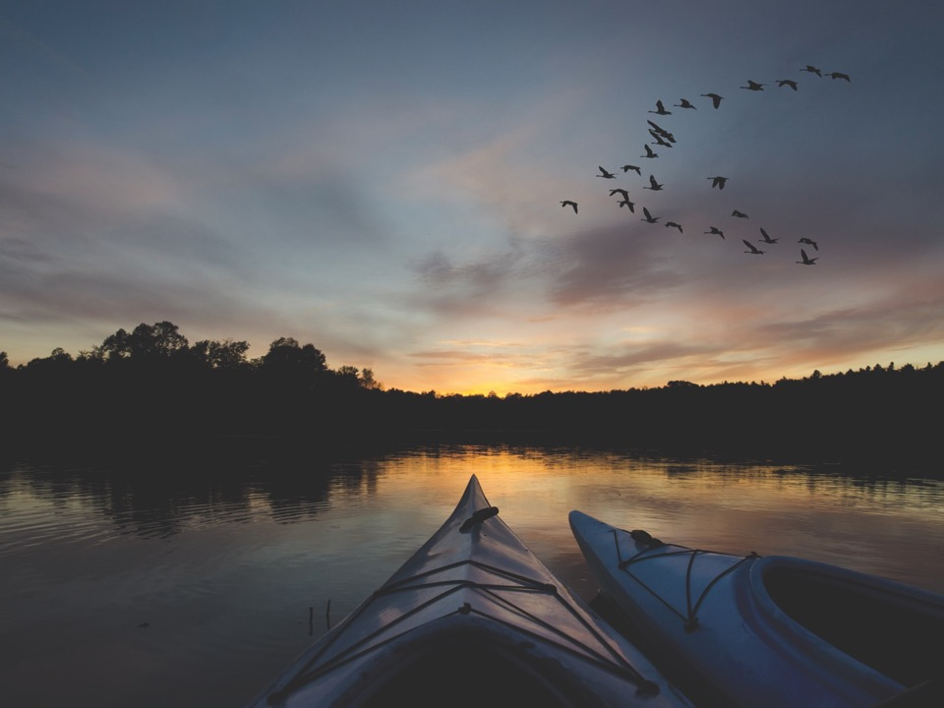
Sustainability is economic development with the future in mind

Slide 29
Our Sustainability Story
Luke Reese
Hormel Nature Center
  What the HNC has done:
    Solar panels, geothermal HVAC, and bird glass
    Land management:
      Local, watershed, and regional contexts
    Environmental education
  Future opportunities:
    DC fast chargers for EVs
    Remember the trees

Slide 30
Community Survey Response
The Utilities has many programs to help people improve energy efficiency and lower water use. I think cost, knowledge of the programs, and a lack of understanding of why they are necessary are all barriers.
Solar power is one way; however, this can make it hard as well as many solar panels are needed to keep businesses running.
I have not heard of any

Slide 31
Assets | Barriers / Gaps
Hormel Nature Center Soil & Water Conservation District Friends of the Nature Center Spruce Up Austin Austin Audubon Society Isaak Walton League Pheasants Forever U of M Extension Partnerships 4-H Ag Society Largest producer of wind in the state Two large solar projects on line Austin Public Utilities is an active partner in clean water, electrifying homes, etc County has active clean water program through ordinances, education, & partnerships 4th Ave Fest Programming Aquatic Invasive Species programming Canoe mobile project 1st. Gravel bed nursery created in 2021 | City is cutting down more trees than replacing 2:1. This is impacting low income neighborhoods more than others for multiple reasons – one is that people who can afford to do so, buy their own trees. Emerald ash bore is working its way here Nurseries selling trees that are on invasive species list such as Norway maple – need them to know what are the best trees for our area and sell them City buys trees at end of year – gets low price but not buying the trees with the species diversity that is needed Do not have a thoughtful, informed, county wide forest/tree plan
Desired Outcomes
Implement No Child Left Indoors Program in 2022
Create gravel bed nursery in Austin at the Fair Grounds and provide template for other communities in the county to replicate
Shift the model of cutting down 2, planting 1 to cutting down 2, planting 3.
Educate the community about why trees matter
Educate community about why getting outdoors matters
Educate community about the role that environmental sustainability plays in economic development

Slide 32

Engage

Slide 33
Our Community Engagement Story
Austin Public Schools

Slide 34
Community Survey Response
We use print advertising, weekly radio, social media, our website, and a semiannual newsletter to communicate with the Austin area.
Our diversity is our strength. Have the young train the old on tech and the internet. Have the young observe and work with the middle aged in careers to gain exposure and experience. Have those that speak the language mentor those that are new to our culture/language and traditions.
We need to make sure Austin area has affordable access to technology and investments should be in that area. Having areas such as the library, maybe YMCA etc be places or hubs for people to go to access technology easily.
Greater access to resources and community connection
Quality and affordable housing, childcare

Slide 35
Assets | Barriers / Gaps
Lots of different hubs (library, etc) Willingness of families to participate and grow in understanding Good networks Major willingess to help groups The areas that do offer training—library, public spaces—could recognition be offered? Success coaches—navigators Some providers are good at responding to issues | Training—from people they trust Trust and mistrust Resources Not sure how to give the resources to the groups Finding space Assuming what is needed—not just with racial groups but also people with disabilities, etc. Assumptions about people’s level of engagement Can be fear Assuming messages have been received Systematic structures to prevent or even discourage engagement?
Desired Outcomes
Look at the willingness to support—and do some type of a give back
Anyone who wants to learn something---they would know where to go
Improved response time from providers
Place to find out where lack of internet access exists and lack of devices--
Engage landlords and businesses that want to solve the problem
Advanced building access—24/7

Slide 36
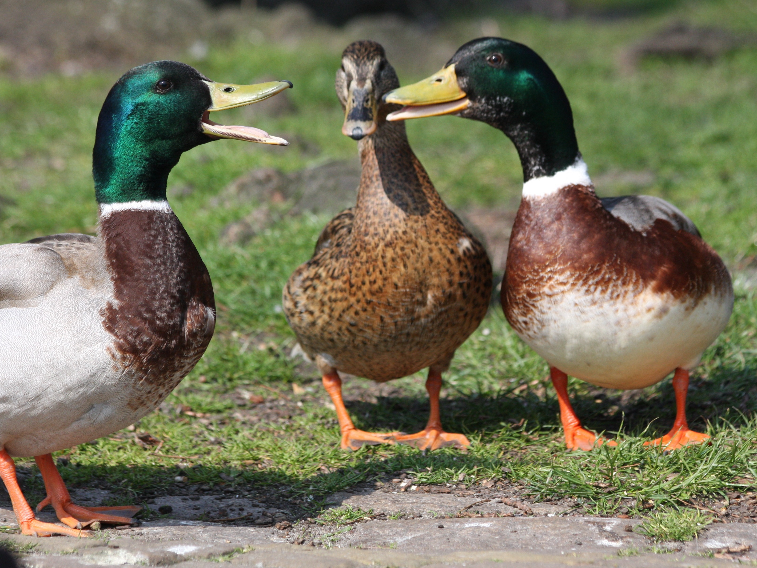
Additional Input

Slide 37
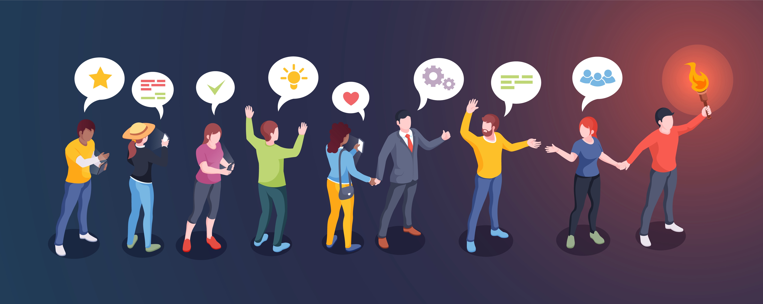
Project Idea Generation
Small Group Discussion
  Appoint a chair
  Appoint a recorder/reporter
Rules
  Project ideas can be for any Intelligent Community element
  We want as many ideas as possible
  We just want the basic idea
    Not the justification
    Not the implementation details
    Not the barriers
  Take turns

Slide 38

Discussion Group Reporting
Round Robin Reporting
Two ideas per group per round
No repetition please
  Adding detail/variations OK
We just want the basic idea
    Not the justification
    Not the implementation details
    Not the barriers

Slide 39
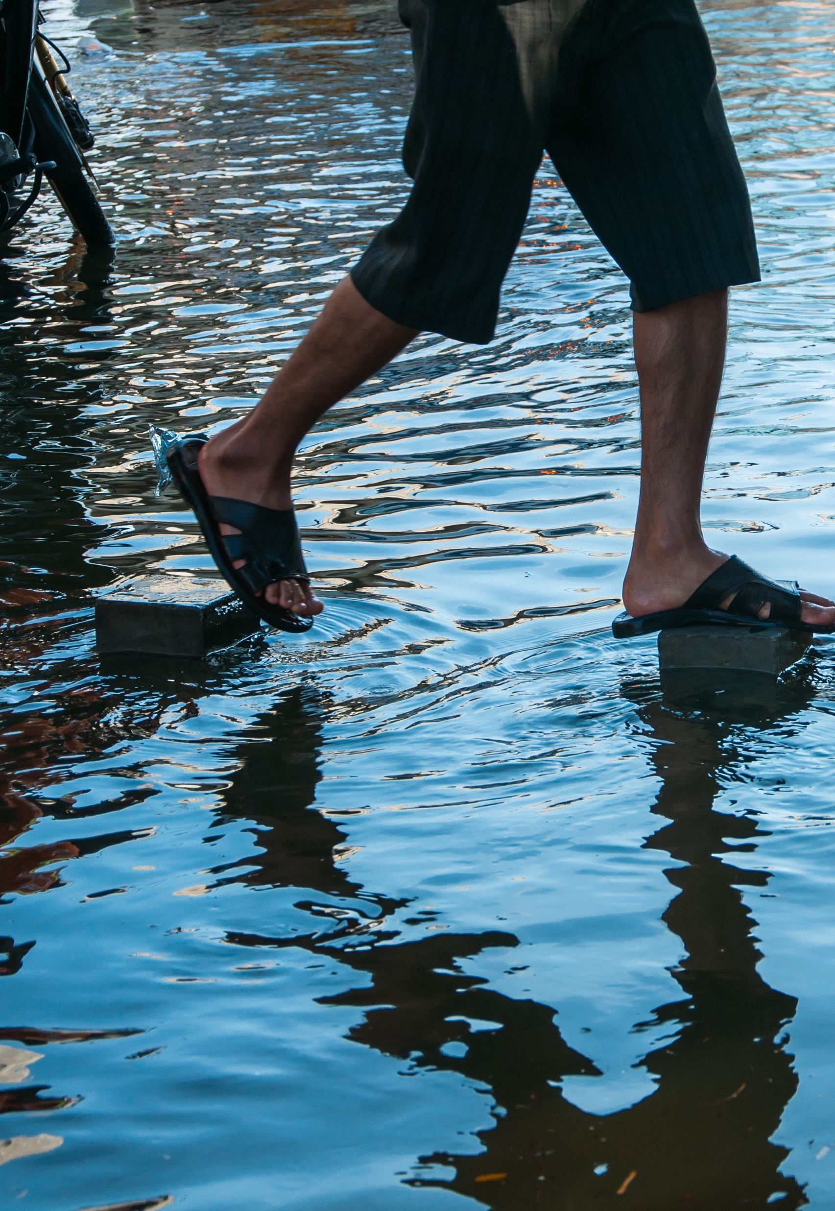
Next Steps
Organizing ideas
Project team champions & volunteering/recruiting
Online project voting
Further project development
Budgets and allocations
Blandin grant application by early January
Grant approval
Project implementation
Additional project development

Slide 40
Adjourn

Slide 41
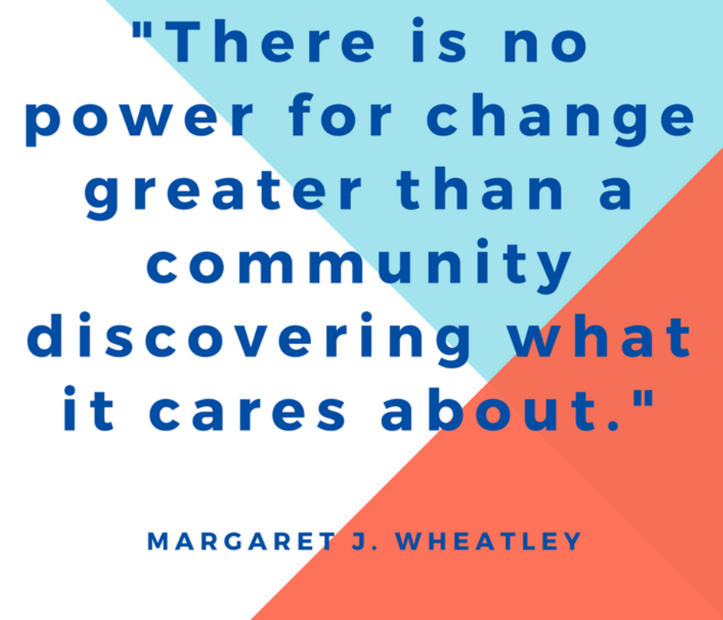
Adjourn
Be sure to vote and volunteer for your favorite projects!

