Slide 1
Community Broadband
A Comprehensive Approach
Bill Coleman
Community Technology Advisors

Slide 2
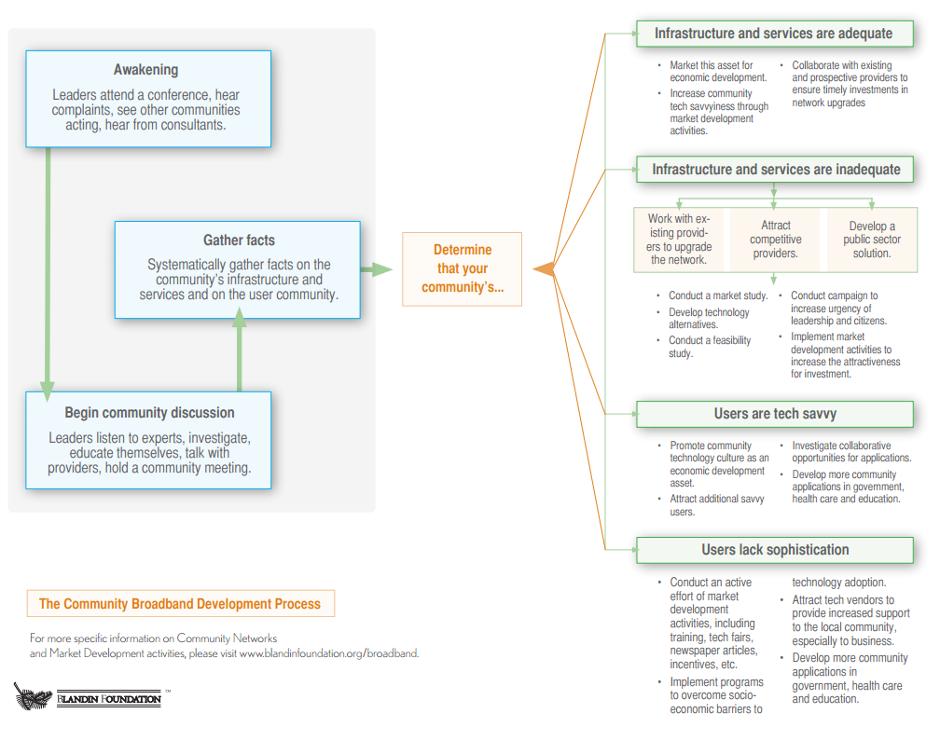

Slide 3
Digital Inclusion
Business and Economic Development
Applications and Utilization

Slide 4
Group Assignment
Identify facilitator (person with fewest letters in name)
Identify three to five questions that your group wants discussed at this session
Write the questions on large post-its
Appoint representative (person with most letters in name)
Representative reads and posts questions

Slide 5
Broadband Networks and Infrastructure
What is it?

Slide 6
Broadband Differentiators
Physical Capacity
Service Limitations
Pricing
Download & upload speeds
Latency
Security
Bandwidth caps
Coverage area
Permitted # of connecting devices
Reliability
Installation
Subscription
Bandwidth pricing model

Slide 7
Technology Comparison
Fiber Optics
Cable/Twisted Pair
Cellular Wireless
Huge bandwidth (Gb)
Bandwidth dependent on fiber (40-100 Mb)
Reliable, low latency & secure
4G speeds (up to 40 Mb)
Expensive to install
Upgrade via electronics
Reliable, low latency and secure
Symmetric
Asymmetric
Expensive to install
Upgrade via fiber and electronics
Fiber dependent
High price per Gb
Mobile
Relatively cheap to deploy
Upgrade via towers, fiber and electronics
Spectrum limitations

Slide 8
Technology Comparison
Fixed Wireless
Satellite
Wi-Fi Hot Spots
Limited bandwidth (less than 10 Mb)
Up to 12 Mb
Reliable, low latency & secure
Speed depends on wired connection and electronics
Inexpensive to install
Upgrade via electronics and bandwidth to the tower
High latency
Asymmetric
Asymmetric
Inexpensive to install
Upgrade via new satellites and end-user electronics
Promoted by cellular carriers to offload from cell network
Free and subscription-based
Inexpensive to deploy
Upgrade via wired service and electronics
Reliable and secure
One speed; price based on usage
Generally unsecure

Slide 9
Community Broadband Assessments

Slide 10
Assessment
Existing providers and existing / prospective services
Users and existing /future demand
Prospective partners
Technology choices
Community appetite for adventure

Slide 11
Assessment Questions
Providers
Consumers
What services are our existing providers delivering now? Are upgrades scheduled? Do these services meet our current & future needs?
Which, if any, parts our our community are underserved?
Is there available middle mile fiber available for use by competitors?
Are other providers interested?
Is an incremental improvement an asset or detriment to a quality long-term solution?
What is your community really willing to do as a partner?
What is the overall consumer satisfaction level?
What are the critical issues around any service dissatisfaction?
How are key institutions obtaining broadband services?
Is collaboration likely among key consumers?
What are the other barriers to sophisticated use of technology within the community?
What is the potential for growing consumer demand?

Slide 12
Studies
Feasibility
Partnership Development
Community funded and owned
Consultant responsibility is to community
Considerations
Market
Technology
Costs
Financing
Operations
Partnership opportunities
Process drives decision-making and partnership development
Leads to fact-based public sector decisions and/or negotiations with prospective partners
Study co-funded and co-owned by community and prospective provider partner
Questions
Who is the consultant’s client?
Who owns the information?
Commitment conditions of provider partner should be obtained in advance
More limited study
Market
Costs
Financing
Partnership agreement
Should lead to yes or no decision by partners

Slide 13
Successful Public-Private Partnerships
Government | Examples
Proving direct funding to providers | Lac qui Parle EDA with Farmers Mutual Cook County with Arrowhead Electric
Serving as anchor tenants | Brainerd School District with CTC ECMECC with US Cable/SCI Anoka County with Zayo
Public fiber rings for use by private providers | City of Little Falls with CTC City of Eagan in open access model Scott and Carver Counties
Providing tower space for wireless providers | Many, many examples
In partnership with other cities | City of Windom with the Southern MN Broadband Services

Slide 14
Deployment Dynamics
FCC USF/other funding changes are slowing CLEC expansion by rural telephone co-ops
FCC CAF fund users only required to meet the 4 Mb/1 Mb standard
FCC prospective changes to allow other entities to use CAF funds to deploy broadband
4G wireless is emerging as an alternative home service and further fragmenting the rural marketplace
700 MHz wireless deployments with licensed spectrum
FirstNet national wireless data network

Slide 15
Digital Inclusion
Who is not online?

Slide 16
Digital Inclusion Elements
Computers
Training
Connectivity
Enabled Citizens

Slide 17
Provide Computers
Refurbished computers from PCs for People or others
Discounted new devices through Comcast Internet Essentials or others
School 1 : 1 programs

Slide 18
Provide Training
Digital literacy through library, ABE or workforce center
Culturally sensitive for selected population groups
Multi-language availability to meet target group needs
Tied to important life purposes
School portals for parents
Employment sites for job seekers
Health, finance and companionship for older adults

Slide 19
Provide Connectivity
Partner w/local ISPs/Lifeline programs
Wi-Fi hot spots
Libraries and other public access spots.

Slide 20
Business and Economic Development

Slide 21
Integrated Strategies Required!
Broadband Availability
Business Utilization
Skills Development
Marketing

Slide 22
Broadband Availability
Big Users
Adequate bandwidth
Redundancy
Competitive pricing
Disaster recovery
Small and Home Businesses
Adequate bandwidth
Customer and tech support service
Networking & security
E-commerce, social media and web
Data Centers
Multiple fiber sources
Electricity
Affordable
Reliable
Redundant

Slide 23
Business Utilization
Bandwidth required = from very low to Gb
Increase leadership tech IQ
Training
Technical assistance
Networking
Ensure strong tech support vendor community
Creation of shared facilities
Networking & collaboration
Available bandwidth
Printing and hardware
Applications

Slide 24
Skills Development
Ensure an adequate tech workforce
Create
Attract
Maintain
Support the Tech workforce
Networking
Shared learning
Cross-organization tech support

Slide 25
Marketing
Create and maintain a tech savvy online community image for both internal and external audiences
Web
Facebook
Twitter
Key components
Broadband
Network and bandwidth
Available tech-ready space
Business Utilization
Highlight best practices within community
Skills Development
Colleges and K12
Lifelong learning
Peer to peer

Slide 26
Applications and Utilization

Slide 27
Realizing Full Value
Manage the Business
Research and Buy
Market and Sell
Communicate

Slide 28
Types of Apps
Analyze and Use Big Data
Video-conferencing
Mobile
Remote Consulting & Management
Marketing

Slide 29
Promotion Strategies
Demonstrate best practices of utilization
Document the ROI of technology investments
Provide coaching to set strategy and make choices
Provide local businesses access to vendors
Provide financial incentives for innovation

Slide 30
Start Someplace!
Digital Inclusion
Business and Economic Development
Applications and Utilization

Slide 31
Discussion
Bill Coleman
bill@communitytechnologyadvisors.com
651-491-2551
www.communitytechnologyadvisors.com

