Slide 1
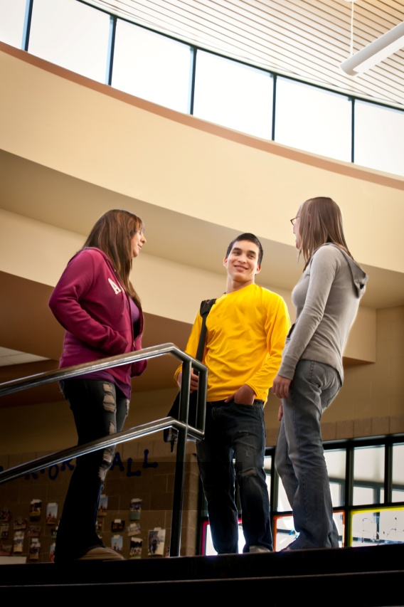
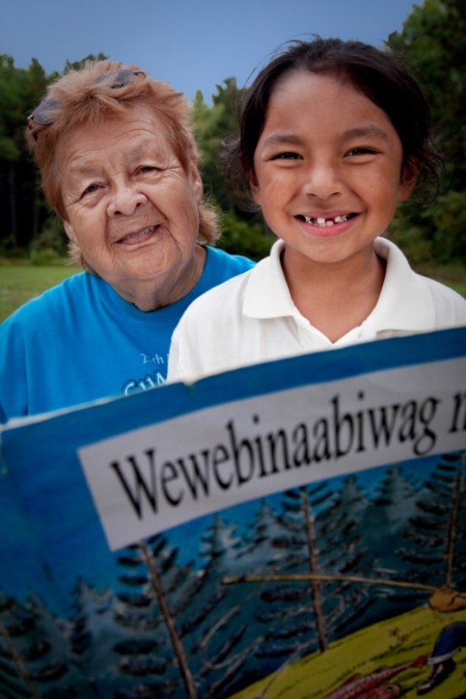
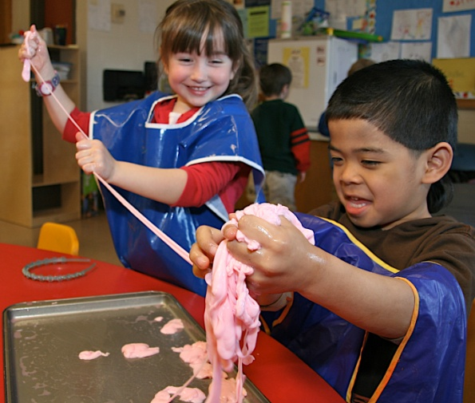
2011 Nonprofit Gathering
Notes:
1
Great to have all of you here. Wanted a big group
Never quite sure what to call this meeting every year. More than grantees. More than nonprofits. Also this year includes board members, not just staff.

Slide 2
Agenda Items
Update on Foundation priorities
Nonprofit strengthening program
Notes:
2
5th gathering of this type. First 3 were pretty much one way affairs with an update from the Foundation.
Starting last year, put more emphasis on common issues for the nonprofit community.
This year will only spend about 15 minutes on the Foundation update and spend the better part of the day on strengthening.

Slide 3
Mission
To strengthen rural Minnesota communities, especially the Grand Rapids area.
Notes:
3
Our mission is very stable. No sense of desire to alter or change.

Slide 4
Blandin Tool Kit
Grants
Public Policy
Leadership
Notes:
4
When you think Foundation, you typically think grants, but want to remind us that Blandin has 3 basic tools.
Leadership programs have over 5,000 alumni in the state after 25 years in service. Hundreds in Itasca alone, including many in this room. Better equiped to build relationships, frame opportunities, and motivate action.
Policy programs have leveraged $6M in fed and state grants for broad band development AND preserved 250k acres of land for support of local forest industries and recreation.
Should really add communications to this tool kit as well. As rural looses influence relative to urban, play more of a role in representing rural perspectives, like the rural pulse document in your packets.
The challenge is to make it all work together and be mutually supportive

Slide 5
Foundation Priorities
Optimize relationship with Itasca area
Rural leadership development
Expand Opportunity
Notes:
5
All of the tools in the tool kit work toward these priorities
Have put a planning process in place where priorities are Revisit every year – nimble adaptation – world is changing to fast to be locked in for years
The board has reiterated its support for these priorities for the second year running so reality is that Foundation priorities in 2011 are unchanged from 2010.
Would be surprised if they wanted to make a significant departure from these in the next few years.

Slide 6
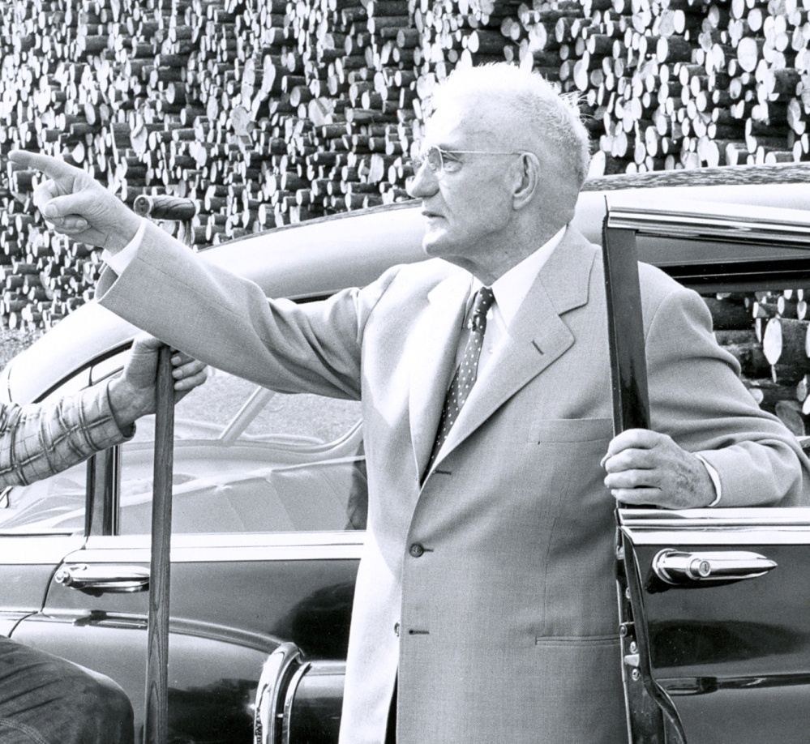
Optimize the work of the Blandin Foundation in the Itasca County area
Notes:
6
The Foundation’s goal is to be stable, predictable entity in the community, but balanced against Mr. Blandin’s clear concern that the Foundation not undermining the community's capacity to take responsibility for its own future
Blandin will still respond to a broad range of grant requests in the local giving area of Itasca County, quite frankly a much broader array than other parts of the state, but we expect that the bulk of our local grants and all statewide will address Expand Opportunity.
Well over 55% of grants will be in local community – we have cut from Statewide grant making.
We are here in this room today because of the commitment to the local community, recognizing that money alone isn’t the answer, but that skills and capacities of our nonprofit and community partners are essential

Slide 7
Sustain Commitment to Rural Leadership Development
Main investment continues to be Foundation leadership programs
Limited number of grants
Notes:
7
Main investment has, and will continue to be Foundation delivered leadership programming.
25 year anniversary coming up – illustrates the notion that important topics deserve support over time – not in and out and leave.
Not a lot of grants here, but some like Native Youth leadership.

Slide 8
Expand Opportunity
Concentrate on synergies between educational attainment, economic opportunity, and inclusion
75% of Foundation grants support this priority area
Notes:
The strategy formerly known as Building Inclusive Prosperity.
Main proactive strategy for grant making and the foundation
We think this is topic matter where both communities and the Foundation have the ability to have a positive influence on the future.
This is where most grant dollars have and will continue to go, however, we are still here to respond to local community initiatives that fall outside this area. Non Local need to be solidly here however.

Slide 9
Notes:
Start with vibrant economy. We all want it, but how do we get there? Entrepreneurship development is one key as well as other strategies to encourage business growth and attraction, like availability of capital, but it is not enough in isolation.
Experience has taught us that you can’t talk about economy without rapidly getting to education. We live in a rapidly changing world that is increasingly competitive on an international scale. The entire education system from early childhood to post doctoral is the seedbed for developing new talent in the form of workers and CREATORS, as well as cutting edge research that will keep this state and nation strong. To the extent that we can build more effective connections between education systems and the economies they reside in, the better chance we have of producing ideas and skills that will work in the regions we live in.
Finally, simple demographics demonstrate that all of us, have a very pragmatic self interest, not to mention a moral imperative, to give all people the opportunity to be productive participants in our educational and economic system. As the state demographer has pointed out, if rural MN wants to maintain its standard of living with a shrinking worker base, we have to increase worker productivity, and you can’t do that without strong skills development. And, we believe, that the very act of inclusion makes the struggle to innovate easier. Noone has all the answers – more complex world benefits from different ideas.
We are more inclined to fund initiatives that hit all three, the sweet spot. Open to good ideas that rest mainly on two axis.
Not likely to fund many projects that don’t clearly articulate how they will build inclusion/greater equity/lessen disparities for low income, racial minorities, or other groups facing historical barriers.

Slide 10
Miscellaneous
Third year of flat budgets after 20% decrease in 2009
Center for Effective Philanthropy Survey in February
New, online monitoring report system in 2011
Notes:
10

Slide 11
Questions?
Notes:
11

Slide 12
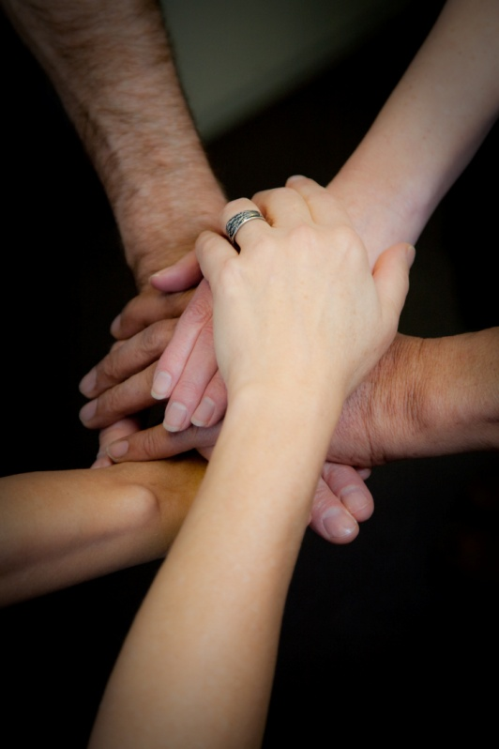
Getting Stronger
Notes:
12
Brings us to the important part of the day, our work together on getting stronger. We all know we need to get better. The statistics for Itasca County themselves tell the story. Even with the great effort we put in, incomes are still low relative to the state, substance and physical abuse persist, poverty, etc.
When I see kids get of the bus and immediately bolting to skip school or folks heading to the homeless shelter for the night, it hurts right here. The need is only growing, and we have to do better.
Once we recognize the need for improvement, the tough question becomes HOW.
Last year when we got together, in the face of all the changes, we asked ourselves as a nonprofit community what we could do to improve our performance.
We took the time to brainstorm, reflect, and prioritize and as a community we identified two leading priorities.

Slide 13
Priorities for Strengthening
Board Governance
Working Together More Effectively
Notes:
We can’t fall into the trap of equating innovation and improvement with more money. There is not giant rock candy mountain in the sky coming to make it all better.
The reality is that the most realistic answer we have to how to get better is sitting right here in this room. The nonprofit community recognizes this, that’s why these topics were prioritized.
As a general rule, an organization is only as strong as its board of directors. All of us who are on boards should be committed to sharpening our skills.
Second, rather than more money, how can we use existing resources more effectively. It will help us if we can shift our visino from a mindset of ‘how effective is my organization’ to a broader vision of ‘how effective is the community response to pressing issues like hunger and poverty? How can we work together on big issues that none of us can tackle alone?
Working together, collaboration, cooperation, these are all obvious responses, but in order for them to work, they require real change, and real change is hard. The good news is that we already have some great examples of collaboration in the community, take Invest Early as one example. They schools, Kootasca, county, and others have done such a good job that some professors from Harvard came out last year to write a case study on it.
The Foundation doesn’t expect that every organization in this room is going to end up joining a big collaborative. Rather, we expect that there will be a growing list of examples of how we work across organizational lines to marshal resources needed to tackle key community challenges. There are skills we can all learn that will dramatically increase our chances of creating successful collaboration that we will be working on starting today – it is a process, not an end destination.

Slide 14
Objectives for Balance of Day
Learning opportunity on board governance and collaboration
Inform attendees how to participate in coaching services
Notes:
Part of strengthening work is going to happen right here today. Seminar style.
That’s fine and good, but seminars only go so far. They aim at a low common denominator.
We are fans of providing more individualized resources – so part of today will also focus on how to take advantage of coaching resources available to individual or groups of organizations.

Slide 15
Resource Provider Introduction
Kate Barr – Nonprofits Assistance Fund
Karen Ray – Karen Ray Associates
Notes:
Are modeling collaboration themselves. Neither is a stranger to Itasca County.
Kate Barr is Executive Director of Nonprofits Assistance Fund, whose mission is to foster community development and vitality by building financially healthy nonprofit organizations. Kate has led the organization’s growth as a premier resource for training, strategic financial counsel, and financing for nonprofit organizations.
Karen Ray has literally “written the book” on collaboration. Her work has been used all across the country for the last 28 years and we are luck to have her in our back yard. Karen has helped foster several collaborations in Itasca County, including partnerships around adult literacy, family safety nets, and Invest Early.

