Slide 1
COST SAVINGS AND INNOVATION
BLANDIN FOUNDATION
LEADERSHIP SERIES

Slide 2
“Cost savings AND innovation” is not an oxymoron.

Slide 3
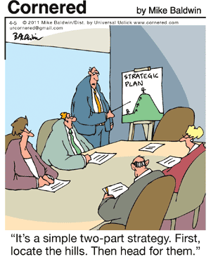

Slide 4
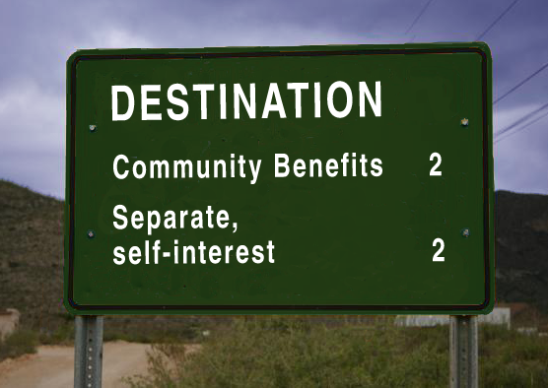
Where are you going?
What results do you want?

Slide 5
Innovation and Cost Savings
Modify your business model thru
Strategic planning
Financial pressures
Partnerships
Copyright © 2010, Karen Ray Associates.

Slide 6
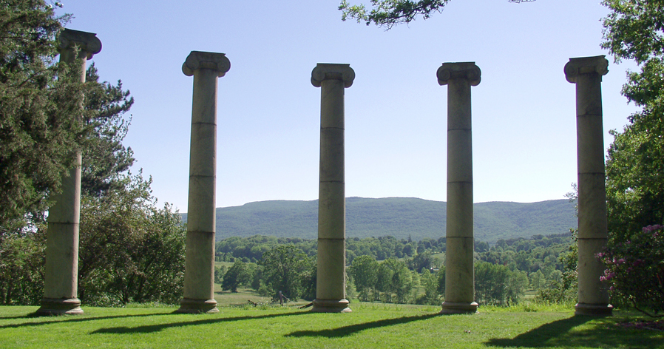
Your organizations are pillars of your community.

Slide 7
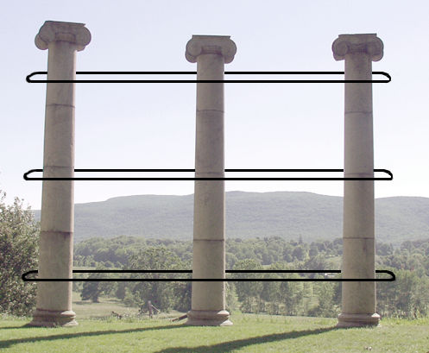
What can you achieve together?
Services to Clients
Infrastructure support
Advocacy; public will

Slide 8
PARTNERSHIPS HELP YOU
GET OVER HISTORY

Slide 9
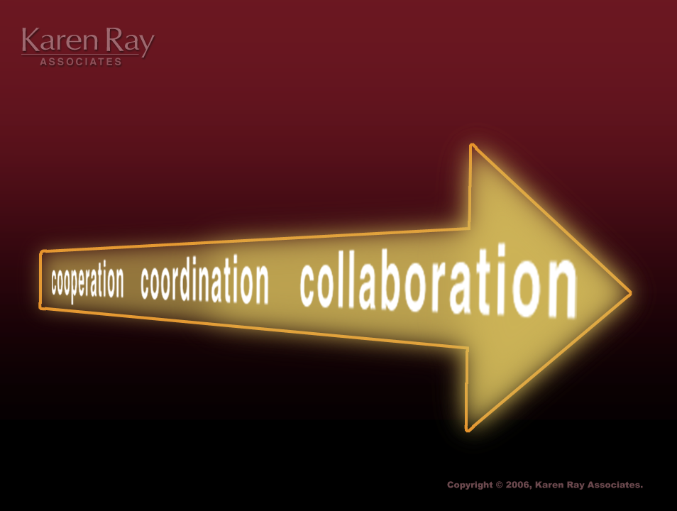
Increasing intensity

Slide 10
STRATEGIC ALLIANCES
Cooperation
Coordination
Collaboration
Consolidation

Slide 11
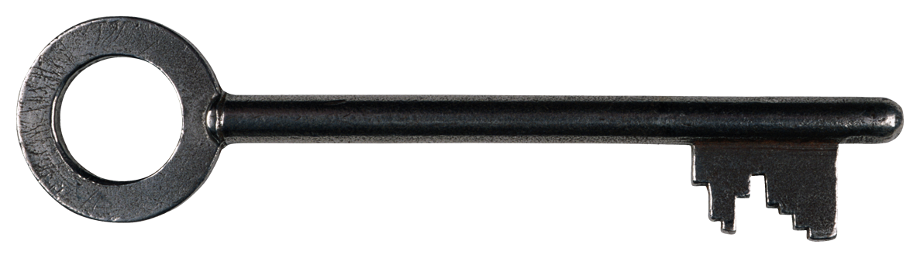
KEY PRINCIPLES
Systems are changed because individual organizations change themselves.
Notes:
Slide Key Collaboration Principles
Those of you in Providence in May remember some of these key ideas about why collaboration is important:
“Systems are changed because individual organizations change themselves.”

Slide 12
KEY PRINCIPLES
Partners focus on the way in which the current system can be improved by changing individual organization policies and procedures.
Notes:
Slide Key Collaboration Principles
Those of you in Providence in May remember some of these key ideas about why collaboration is important:
“Systems are changed because individual organizations change themselves.”

Slide 13
KEY PRINCIPLES
Partnerships are the mechanism for mutual institutional renewal.
Notes:
Slide Key Collaboration Principles
Those of you in Providence in May remember some of these key ideas about why collaboration is important:
“Systems are changed because individual organizations change themselves.”

Slide 14
Replacement
The concept of independence must be replaced by a focus on interdependence.
“Collective Impact”

Slide 15
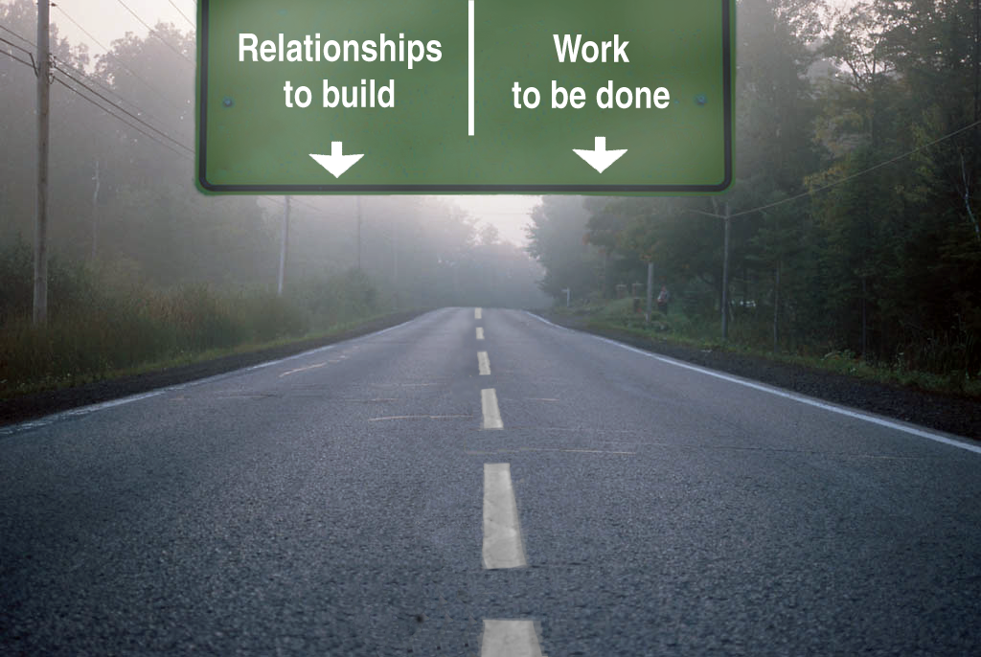

Slide 17
COLLECTIVE IMPACT
Systems are changed because individual organizations
change themselves.
Copyright © 2010, Karen Ray Associates.

Slide 18
Strategies
Informal or one-time partnerships
Barter or trade resources
Formal agreements for joint purchases
Co-location or co-programming
Collaboration
Consolidation


Slide 19
“We are caught in an inescapable network of mutuality, tied in a single garment of destiny. Whatever affects one directly, affects all indirectly.”
− Martin Luther King Jr.

Slide 20

The Nimble Collaboration

Slide 21
Strategies
 Results
 Relationships
 Resiliency

Slide 22
Results
 What is happening?
 Why is it important?
 Who are you telling?

Slide 23
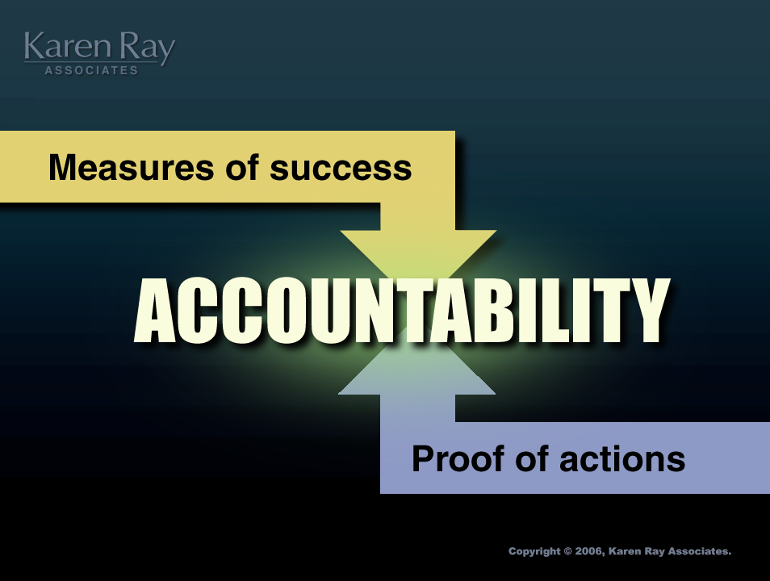

Slide 24
Systems are changed because individual organizations change themselves.

Slide 25
Relationships
 Equity (not equality or power)
 Self-interest
 Trust and conflict

Slide 26
Collaborations are not permanent; relationships are.

Slide 27
The prime mover . . .
“Self-interest is the prime mover of people.”
− Saul Alinsky

Slide 28
Not good or bad . . .
Self-interest is not to be denied; it is only to be acknowledged.

Slide 29
Separate, self-interest . . .
“God protect me from self-interest masquerading as moral principle.”
− Mark Twain

Slide 30
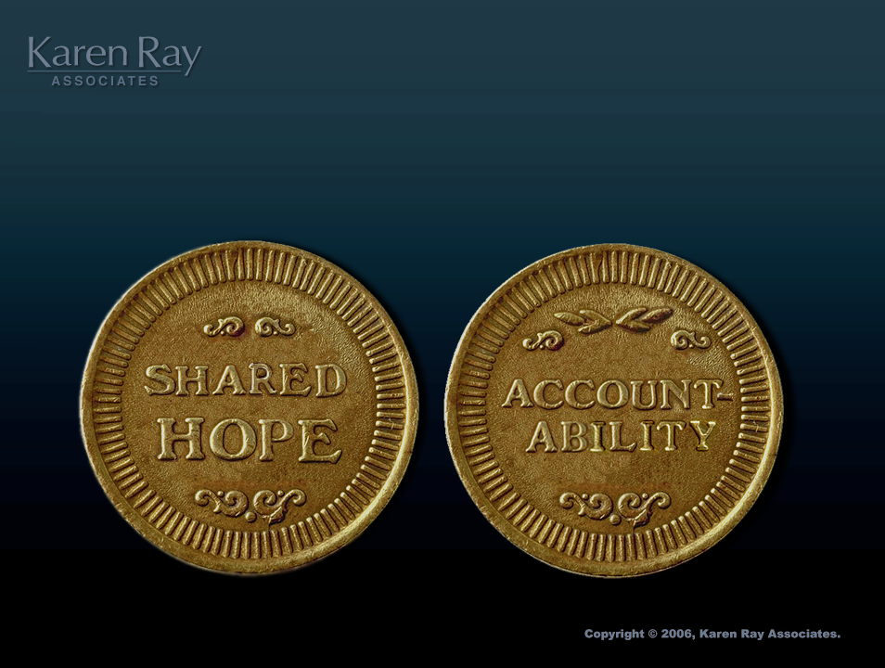
Definition of trust

Slide 31
Definition of trust

Slide 32
Strategies
 Results
 Relationships
 Resiliency

Slide 33
Resilience
What do we do when the
funding runs out?

Slide 34
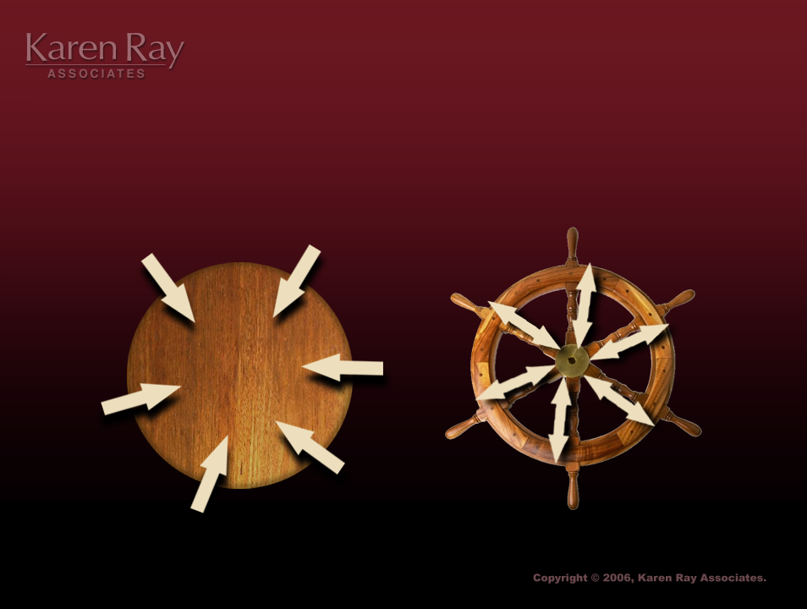
Bring people together

Slide 35
STRUCTURE
Leader To Leader
Manager To Manager
Staff to Staff

Slide 36
RELY ON A CHARTER
Process = Trust Builder
Product = Document to Share

Slide 37
Find common interests to create common solutions. We cannot sell others on our existing answers.

Slide 38

The feet are in
agreement.
− an African proverb

Slide 39
Results
Mutual institutional renewal

Slide 40
A definition for the new millennium . . .
Collaboration is the mechanism from mutual institutional renewal.

Slide 41
The Nimble Collaboration

Slide 42
Stages of Collaboration
STAGE 1
Envision What the Collaboration Can Achieve
Challenges: Work with an Initiator
Invite Participation by Organizations
Actively Choose Collaboration
Envision the Destination

Slide 43
Stages of Collaboration
STAGE 2
Ensure the Collaboration Gets Results
Challenges: Organize the Core Collaboration Work Group
Focus on Work
Settle on Structure and Governance
Prepare for Evaluation
Resolve Conflict

Slide 44
Stages of Collaboration
STAGE 3
Empower the Collaboration to Complete the Work
Challenges: Manage the Work
Invest in Change
Rejuvenate the Effort

Slide 45
Stages of Collaboration
STAGE 4
Endow a Broader Community with the
Power to Collaborate
Challenges: Create Visibility
Involve the Community
End the Collaboration

Slide 46
Definition
Collaboration is a mutually beneficial and well-defined relationship entered into by two or more organizations to achieve common goals they are more likely to achieve together than alone.

Slide 47
WHAT IS EFFECTIVE?

Slide 48
Today
Is there an existing partnership trying to do this work?

Slide 49
Response Team

Slide 50
“When you’re thinking about cost all the time, you’re thinking about the least cost.”
− Steve Rothschild

Slide 51
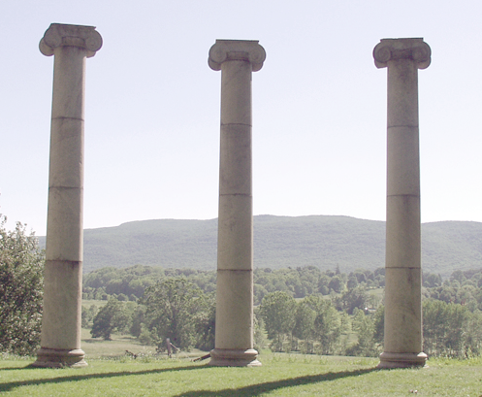
The promise
Service
gaps
Unmet
needs
Complex
issues

