Slide 1



Slide 2
Digital Inclusion Building Blocks
Brief history of PCs for People
The digitally distant
What we do
How we do it

Slide 3
A Brief History
1998: Founded in Mankato
2007: 305 computers distributed
2008: Incorporation, 501(C)(3); 1000 family waiting list!
2010: Working with Blandin Foundation and Rural Minnesota; Started working with United Way; Waiting list eliminated!
2011: Affiliate program launched
2012: Mobile computer refurbishing and internet offered
2013: Averaged 25 internet subscribers and 33 computers per day; Tripled staff

Slide 4
The Digitally Distant
Three of the strongest factors associated with home broadband adoption are:
  Age
  Education
  Household income

Slide 5
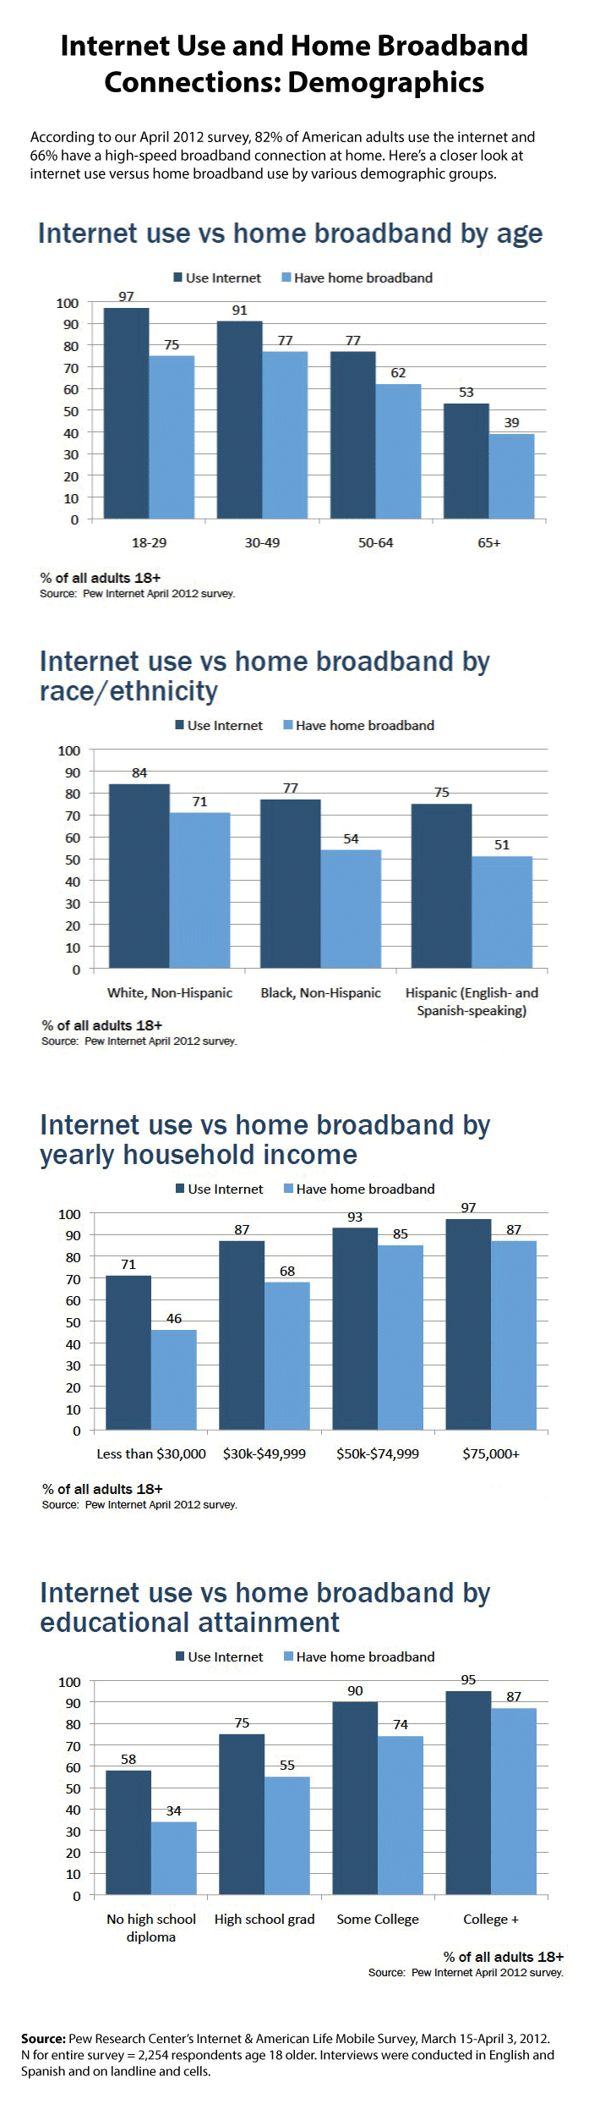

Slide 9
Our Recipients
“You gave us a chance to join the world.”
- Esete, Apple Valley, MN
“I needed a computer because I was going back to school… now I’m getting my Associate Degree in medical billing and coding.”
– Tonja, Crystal, MN
“[The computer] has opened my world. I can pay my bills, meet new people through Facebook, and keep in touch with friends. I am disabled so I can use my computer for my ‘legs’ and go wherever and whenever I want.”
- Trayce, Coon Rapids, MN

Slide 10


What we do - Computer Recycling
Organizations
85% of “donations”
Free pickup
Data sanitization
Individuals
15% of donations
Tax deductible
Help their community

Slide 11

What we do - Refurbishing Computers
Microsoft Registered Refurbisher
  Operating System: Windows 7 new license
  Office Productivity: OpenOffice
  Antivirus: Microsoft Security Essentials, Malwarebytes, CCleaner
  Web: Adobe Reader, Flash, Mozilla Firefox
  Media: 7-Zip, Picasa, VLC Media Player, K-lite Codecs
Work done by employees, volunteers, and interns

Slide 12
What we do - Computer Repair
All eligible recipients can have computer repaired
Repairs cost $25
2,023 computers repaired in 2013

Slide 13


What we do - Internet Sales
Currently available only in Twin Cities
Recipient purchases device ($50-$60)
Pay as you go ($10-$13/month)
6,368 subscribers in 2013

Slide 14
Recipient Eligibility
Computers are distributed to people:
  On government assistance or 150% of the poverty level
  Have a documented disability and live in an area with limited access to technology
To receive a computer, recipients must provide:
  Proof of eligibility
  A photo ID
  An optional cash donation

Slide 15
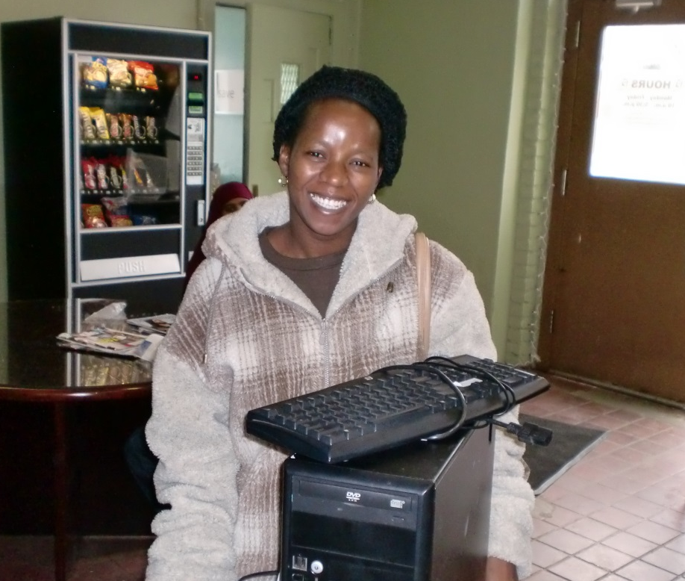
Store Front
PCs for People’s St. Paul office does the majority of the organization’s work.
1481 Marshall Ave in St Paul
Open Monday-Friday 10am-5:30pm
Employs 11 full-time staff
Sells miscellaneous computer accessories

Slide 16
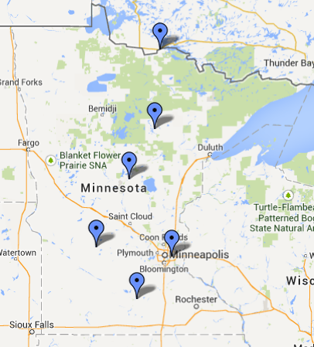
Affiliate Offices
PCs for People provides an organization with the technology and best practices to refurbish computers on their own.
Partners can be private or public organizations
First year costs typically around $5,000
Annual cost typically $2,500

Slide 17
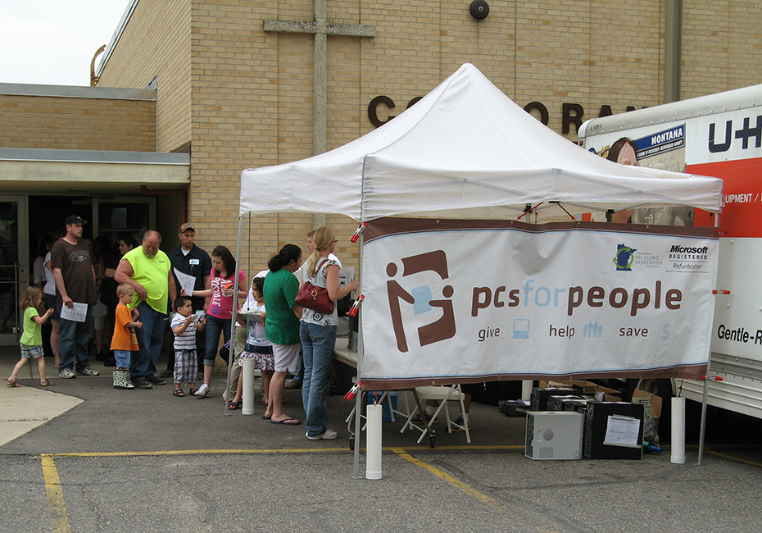
Distribution Events
PCs for People delivers computers to a community for distribution to eligible recipients.
50-100 computer systems
Partner organizations are typically more responsible for finding recipients

Slide 18
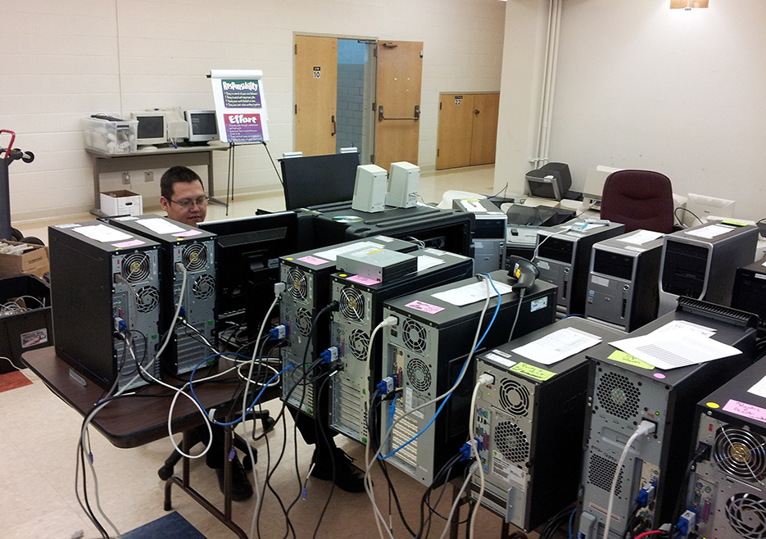
Mobile Events
PCs for People travels to a community sources, refurbishes, and distributes the computers.
75-300 computers
Staff coordinate all aspects of the event
Staff on site for three days

Slide 19
Questions?
www.pcsforpeople.org
Sam Drong
  Email: sdrong@pcsforpeople.org
  Office: (651) 354-2552
  Mobile: (612) 424-3918
  LinkedIn: SamDrong

