Slide 1
The Return from Investment in Broadband Infrastructure and Utilization Initiatives
Insights from the 2014 SNG White Paper
Border to Border Broadband: A Call to Action
February 5, 2014
Saint Paul, Minnesota

Slide 2














Making Broadband Work and Proving it
WE ARE a global leader in broadband planning for socio-economic development
WE PROVIDE data and insights to increase
broadband utilization and impacts
WE DELIVER strategies for economic development
and community transformation through broadband
Some of our clients:

Slide 3
Let’s Start With What We Know…
There is a relationship between broadband and economic development.
SNG research in the U.S shows…
  56% of businesses and organizations said broadband is essential for remaining in current location
  56% of households said they would definitely/likely relocate if broadband was not available
  32% of households work from home or have a home-based business
Source: SNG Digital Economy Database n = 19,951 businesses and 9,318 households

Slide 4
…and Broadband Means Jobs
Broadband is responsible for 23.4% of all new jobs
  Percent of New Jobs
  Related to Internet
  By Size of Employer Group
Small businesses create 12x more Internet jobs relative to large firms
Source: SNG Digital Economy Database n = 6,177

Slide 5
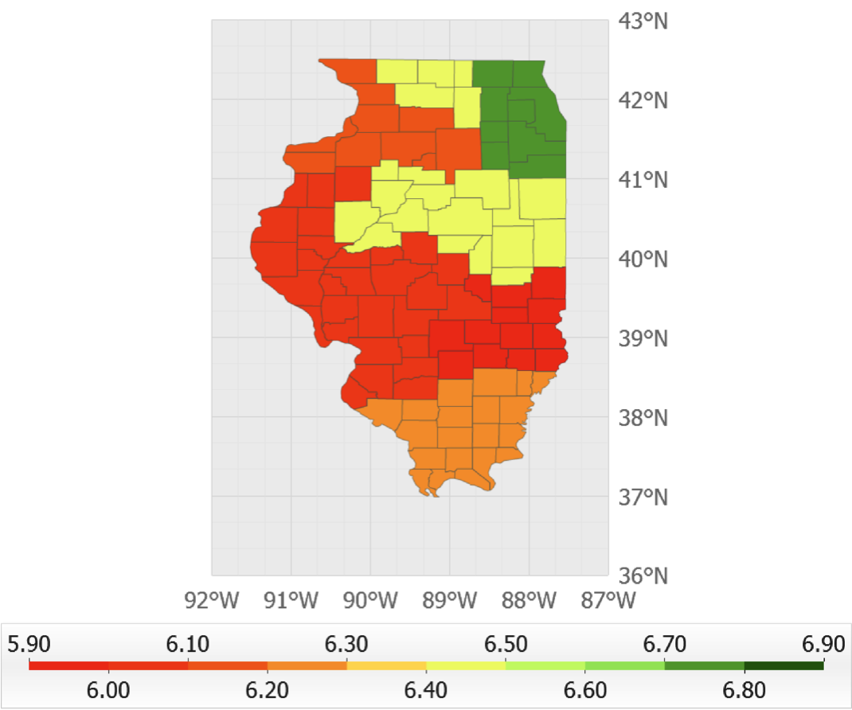
SNG Broadband Research in Illinois
Study was conducted in 2012 statewide
Collected broadband metrics from over:
  4,329 commercial businesses
  2,896 community anchor institutions
  2,058 households
Provided actionable insights
on broadband
utilization and impacts in Illinois
Average DEi score by region
Source: SNG Digital Economy Database for Illinois n = 7,225

Slide 6
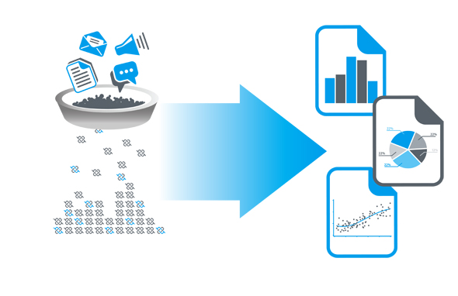
Our Broadband Research Methodology
Data collection from thousands of local businesses, organizations and households
110 advanced broadband metrics are collected from each respondent
  17 broadband utilization categories for businesses and 30 categories for households
  Quantified broadband impacts on revenues, cost savings, and job creation
  Focus on industry sectors, community anchor institutions, etc.
  Benefits and barriers, skills, awareness, telework, home business, etc.

Slide 7

SNG Put Data into Action
Data analysis leading to statewide, regional and business individual assessments
Personalized strategic action to improve broadband utilization
Understand the local market demand for broadband
Assess potential socio-economic impacts (community ROI)
Develop an action plan for regions and
individual businesses/organizations
that will achieve desired results

Slide 8
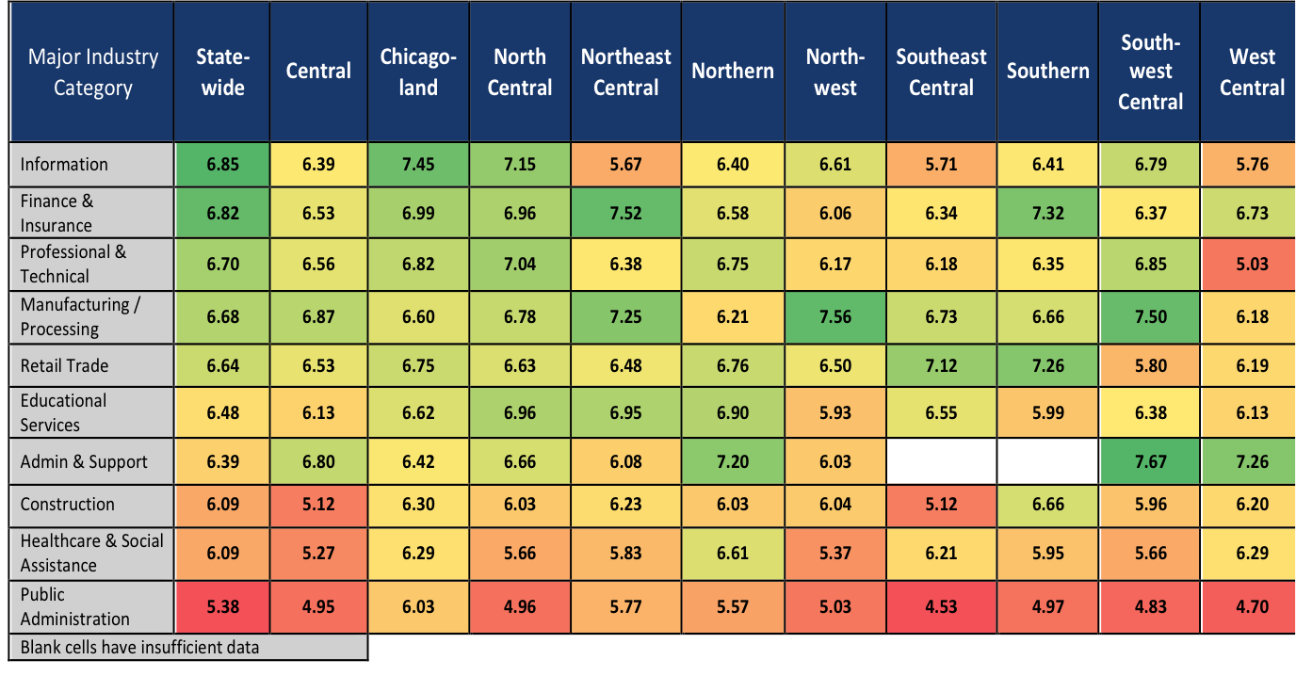
Illinois: Utilization by Region and Industry
Cross referencing data enables to develop customized strategies
Based on Average DEi Score - Source: SNG Digital Economy Database for Illinois n = 7,225

Slide 9
Illinois: Planning Utilization Increase

Slide 10
Digital Divide Showed in Real Numbers
Based on Average DEi Score - Source: SNG Digital Economy Database for Illinois n = 2,125

Slide 11

2014 White Paper for Blandin Foundation
Used our proprietary database on broadband impacts to study
the ROI in Broadband Infrastructure and Utilization Initiatives
Focus on 2 areas:
  Lac qui Parle County, 100% broadband coverage
  Kanabec County, only 27% broadband coverage
Inside these areas, the paper focuses on three industry sectors
  Manufacturing
  Professional and Technical Services
  Retail Trade
Notes:
These two regions are examined in terms of the direct economic impact of increasing broadband utilization to move the county from an average level of eSolutions (based on SNG research) to a higher level of eSolutions. In addition, the direct economic impacts are estimated for new utilization of broadband in Kanabec County by increasing broadband coverage to 100%.

Slide 12
Incremental Impacts for Lac qui Parle County
Incremental Revenues and Savings From New eSolutions – Lac qui Parle County
Industry | Total All Businesses | Incremental Revenue from new eSolutions | Incremental Cost Savings from new eSolutions | Total Incremental Impact
Manufacturing | 10 | $429,000 | $40,000 | $469,000
Professional & Technical Services | 9 | $66,000 | $2,000 | $68,000
Retail Trade | 38 | $725,000 | $34,000 | $760,000
TOTAL | 57 | $1,220,000 | $77,000 | $1,297,000
Notes:
Lac qui Parle has 100% broadband coverage so these economic impacts are based on increasing utilization of eSolutions by existing business broadband users. The investment needed to realize these impacts is estimated at $120,000 to $145,000 for driving broadband utilization with businesses in the targeted industry sectors.
Driving utilization for targeted businesses in Lac qui Parle County includes outreach and engagement with businesses, training and support, and coordination by local / regional economic development agencies. To be successful, this effort would need to be appropriately resourced and accompanied by an appropriate strategy to maximize benefits and accelerate the rate at which these benefits accrue.
As show, businesses in Lac qui Parle County could see new revenues of over $1.2 million and cost savings of over $77,000, for a combined impact of nearly $1.3 million.

Slide 13
Incremental Impacts for Kanabec County
Incremental Revenues and Savings From New eSolutions – Kanabec County
Industry | Total All Businesses | Incremental Revenue from new eSolutions | Incremental Cost Savings from new eSolutions | Total Incremental Impact
Manufacturing | 19 | $7,987,000 | $1,264,000 | $9,251,000
Professional & Technical Services | 18 | $1,404,000 | $100,000 | $1,504,000
Retail Trade | 45 | $8,840,000 | $802,000 | $9,642,000
TOTAL | 82 | $18,231,000 | $2,166,000 | $20,397,000
Notes:
As Kanabec County has only 27% broadband coverage, the projected impacts are based on:
Increased utilization of eSolutions by existing business broadband users
Utilization of eSolutions by new adopters of broadband (the other 73%)
The investment needed to realize these impacts is estimated at:
$11.3 million for fiber to the home (FTTH) infrastructure (or $7.3 million for fiber / wireless hybrid) to have 100% broadband coverage in Kanabec County
$175,000 to $225,000 for driving broadband utilization with businesses in the targeted industry sectors Source: Robust Broadband Network Feasibility Study - Bringing Robust Broadband Networks to Kanabec County, MN, 2012.
U-reka Broadband Consultants.
As with Lac qui Parle, driving utilization for targeted businesses in Kanabec County includes outreach and engagement with businesses, training and support, and coordination by local / regional economic development agencies, appropriately resourced.
As shown, businesses in Kanabec County could see new revenues of over $18 million and a cost savings of over $2.1 million for a combined impact of nearly $20.4 million.
The impacts for Kanabec County are much higher because the scenario as described includes increasing access by increasing broadband coverage from 27% to 100%, and then focusing on adoption of broadband service and utilization of eSolutions, whereas Lac qui Parle County was only looking at incremental impacts from increased utilization.
In other words, Lac qui Parle already has 100% broadband coverage, so the impacts are based on increasing utilization of eSolutions by existing business users. Kanabec County has 27% coverage, so the impacts are based on both:
Increasing utilization of eSolutions by existing business broadband users
Increasing utilization of eSolutions by new adopters of broadband
As a result, Kanabec County shows a much higher economic impact.

Slide 14
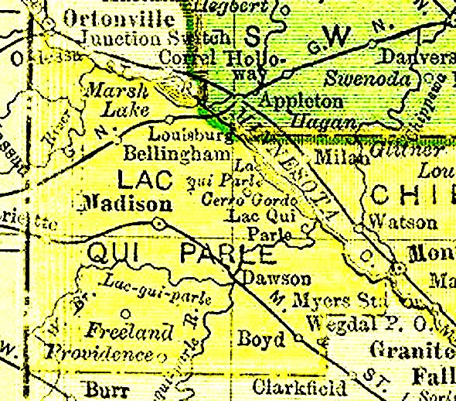
Projected Impacts for Lac qui Parle County
$1.3 million↑ in total incremental impacts
22 jobs created
$529,000 ↑ household income
Impact on GDP: $1.4 million ↑
$148,000 ↑ direct tax revenues

Slide 15
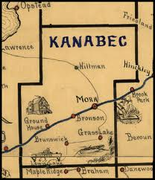
Projected Impacts for Kanabec County
$20.4 million ↑ in total incremental impacts
310 jobs created
$6.6 million ↑ household income
Impact on GDP: $21.6 million ↑
$2.3 million ↑ direct tax revenues

Slide 16
Increasing Broadband Utilization
Based on SNG research, the eSolutions below have the greatest impact for each sector.
Manufacturing | Professional & Technical Services | Retail Trade
Selling goods or services | Selling goods or services | Selling goods or services
Web site for organization | Web site for organization | Web site for organization
Advertising and promotion | Advertising and promotion | Customer service and support
Customer service and support | Customer service and support | Deliver services and content
Supplier communication and coordination | Teleworking | Social networking
Staff training and skills development | Deliver services and content | Staff training and skills development
Teleworking | Social networking | Accessing collaborative tools
Challenge: how to raise awareness and drive utilization of these esolutions?
Notes:
The seven eSolutions were selected for each industry based on the following criteria:
They represent the lowest current utilization levels and, therefore, the greatest opportunity for increasing utilization
They have high relevance to each industry
They provide a significant opportunity for impacting revenues and/or cost savings
While the top seven eSolutions are identified for each industry, it is not expected that every business will adopt all of these seven eSolutions. Not every business will recognize the need for each eSolution for their particular business (e.g. teleworking may be more applicable to some businesses than others) and from a practical standpoint, individual businesses may not have the capacity to take on new eSolutions. Therefore, the impact analysis assumes that no business will adopt more than three of the seven eSolutions initially, as a conservative estimate.
Based on the current utilization levels for each eSolution for each industry, the number of new eSolutions being used and number of businesses using new eSolutions are estimated based on a 20% increase in utilization by those not currently using each eSolution. In other words, one in five businesses not currently using each eSolution will start to use eSolutions to increase their productivity and competitiveness.
The above criteria should be incorporated for an effective broadband investment initiative, which includes investment in infrastructure (reliable connectivity is clearly a necessary condition), as well as programs to educate, raise awareness, and encourage adoption and utilization of eSolutions among businesses.
A 20% participation rate in a program (i.e. one in five businesses approached participate) to drive broadband utilization is conservative, but realistic.

Slide 17
The Field of Dreams
Technology is not enough

Slide 18
With BB Coverage, is the job done?
The situation in North Georgia
Government investment of $43 million in 2009 to support FTTH network
Needed for local economic development in rural region north of Atlanta
BUT
18% had taken up the service by Q2 2012
Network not sustainable by November 2012 – need closer to 30% take-up
  Hired SNG to raise awareness and drive utilization with customers
“Traditional marketing to customers wasn’t going
to get our network to sustainability.”
Bruce Abraham, President, North Georgia Network

Slide 19
Broadband …
Availability
Adoption
Utilization

Slide 20
Take a Comprehensive Look at Broadband
In the Broadband equation,
the quality of each input affects the outcome
Lagging Technology
Utilization
Average
Technology
Low Utilization
Poor
Technology
Utilization
BENEFITS

Slide 21
Why we Build Broadband Networks
Operators
Revenues from network subscriptions
Investment, operations & maintenance costs
= PROFIT
Local Economy
Increased productivity and competitiveness,
increased revenues, new jobs,
better quality of life, etc.
Investment, utilization programs and support
= BENEFITS FOR THE COMMUNITY
“Off- balance-sheet”
Notes:
Investing in broadband is all about increasing productivity and improving quality of life.
Investing in broadband requires demonstrating a positive community ROI.
Productivity, transformation, innovation.
SNG’s data details how broadband increases productivity, whether for governments, businesses, or households.

Slide 22
Adoption and Utilization Is Key
How SNG Helps Drive Utilization

Slide 23
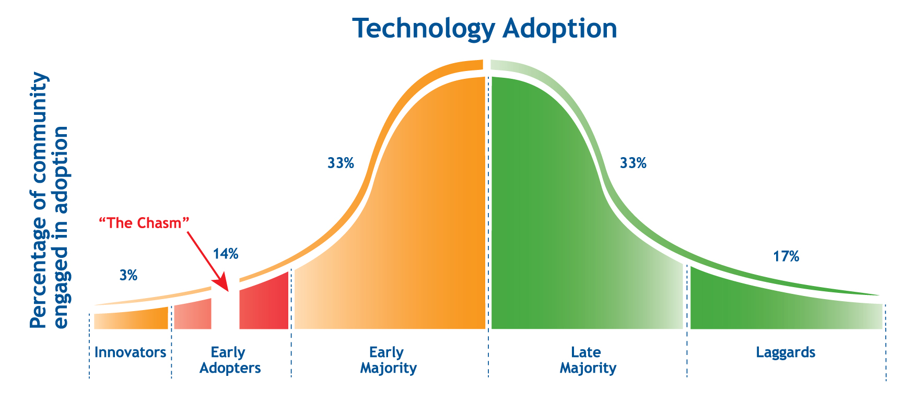
“Crossing the Chasm”
Why “build-it and they will come” does not work?
→ Because people buy benefits, not features
… so driving awareness and utilization is the next challenge
For further information, see “No Field of Dreams: Eliminating the Waiting Game and Driving Uptake”

Slide 24
Impact of Driving Utilization
Network operators are typically*
not sustainable with a “build it and they will come approach”
 | Laissez-faire (A) | Driving Utilization (B)
Year One | 10% uptake | 12% uptake
Year Three | 18% uptake | 35% uptake
Internal Rate of Return (IRR) at year 3 | 5% | 24%
* Financial profile of typical fiber network build. Source: Ventura Team LLP, www.venturateam.com

Slide 25
The Biggest Barrier is Not Knowing
Fear of the unknown overrules slow Internet as a barrier
Source: SNG Digital Economy Database

Slide 26
Active, Actionable Data Is the Key to Capitalizing on the Transformative Economic Benefits of Broadband
The right metrics and data help you:
Understand the local market demand for broadband
Assess potential socio-economic impacts (community ROI)
Develop an action plan for regions and individual businesses/organizations that will achieve desired results

Slide 27
What is important to measure for driving adoption?
The SNG Data Collection Process

Slide 28
What are Broadband Metrics?
Census Data - good to have | Active broadband metrics - need to have
Type of connection | Measure broadband speed vs. advertised speed
Broadband speed | Broadband satisfaction by end-users
Material resources | Utilization of Internet enabled tools and processes
 | Benefits from broadband on daily operations
 | Barriers to adopt broadband and to use Internet enabled tools and processes
 | Quantified impacts from broadband on revenues, cost savings
 | Quantified impacts on job creation
 | Skills needed and preferred method of acquisitions
 | Digital Economy index scoring at an individual level - industry sector level, regional level, etc.
 | Special use and daily benefits metrics for Community anchors institutions
 | Industry sector focus studies, comparison and benchmarking
 | Regional focus studies and comparison

Slide 29

Need metrics to know… …. where are we now?
… and how much closer are we to our goal?

Slide 30
So What Should You Measure?
Utilization
How businesses, organizations, and households are currently using, or planning to use broadband and e-solutions.
Gaps and Barriers
Where the gaps in the utilization of e-solutions are and which factors inhibit, or prevent adoption.
Drivers and Needs
Understanding the needs and preferences of end-users in order to raise awareness, to increase adoption, and to drive effective utilization.
Benefits
How things have improved and which e-solutions have benefitted businesses, organizations, and households.
Impacts
Quantify benefits in terms of new revenues, cost efficiencies, new jobs, quality of life, etc.
Profile Data
Internet connection type, tested speed, length of time using broadband, organization size, industry sector classification, demographics, etc.

Slide 31
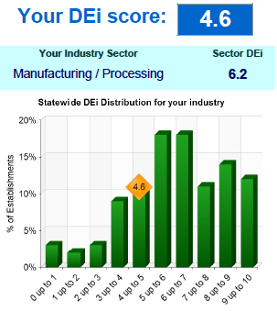

How SNG Measures Utilization
We uncover Internet use at a micro-level
and benchmark against peers
17 e-solutions¹ by businesses / organizations
30 e-solutions¹ by households
Utilization data collected² by SNG directly
from 27,150 businesses / organizations
And 12,400 households.
SNG has normative database with deep insights on
Internet usage and impacts – over 110 metrics for each record.
Results shown use SNG’s Digital Economy index (DEi), a composite score
between 1 and 10 to reflect level of Internet utilization.
1. Internet-enabled applications and processes; 2. Between 2008-2013

Slide 32
What’s so hard about utilization?
Quick to Adopt ‘Laissez-faire’ approach “Okay” |  | Slow to Adopt Need to ‘lead horse to water’
Business Applications |  | Business Applications
Buying Online |  | Selling Online
Basic Website |  | Online media (video)
Research and accessing information |  | Teleworking
e-mail |  | Delivering Content and Services
Document transfer |  | Social Networking
Household Applications |  | Household Applications
e-mail |  | Entertainment
Banking |  | Investments and Trading
News and Sports |  | VoIP
Information gathering |  | Home Based Business
BIGGEST
BENEFITS

Slide 33
Identify Broadband Impacts
Benefits from the Digital Economy

Slide 34
Increased Utilization Directly
Correlates to Revenue Growth
Businesses underutilizing the Internet miss significant revenue opportunities

Slide 35

Why Drive Utilization?
For an individual business or organization, increasing utilization by 10% means:
Increasing revenues by 24%
Decreasing costs by 7%
For a Region, it means :
Allowing businesses to be more competitive
Creating a demand for high-skilled workers
Adding fiscal revenues
Average multipliers identified by SNG from over 12,000 data records collected in 2009-10.
Notes:
Way too busy
35

Slide 36
Motivating Business Broadband Utilization
Tools for Economic Development

Slide 37
Helping Businesses Take Action
Take stock
How is the business using esolutions?
Measure current uses and benefits
Create greater awareness
Business Assessment Survey
Review options
Where are gaps and opportunities ?
Motivation
Compare to peers
Reveal financial benefits
DEi Scorecard
Evaluate benefits
What guidance does the business need?
Engage and advise
Run financial impact scenarios
Choose esolution priorities
Financial Impact Calculator
Take action
How will businesses take action?
Learning resources
Choose the right tactics
Develop a plan
e-Business Tactics

Slide 38

SNG Recommendations for Minnesota
There is an economic case for investing in broadband
To promote broadband investment, increase coverage and drive utilization you need to:
Engage local stakeholders to “own the process”
Collect and use meaningful, actionable broadband data
Illustrate local examples of broadband impacts
Notes:
Engage local stakeholders to “own the process” of driving economic development through broadband utilization
Collect meaningful, actionable broadband data through the proper utilization metrics and indicators (not just coverage) to measure current status and track progress towards goals
Provide case studies that illustrate local examples of broadband impacts

Slide 39
Thank You
Michael Curri, President
Strategic Networks Group, Inc.
+1 202.558.2128
mcurri@sngroup.com
Let’s connect !
www.sngroup.com

Slide 40
Industry Sector Profiles
Sector | Number of establishments (fewer than 250 employees)
 | Minnesota | Lac qui Parle | Kanabec
Manufacturing | 7,071 | 10 | 19
Professional & Technical Services | 16,375 | 9 | 18
Retail Trade | 19,287 | 38 | 45
Both Lac qui Parle and Kanabec counties are rural and relatively small in terms of total business establishments (191 and 295, respectively) and total employment (1,945 and 3,188, respectively).
Notes:
For purposes of this white paper, the economic impact analysis focuses on business establishments with fewer than 250 employees. The reasons for focusing on this size of business are:
Small and Medium Enterprises (SMEs) form the majority of businesses, especially in non-urban areas (99% statewide in Minnesota)
SMEs are a primary engine for job growth and provide the greatest opportunity for increasing utilization of eSolutions
SMEs, especially small enterprises, are fertile ground for influencing utilization of eSolutions for productivity and competitiveness

Slide 41
Total Incremental Impacts – Lac qui Parle
Incremental Impact From New eSolutions – Lac qui Parle County
Sector | Household Income | Total Employment | Total GDP | Total Tax
Manufacturing | $106,000 | 4 | $386,000 | $46,000
Professional & Technical Services | $25,000 | 1 | $90,000 | $11,000
Retail Trade | $398,000 | 16 | $950,000 | $91,000
TOTAL | $529,000 | 22 | $1,426,000 | $148,000
Notes:
The foundation for this is not a custom input/output analysis, rather it is an illustrative assessment of the potential direct, indirect, and induced impacts based on past SNG research. The statistics identify the following economic impacts:
Employment – The impact on employment, measured in person years,
Household Income – The impact on wages associated with the person years of employment.
Gross Domestic Product (GDP) – Changes in GDP at market prices.
Tax Effects – Changes in local, state, and federal tax revenues resulting from the increased economic activity.
Direct impacts from increased utilization of eSolutions result in the following economic total impacts:
Within the Lac qui Parle County, the combined impacts generate nearly $530,000 in household income, create or help sustain 22 positions, $1.4 million in GDP, and almost $150,000 in tax revenues, annually – which is greater than the one-time public investment cost of $120,000 to $145,000 to drive broadband utilization.
A person year is equal to 2,000 hours and defined as a full-time equivalent position (FTE). FTEs are calculated on the basis of annual per capita salaries, by county.
Within Kanabec County, the combined impacts generate just over $6.6 million in household income, create or help sustain over 310 positions, contribute $21.6 million in GDP, and generate over $2.3 million in tax revenues, annually – which is greater than the one-time public investment cost of $175,000 to $225,000 to drive broadband utilization.

Slide 42
Total Incremental Impacts – Kanabec
Incremental Impact From New eSolutions – Kanabec County
Sector | Household Income | Total Employment | Total GDP | Total Tax
Manufacturing | $1,784,000 | 84 | $7,618,000 | $914,000
Professional & Technical Services | $479,000 | 22 | $1,976,000 | $252,000
Retail Trade | $4,342,000 | 204 | $12,050,000 | $1,153,000
TOTAL | $6,605,000 | 310 | $21,644,000 | $2,319,000
Notes:
The foundation for this is not a custom input/output analysis, rather it is an illustrative assessment of the potential direct, indirect, and induced impacts based on past SNG research. The statistics identify the following economic impacts:
Employment – The impact on employment, measured in person years,
Household Income – The impact on wages associated with the person years of employment.
Gross Domestic Product (GDP) – Changes in GDP at market prices.
Tax Effects – Changes in local, state, and federal tax revenues resulting from the increased economic activity.
Direct impacts from increased utilization of eSolutions result in the following economic total impacts:
Within the Lac qui Parle County, the combined impacts generate nearly $530,000 in household income, create or help sustain 22 positions, $1.4 million in GDP, and almost $150,000 in tax revenues, annually – which is greater than the one-time public investment cost of $120,000 to $145,000 to drive broadband utilization.
A person year is equal to 2,000 hours and defined as a full-time equivalent position (FTE). FTEs are calculated on the basis of annual per capita salaries, by county.
Within Kanabec County, the combined impacts generate just over $6.6 million in household income, create or help sustain over 310 positions, contribute $21.6 million in GDP, and generate over $2.3 million in tax revenues, annually – which is greater than the one-time public investment cost of $175,000 to $225,000 to drive broadband utilization.

Slide 43
Personalize Results: DEi Scorecard
A DEi Scorecard is delivered to each business and organization
Individualized ‘broadband health check’ that:
  benchmarks competitiveness against peers
  estimates ROI from increased utilization
  provides links to local advisors and support
Data based on the individual’s current broadband utilization against industry average
Shared with local economic development agencies so they can raise awareness, increase adoption, and drive utilization

Slide 44
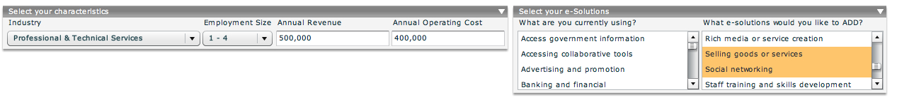
DEi Impact Calculator
- choose e-strategy based on ROI -
1. Select your organization characteristics
2. Select your actual and needed e-Solutions
Source: SNG Digital Economy Database n = 27,200

Slide 45
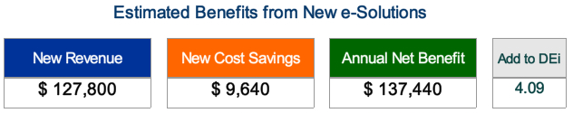
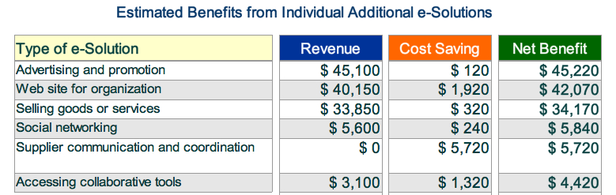
DEi Impact Calculator
- choose e-strategy based on ROI -
3. See your potential benefits from increased utilization
4. Details of potential revenues and cost savings
Source: SNG Digital Economy Database n = 27,200

