Slide 1

Technology Education for Refugees and Immigrants
2011-2013

Slide 2

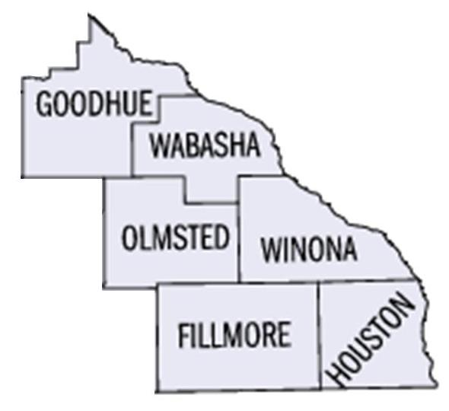
Mission:
To strengthen and enrich our community by facilitating the integration of people who are ethnically diverse.
Geographic Area Served:

Slide 3
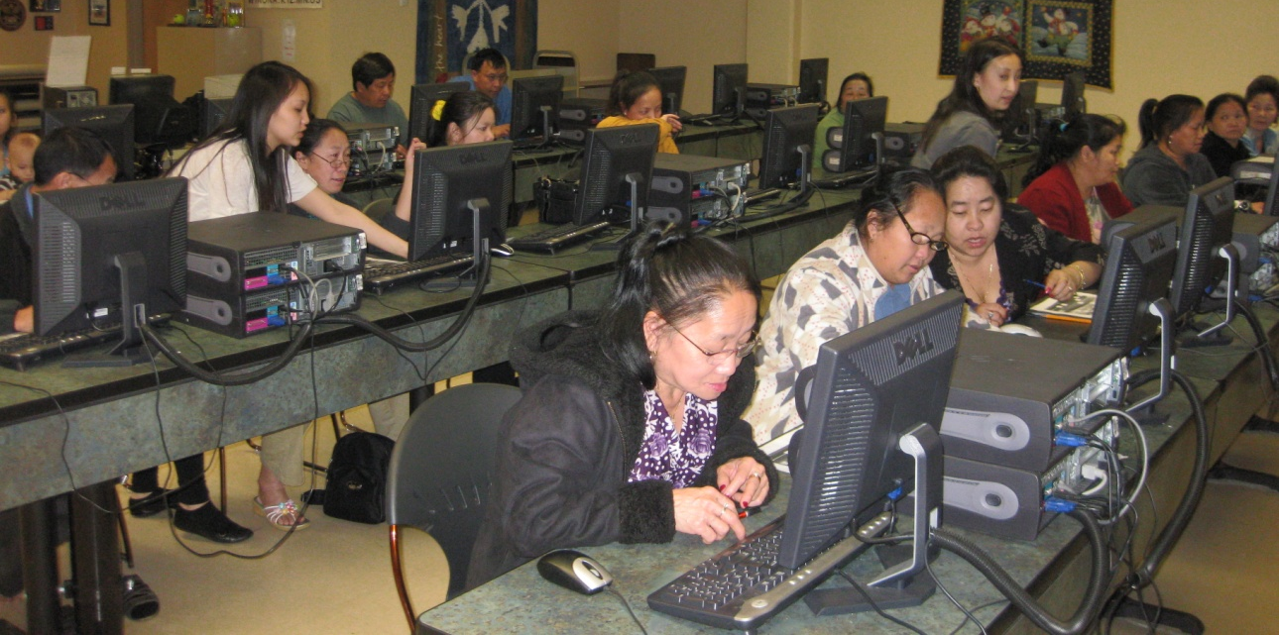
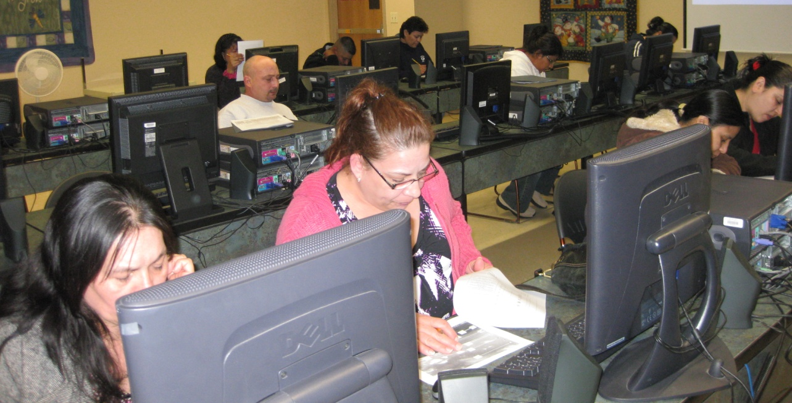

Slide 4
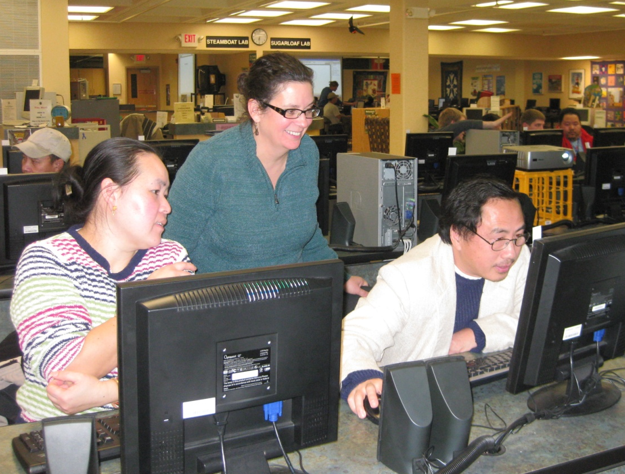
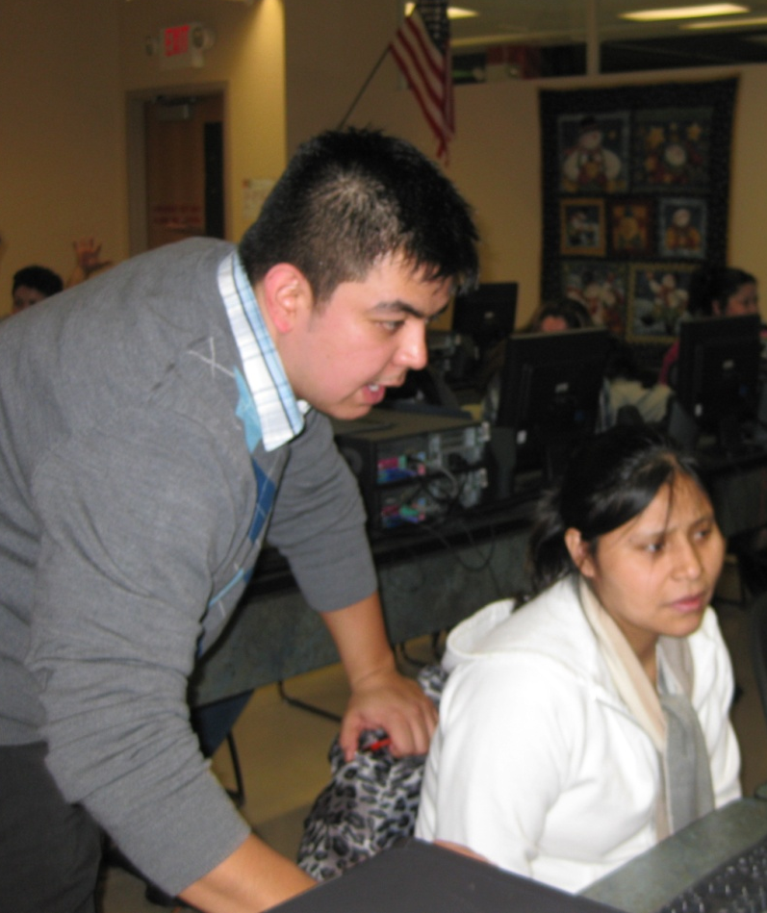
“They have a lot of patience with us.”
~ Maria Castro
“They do a good job of explaining the computers and programs.”
~ Anonymous

Slide 5
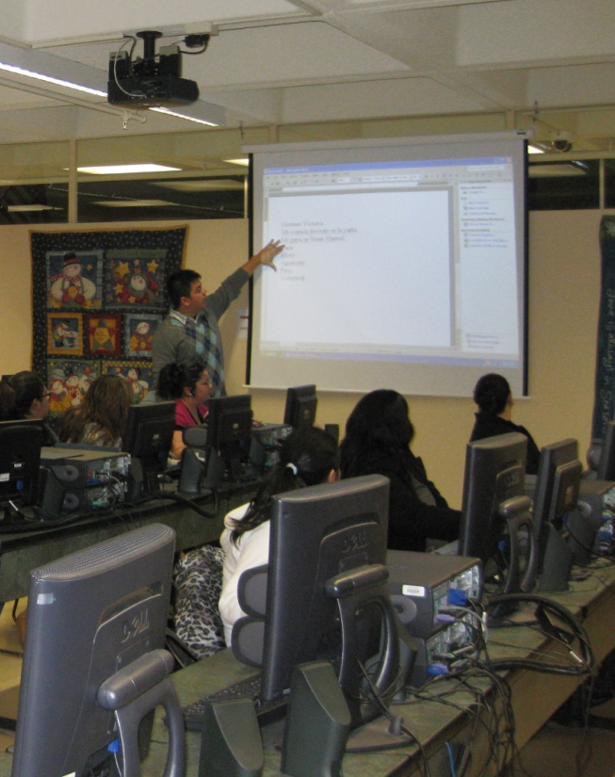
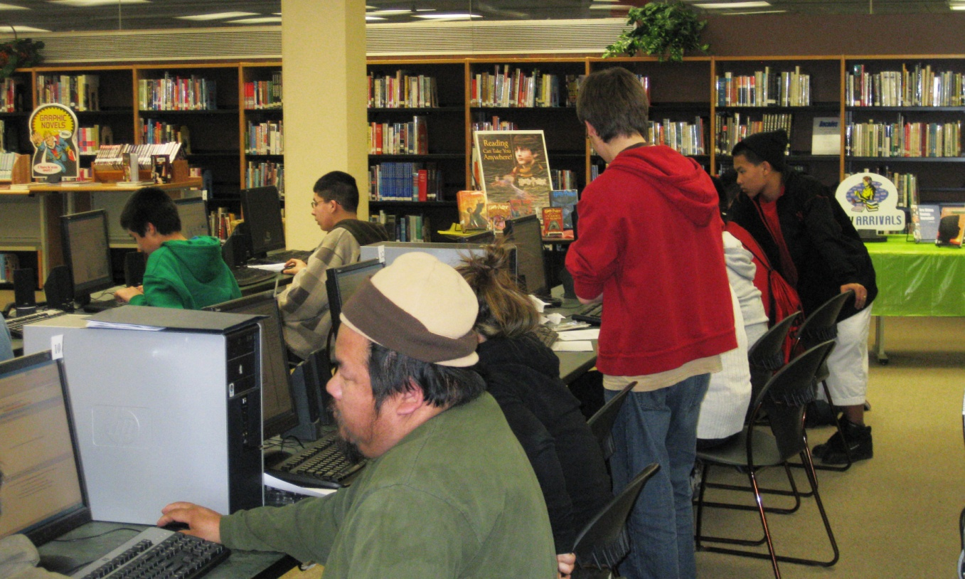
“I am thankful for the class. I have nothing but positive things to say about Project FINE. I was able to get my Drivers License and employment through them. I’m not sure where to get the services if there is no Project FINE. I am so thankful to them.”
~ Cha Lee

Slide 6
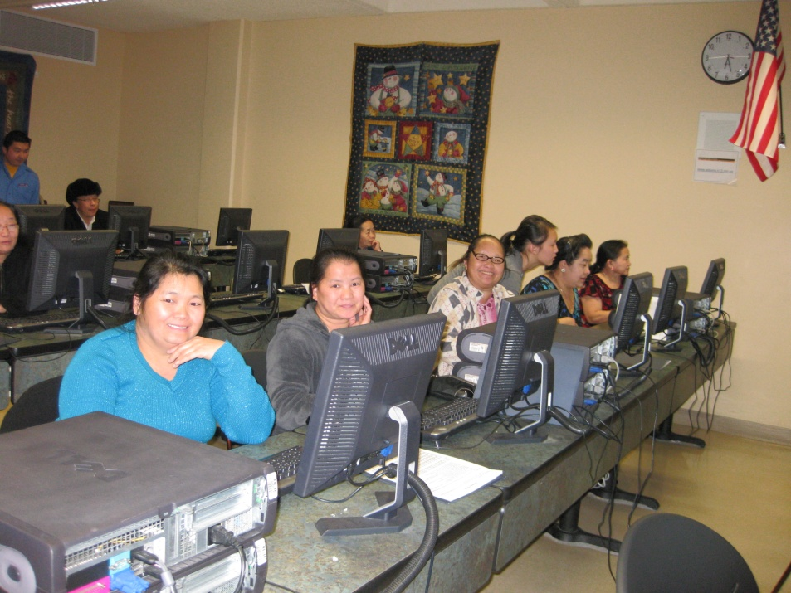
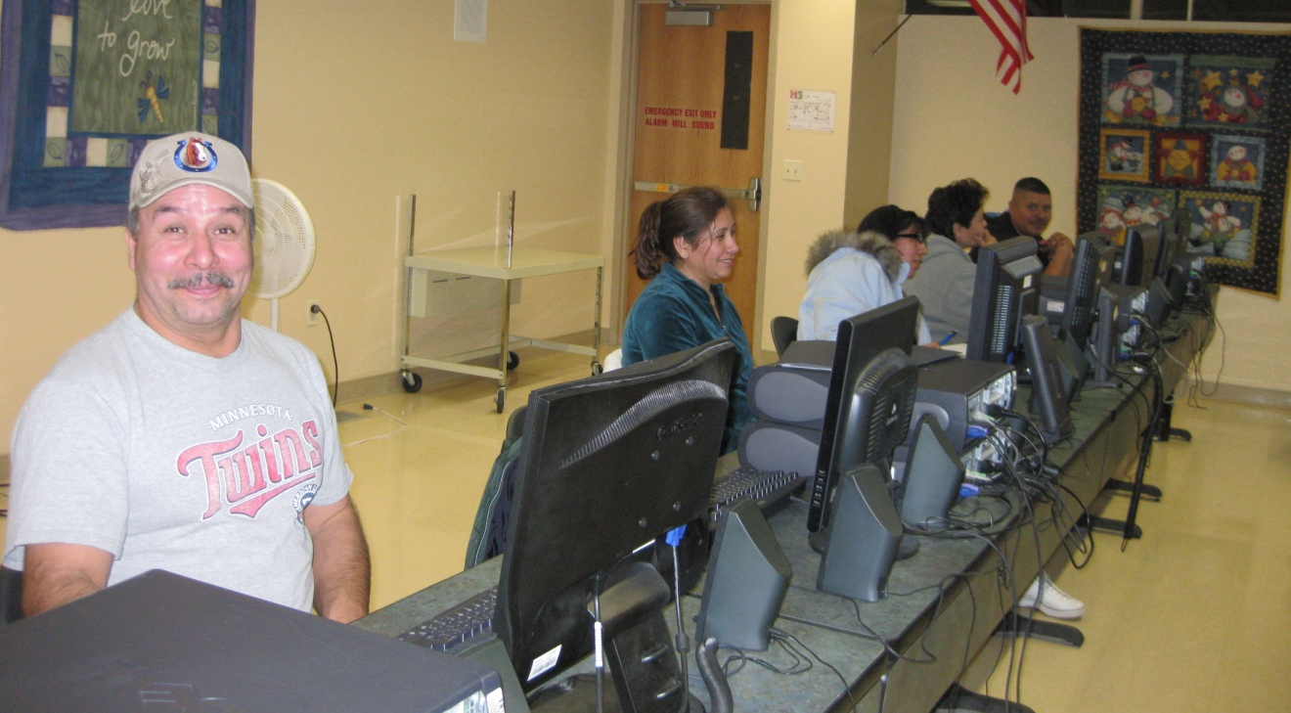
“Coming to the computer sessions has helped me learn a lot about computers. I know that sometimes it’s hard for me to understand, but Project FINE staff have been very helpful with this program.”
~ Khoua Yang

Slide 7
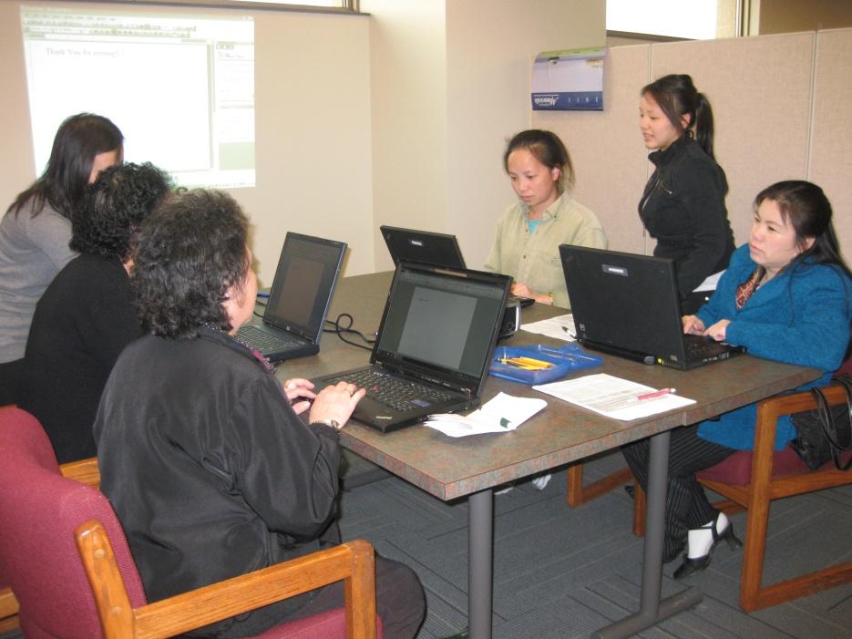
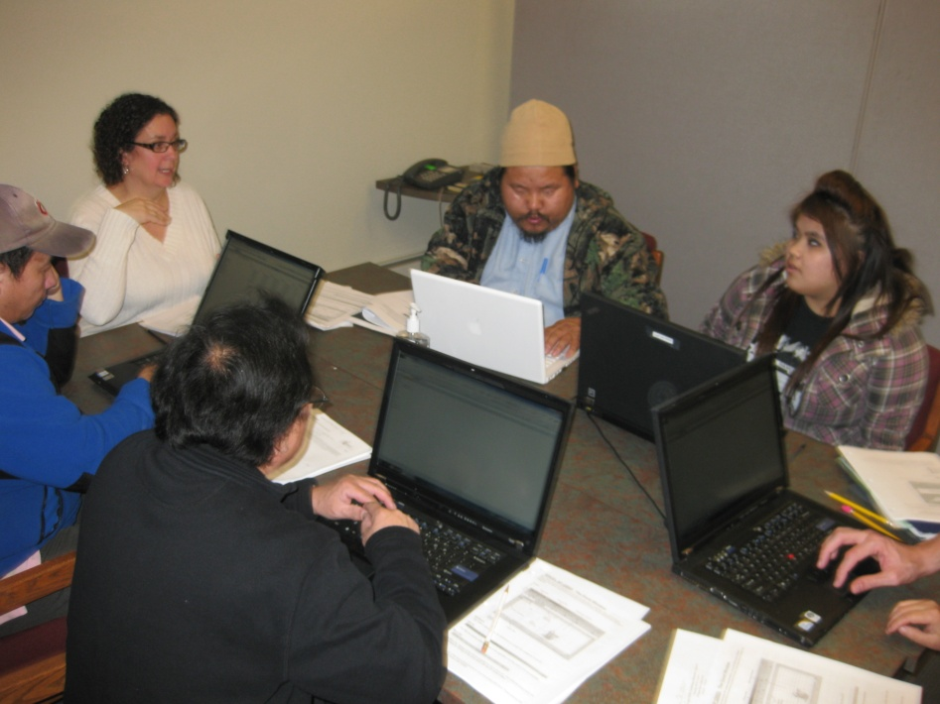
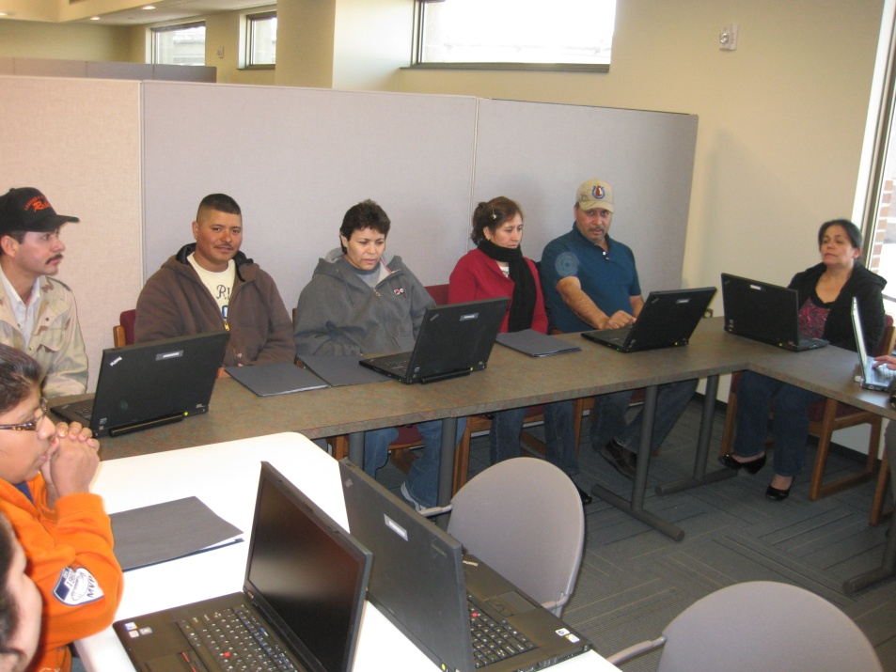
“We learned how to use a laptop.”
~ Juana Martinez
“I am learning to send e-mail.”
~ Anonymous

Slide 8
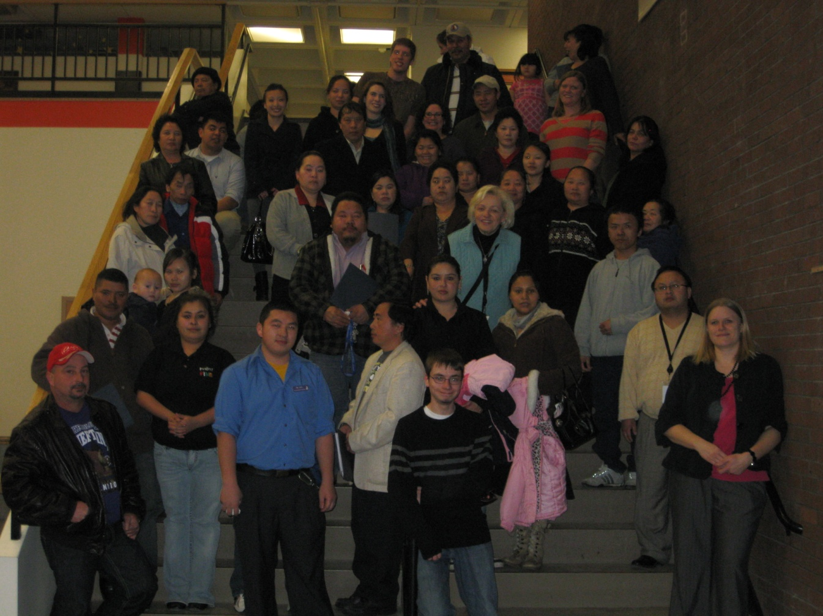
“This computer program helps us a lot. We learn many new things that will help us in the future when we are using the computers given to us. I’m so grateful for the help of Project FINE in expanding our knowledge and by giving us better opportunities in the world. We will support this organization.”
~ Sai Her

Slide 9
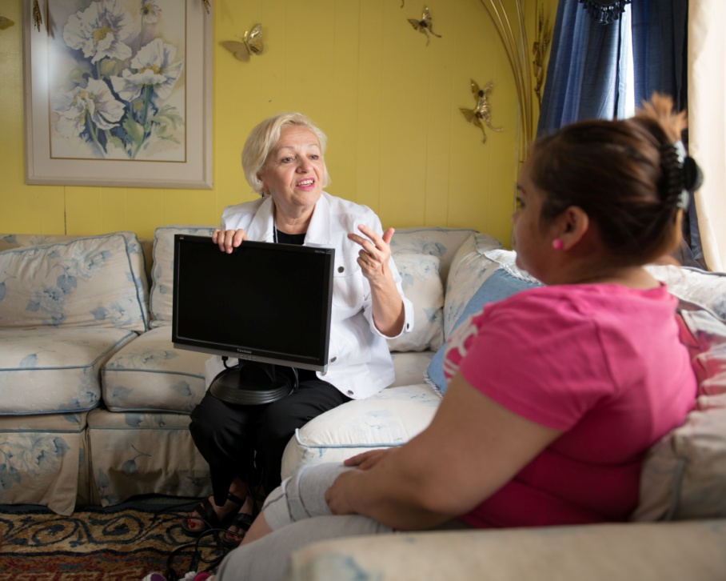
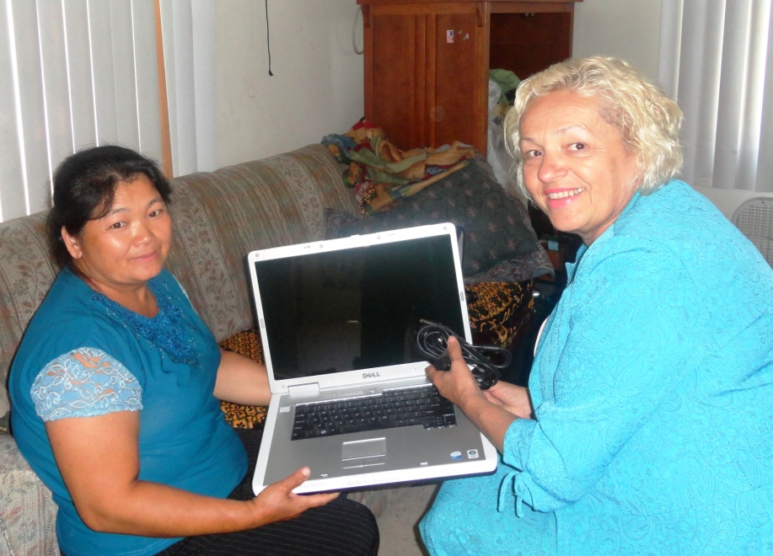

Slide 10
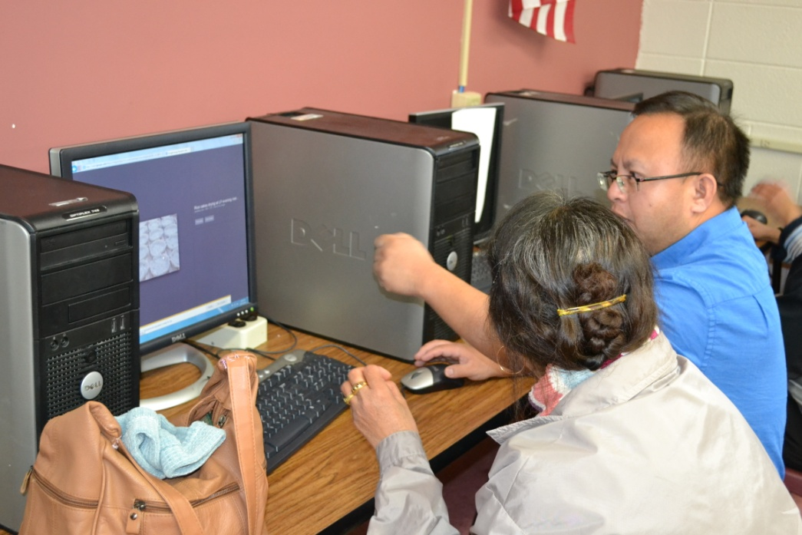
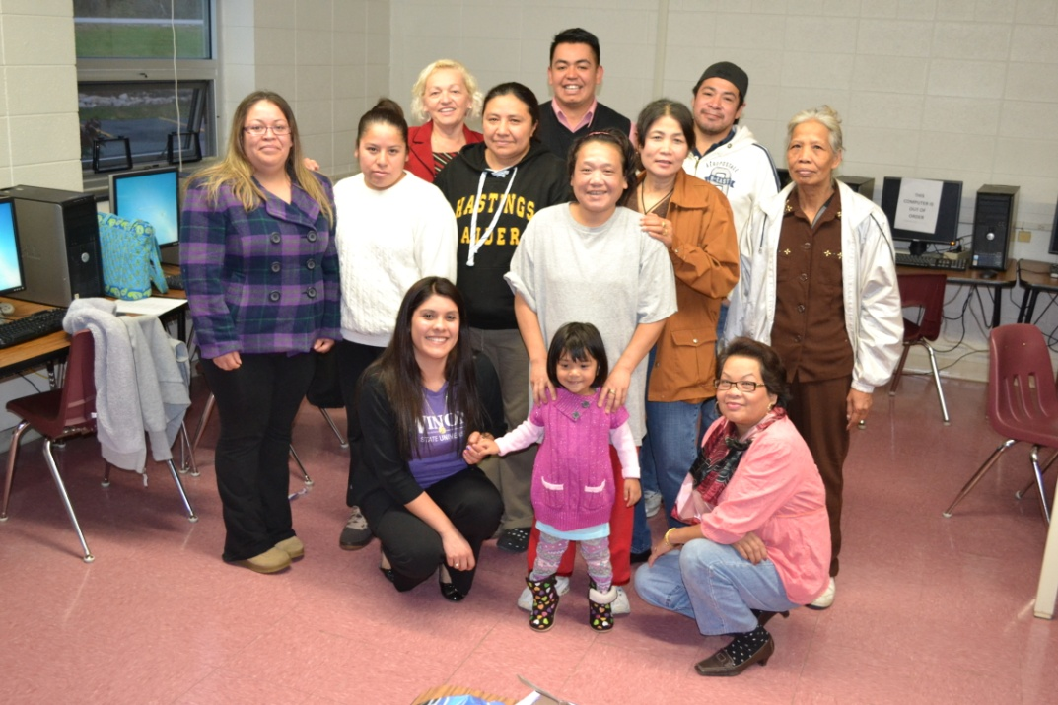
“I know and have learned a lot. I like learning!”
~ Anonymous
“I am glad to have a class like this.”
~ Lee Xiong

Slide 11
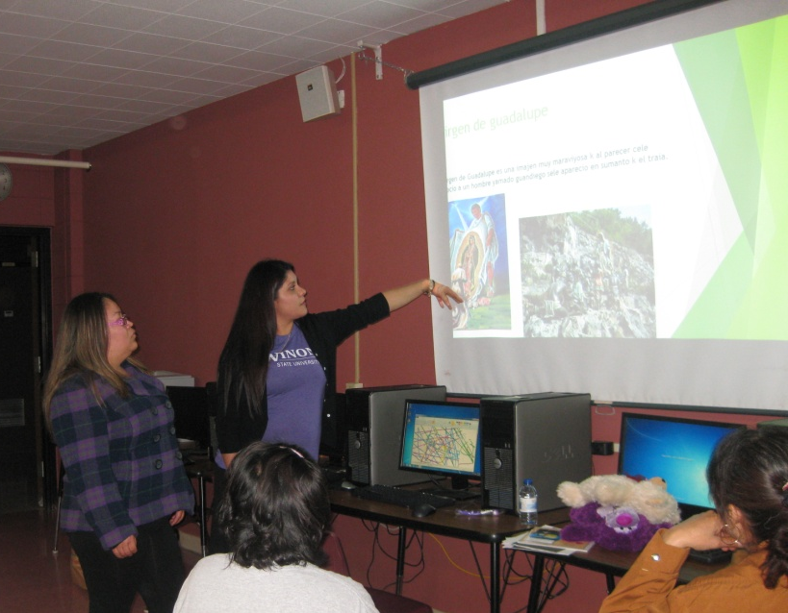
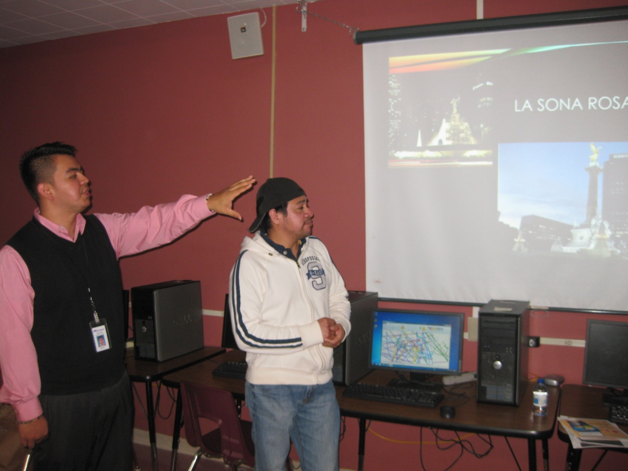
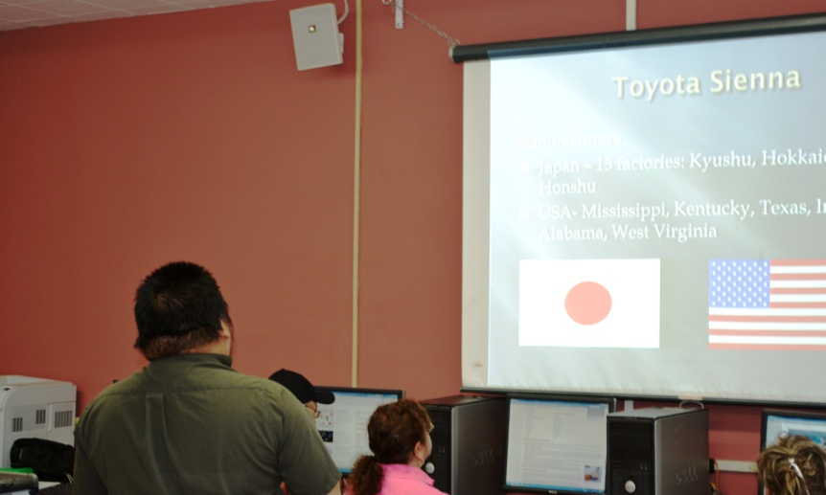
“I have never touched a computer before, but this is fun!”
~ Anonymous

Slide 12
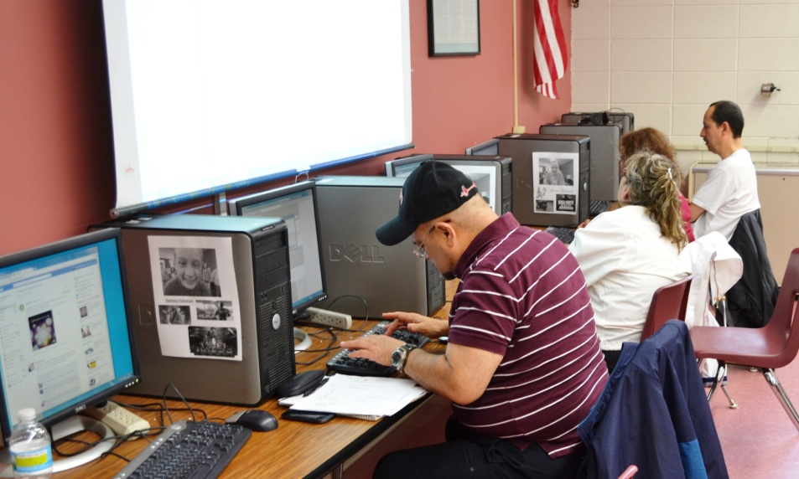
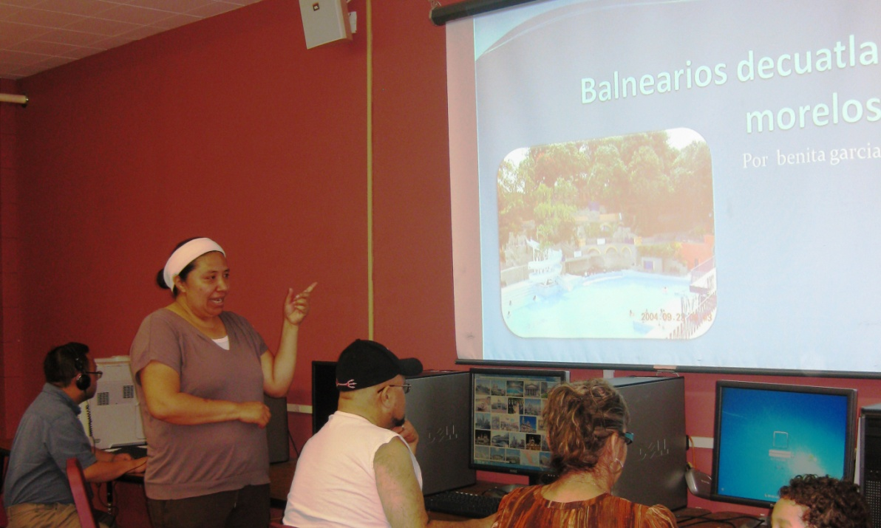
“It is better for us because we can learn something about computers.”
~ Anonymous
“I really enjoy the program.”
~ May Moua

Slide 13
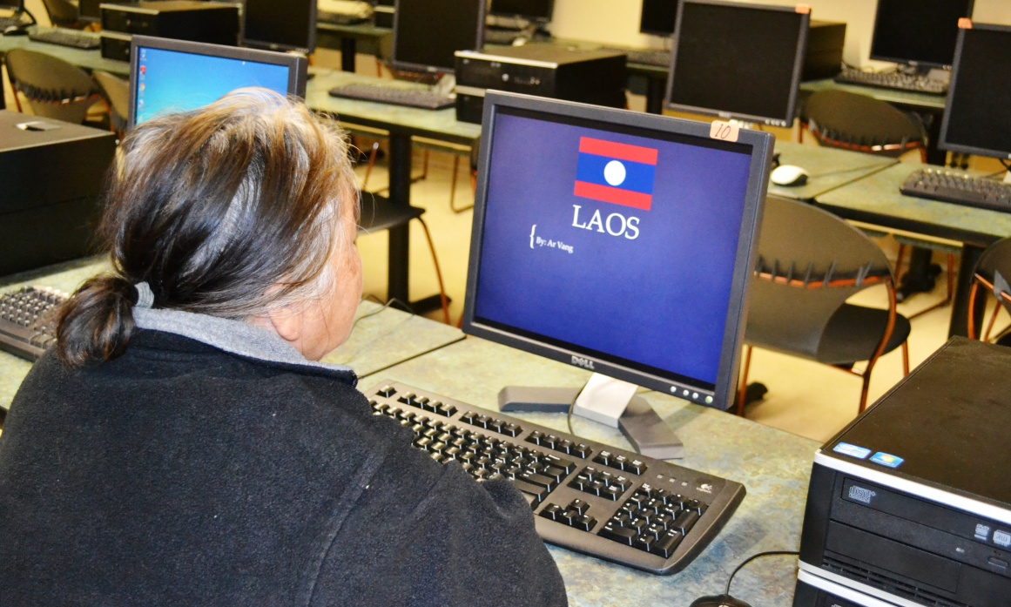
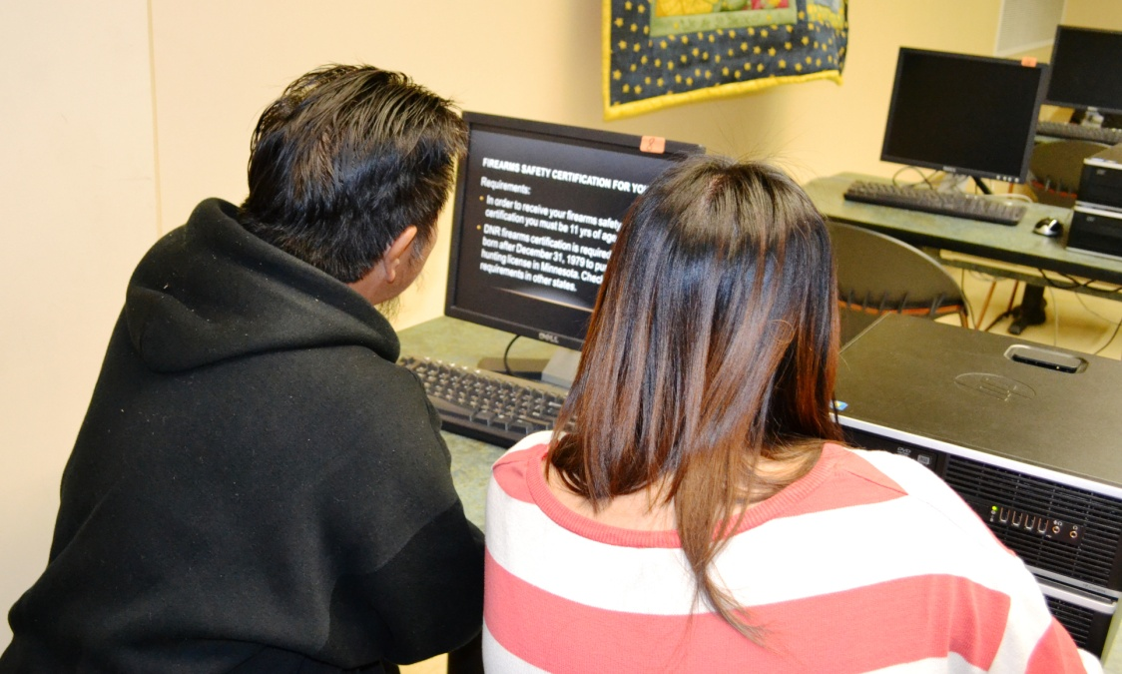
“I like the hands on session.”
~ Leng Yang
“This class is very helpful to us.”
~ Mai Vang Chang

