Slide 1
Broadband Lifeline Assistance
W. Tom Simmons
Sr. VP – Public Policy

Slide 2
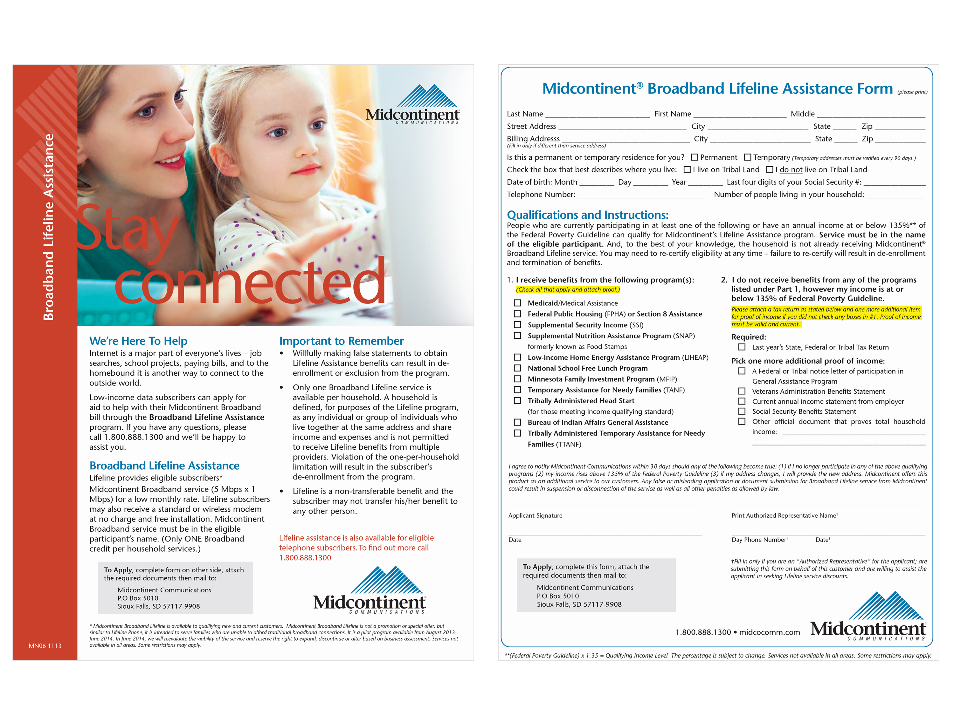
Company | Program name | Web link | Basic terms | Eligibility
Midcontinent Communications | Broadband Lifeline Assistance | www.midcocomm.com | $9.95/mo. 5 Mbps by 1 Mbps Internet service, free wireless modem, installation and setup. No contract. | Families qualifying for telephone Lifeline assistance program. No restrictions on current customers.
Comcast | Internet Essentials | www.internetessentials.com | $9.95/mo 5 Mbps by 1 Mbps Internet service, discounted computers, and training | Families with children qualifying for National School Lunch Program
Cable Companies | Connect2Compete | www.connect2compete.org | $9.95 3 Mbps by 1 Mbps Internet service, discounted computers and training | Families with children qualifying for free National School Lunch Program
CenturyLink | Internet Basic |  | $9.95 1.5 Mbps by 1.5 Mbps Internet service, discounted computer and training. Contract required. | Families qualifying for phone Lifeline assistance

Slide 3
Company | Program name | Web link | Basic terms | Eligibility
Midcontinent Communications | Broadband Lifeline Assistance | www.midcocomm.com | $9.95/mo. 5 Mbps by 1 Mbps Internet service, free wireless modem, installation and setup. No contract. | Families qualifying for telephone Lifeline assistance program. No restrictions on current customers.
Comcast | Internet Essentials | www.internetessentials.com | $9.95/mo 5 Mbps by 1 Mbps Internet service, discounted computers, and training | Families with children qualifying for National School Lunch Program
Cable Companies | Connect2Compete | www.connect2compete.org | $9.95 3 Mbps by 1 Mbps Internet service, discounted computers and training | Families with children qualifying for free National School Lunch Program
CenturyLink | Internet Basic | www.centurylink.com/Pages/Support/LifeLine | $9.95 1.5 Mbps by 1.5 Mbps Internet service, discounted computer and training. Contract required. | Families qualifying for phone Lifeline assistance

