Slide 1
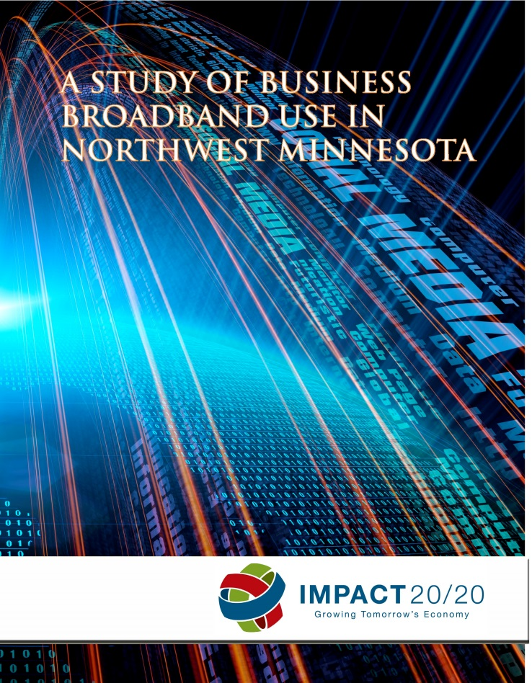
Businesses Knocking it Out of the Park in Northwest Minnesota
Broadband Superstars

Slide 2
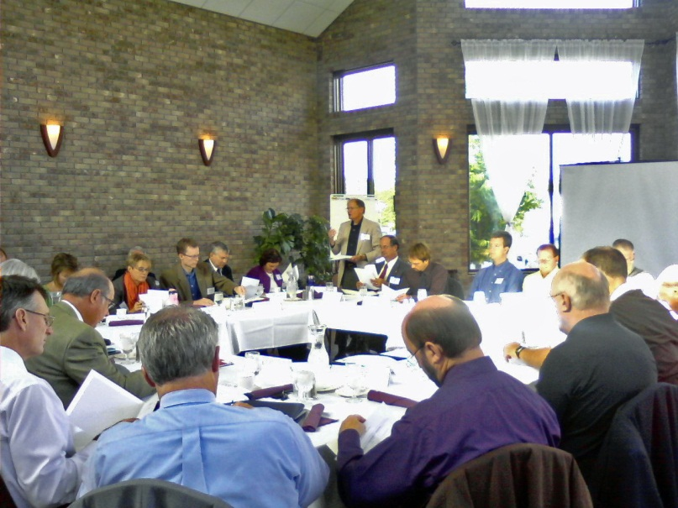
Who is impact 20/20?

Slide 3
Purpose Statement
IMPACT 20/20 is an influential group of Northwest Minnesota leaders representing diverse interests and working together for the region’s economic success.
Current work focuses on three areas: education, workforce, and broadband.

Slide 4
Task Force for broadband

Slide 5
Disparities Between Rural and Urban
Fewer rural businesses have websites – 21% less than urban businesses
Rural businesses without broadband have lower revenues than urban businesses without broadband

Slide 6
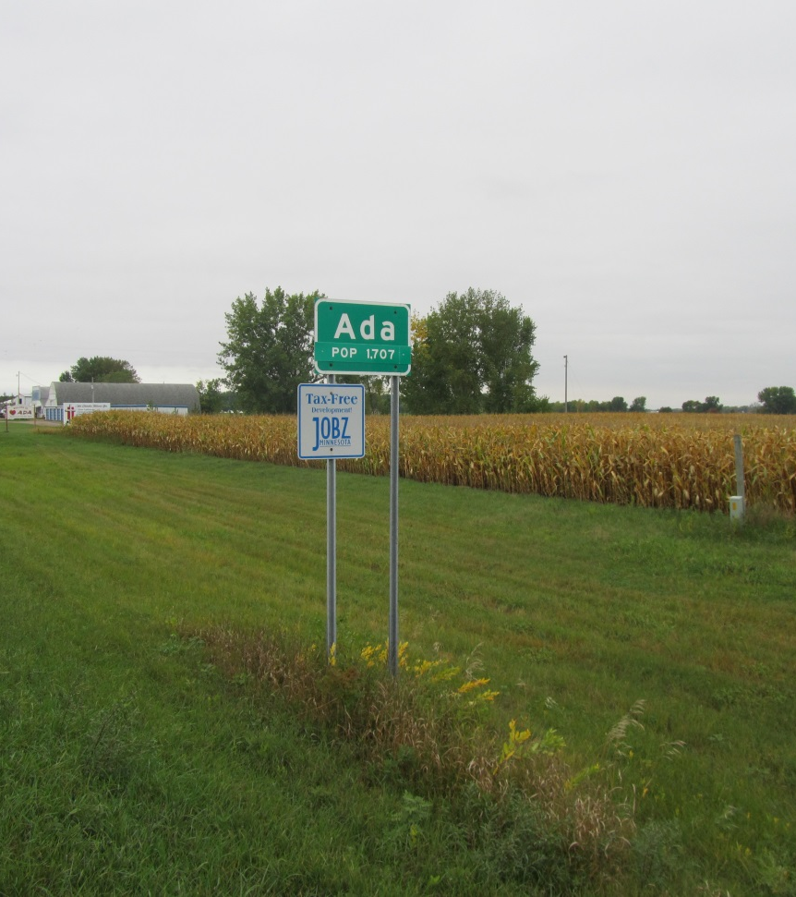
Purpose of the Micro-study
To gain a better understanding of the role broadband is currently playing among the region’s business
Identify best practices
To share identified best practices with the broader business community
Ada, MN – population 1,707

Slide 7
Micro-study Business Profiles
Central Boiler- Manufacturer of outdoor wood furnaces
Eleven Hockey- Hockey stick manufacturer and marketer
Curiosity Shop- Retail home décor, and gift items
Indian Harvest- Sells artisan grains and grain blends,
Itasca Leathergoods- Manufactures moccasins and other fine leather goods
Lake of the Woods Outdoorsman- Fishing, hunting and exploring guide service

Slide 8
Micro-study Business Profiles
Mattracks, Inc.-Manufactures rubber track conversion systems
Stittsworth Meats- Old fashioned Meat Market
Tom’s Tackle- Manufacturer and wholesaler of fishing tackle
T- Shirt Barrel- Custom embroidery and screen-printing
Tutto Bene- Italian restaurant, locally grown ingredients
Weave Got Maille- Manufacturer of jewelry supplies

Slide 9
Micro-study Major Findings
Social media tools are an extremely effective means of growing a business
Businesses who use broadband tools are increasing their customers, efficiency, scope of market, and profits
The cost-benefit ratio of using broadband is very high in terms of time/money and perceived return on investment
The importance of broadband to business success will not diminish – if anything, it will increase

Slide 10
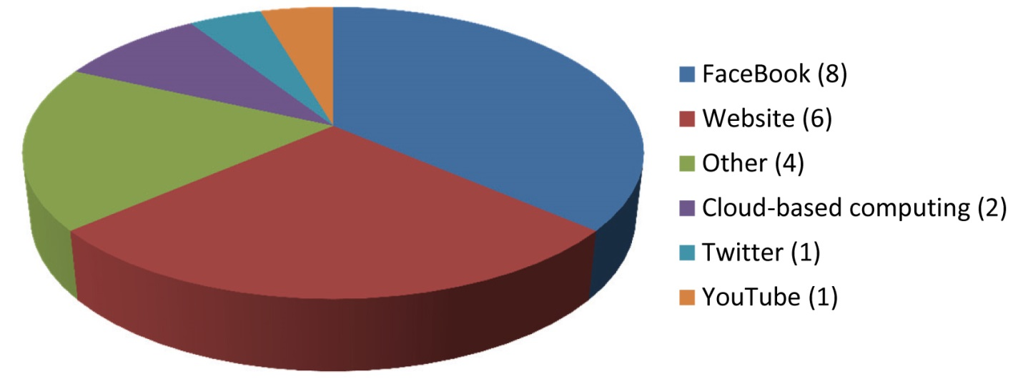
Micro-study Major Findings
Chart 1: Responses to the question: “which broadband tools have
provided the most value to your business?”

Slide 11
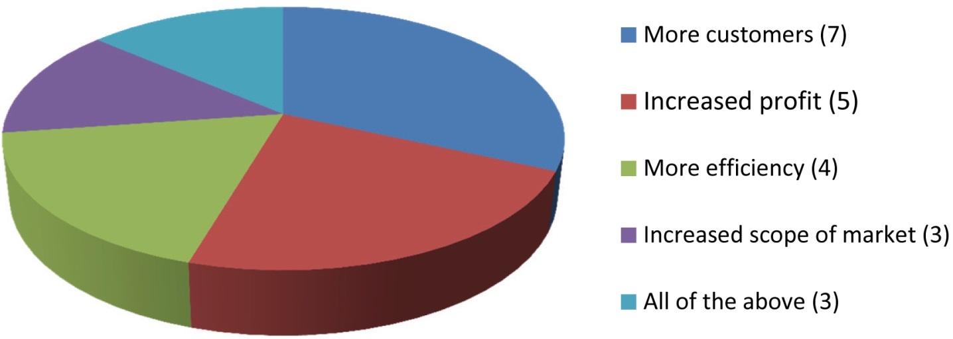
Micro-study Major Findings
Chart 2: Responses to question: “please describe the impact
these tools have had on your business.”

Slide 12
Case Study: Stittsworth Meats
Old-fashioned meat market
Located in Bemidji
Family owned since 1993
Broadband tools used: cloud-based computing, Facebook, Google +1, Google Places, Google Sites, Pinterest, QR codes, Twitter, website, and YouTube
Broadband = more customers and more revenue

Slide 13
Case Study: Stittsworth Meats

Slide 14
Case Study: Stittsworth Meats
In the top 1% of business in the US for the largest number of Facebook followers (private business category)
Has more followers than:
Leanne Rimes
WWE Fans
Hugo Chavez

Slide 15
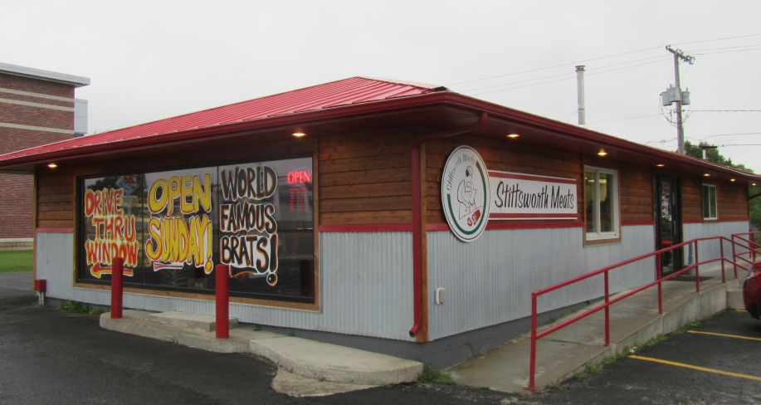
Case Study: Stittsworth Meats
Walk-in traffic has tripled since using Facebook
Mike Stittsworth credits social media marketing for 50% of their growth

Slide 16
Two More Case Studies
Weave Got Maille
New manufacturing business with customers in 56 countries in less than two years
Lake of the Woods Outdoorsman
Uses YouTube to drive traffic to his site - has more than 150,000 individual IP hits on his videos
Case Study YouTube Videos Online

Slide 17
Mission Possible
No customer left behind
Foundational training
Individualized business assessments
Advanced training, focused on meeting needs identified during assessments

Slide 18
Mission Possible
No customer left behind
Notes:
Why your business needs to be online.
How are businesses found online and on mobile devices?
What are the alternatives to a website?
In general what is Social Media and how it can help you succeed in business?

Slide 19
For more information, to download a copy of the study, to view the business videos, or current training schedule:
Www.impact2020.org
www.nwmf.org

