Slide 2
Telework: Work done from a location other than the office.
Our primary effort focuses on employee/employer relationship vs. independent contractor or self-employed .
Great application for broadband and economic/workforce development.

Slide 3
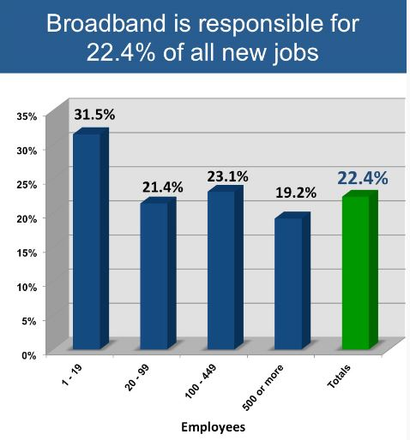
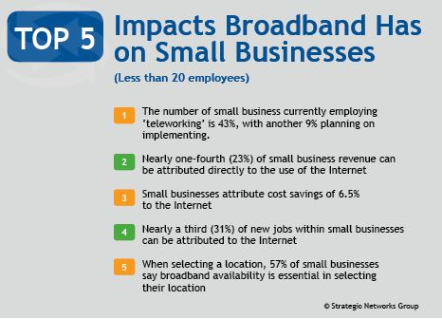
Thinking of new ways
to grow the local
economy…
Data from Strategic Networks Group; their research in THREE STATES reveal that more than 1 in 5 jobs is attributed directly to broadband and the use of e-solutions.

Slide 4
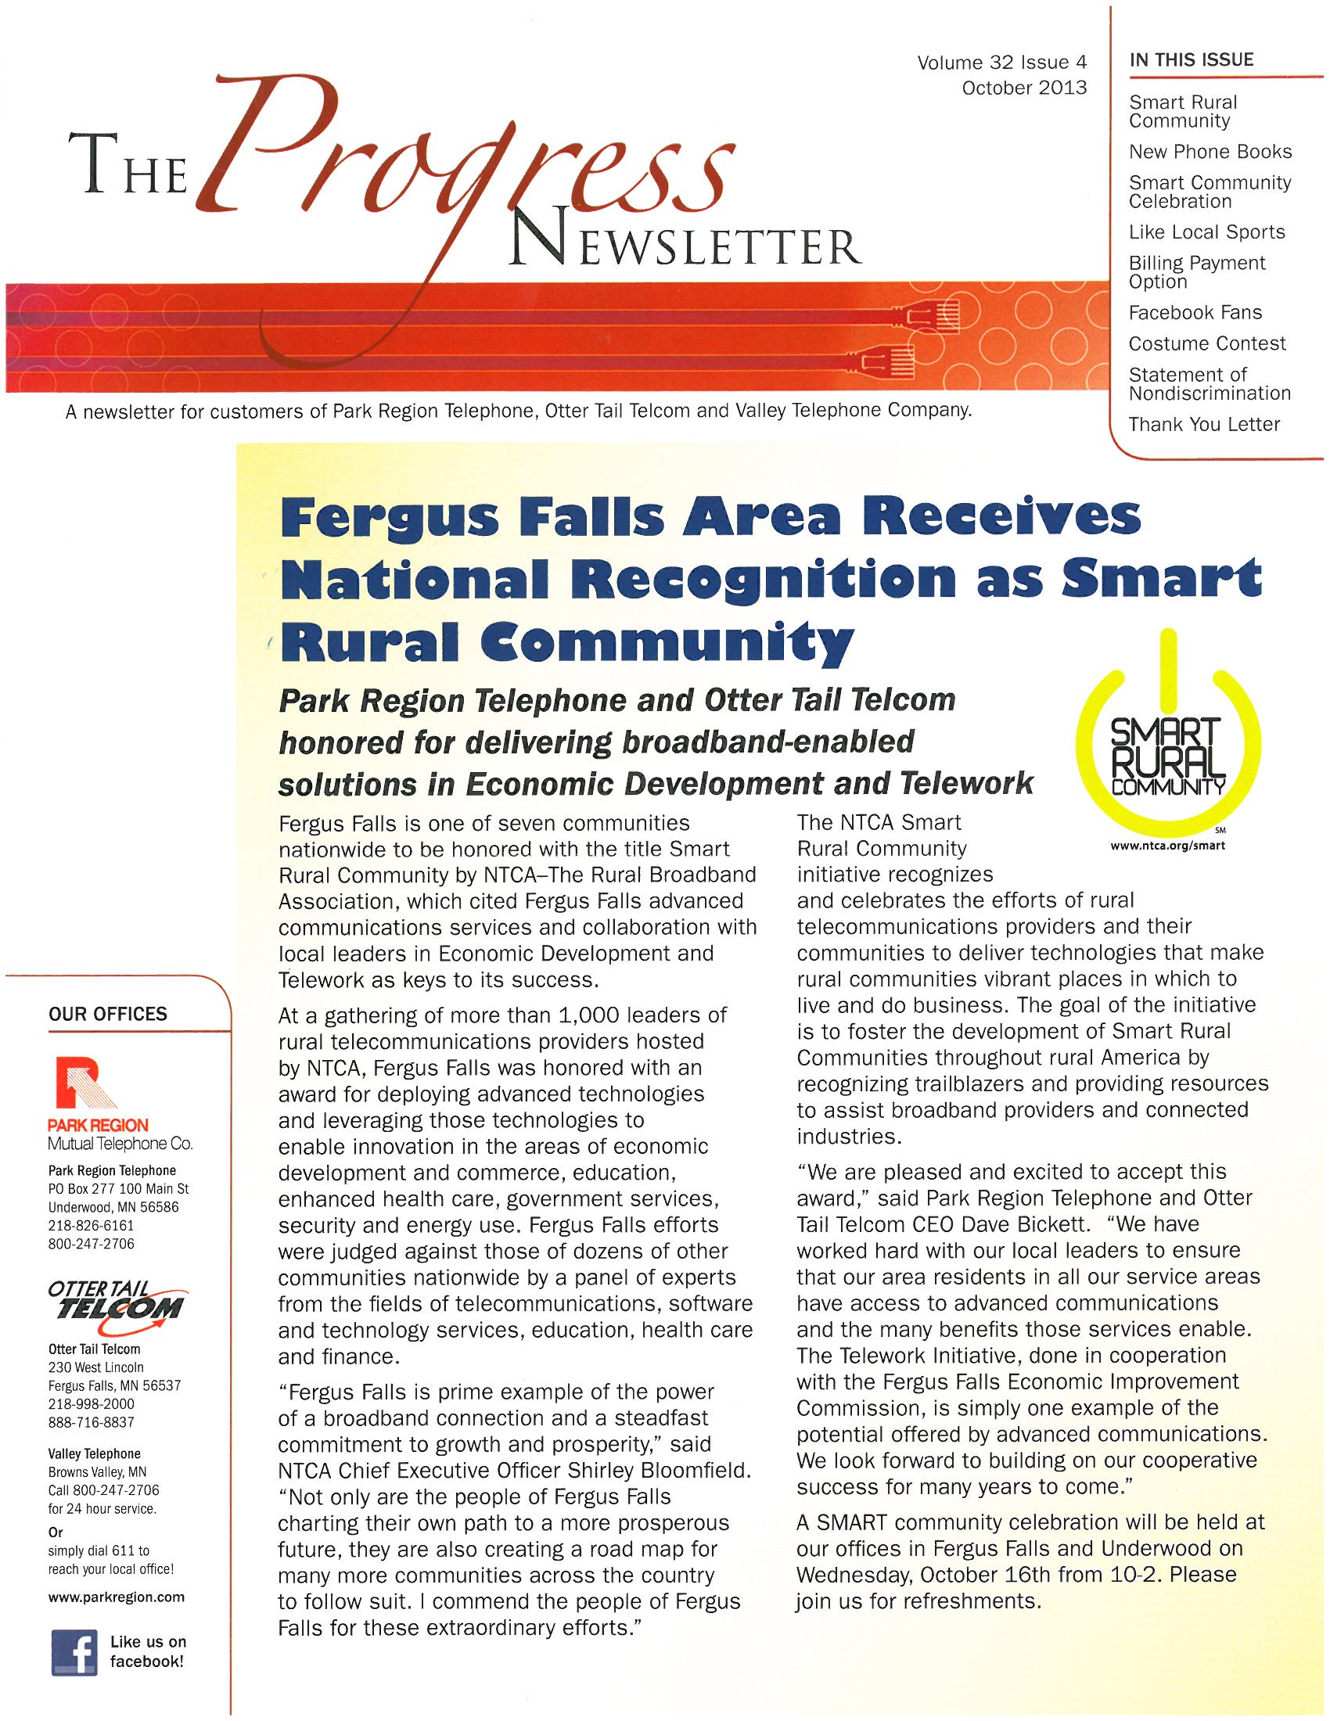

Slide 8
Healthcare Telecommuting Positions
Noridian Administrative Services
Education Representatives
Auditors
BCBSND
Telephone Representatives
Information Services (IS)
Medical Directors
Notes:
Both NAS and BCBS have employees who are telecommuters. NAS has had to jump their program in order to adjust to the work environment.
The bulk of NAS’ telecommuters are in professional roles:
Education Representatives (4 employees/Idaho, Oregon, California and Arizona)
Auditors (13 employees/Minnesota, Utah, Montana and Arizona)
Medical Directors (3 employees/Missouri and Arizona)
BCBSND has implemented a pilot program which is slated to end at the end of April. Once the pilot is ended, the expectation is that other departments will follow suit with the telecommuting program.
Telephone Representatives Non-exempt (2 employees/North Dakota)

Slide 11
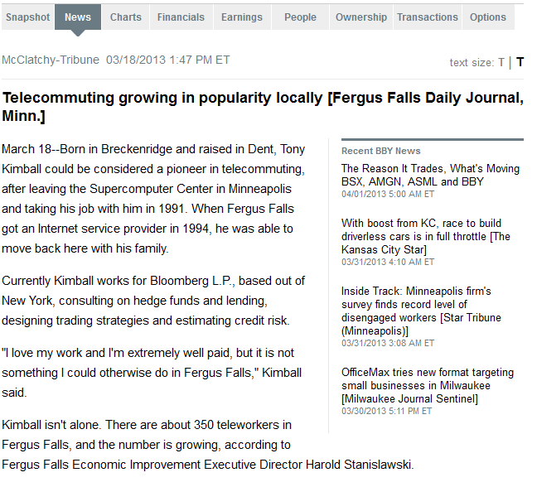
in N.D. could support beet-to-ethanol plants, expert says
13 communities in N.D. could support beet-to-ethanol plants, expert says Thirteen communities in central North Dakota are suitable for beet-to-ethanol plants, said Maynard Helgaas, president of the Green Vision Group. One such plant could employ about 25 people and buy energy beets from farmers within a 20-mile radius, Helgaas said,noting that a demonstration-scale facility could be up and running in the region by 2015 or 2016. Agweek/Forum News Service (12/30)

Slide 13
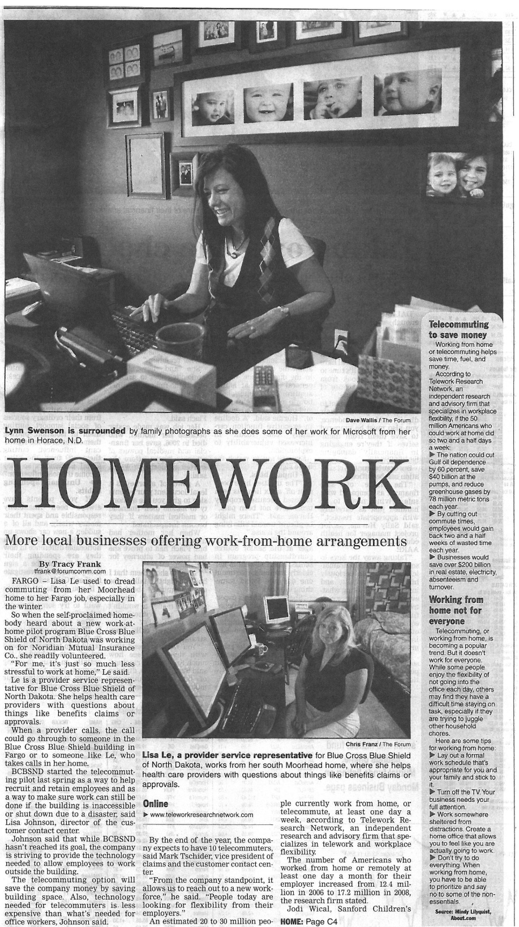
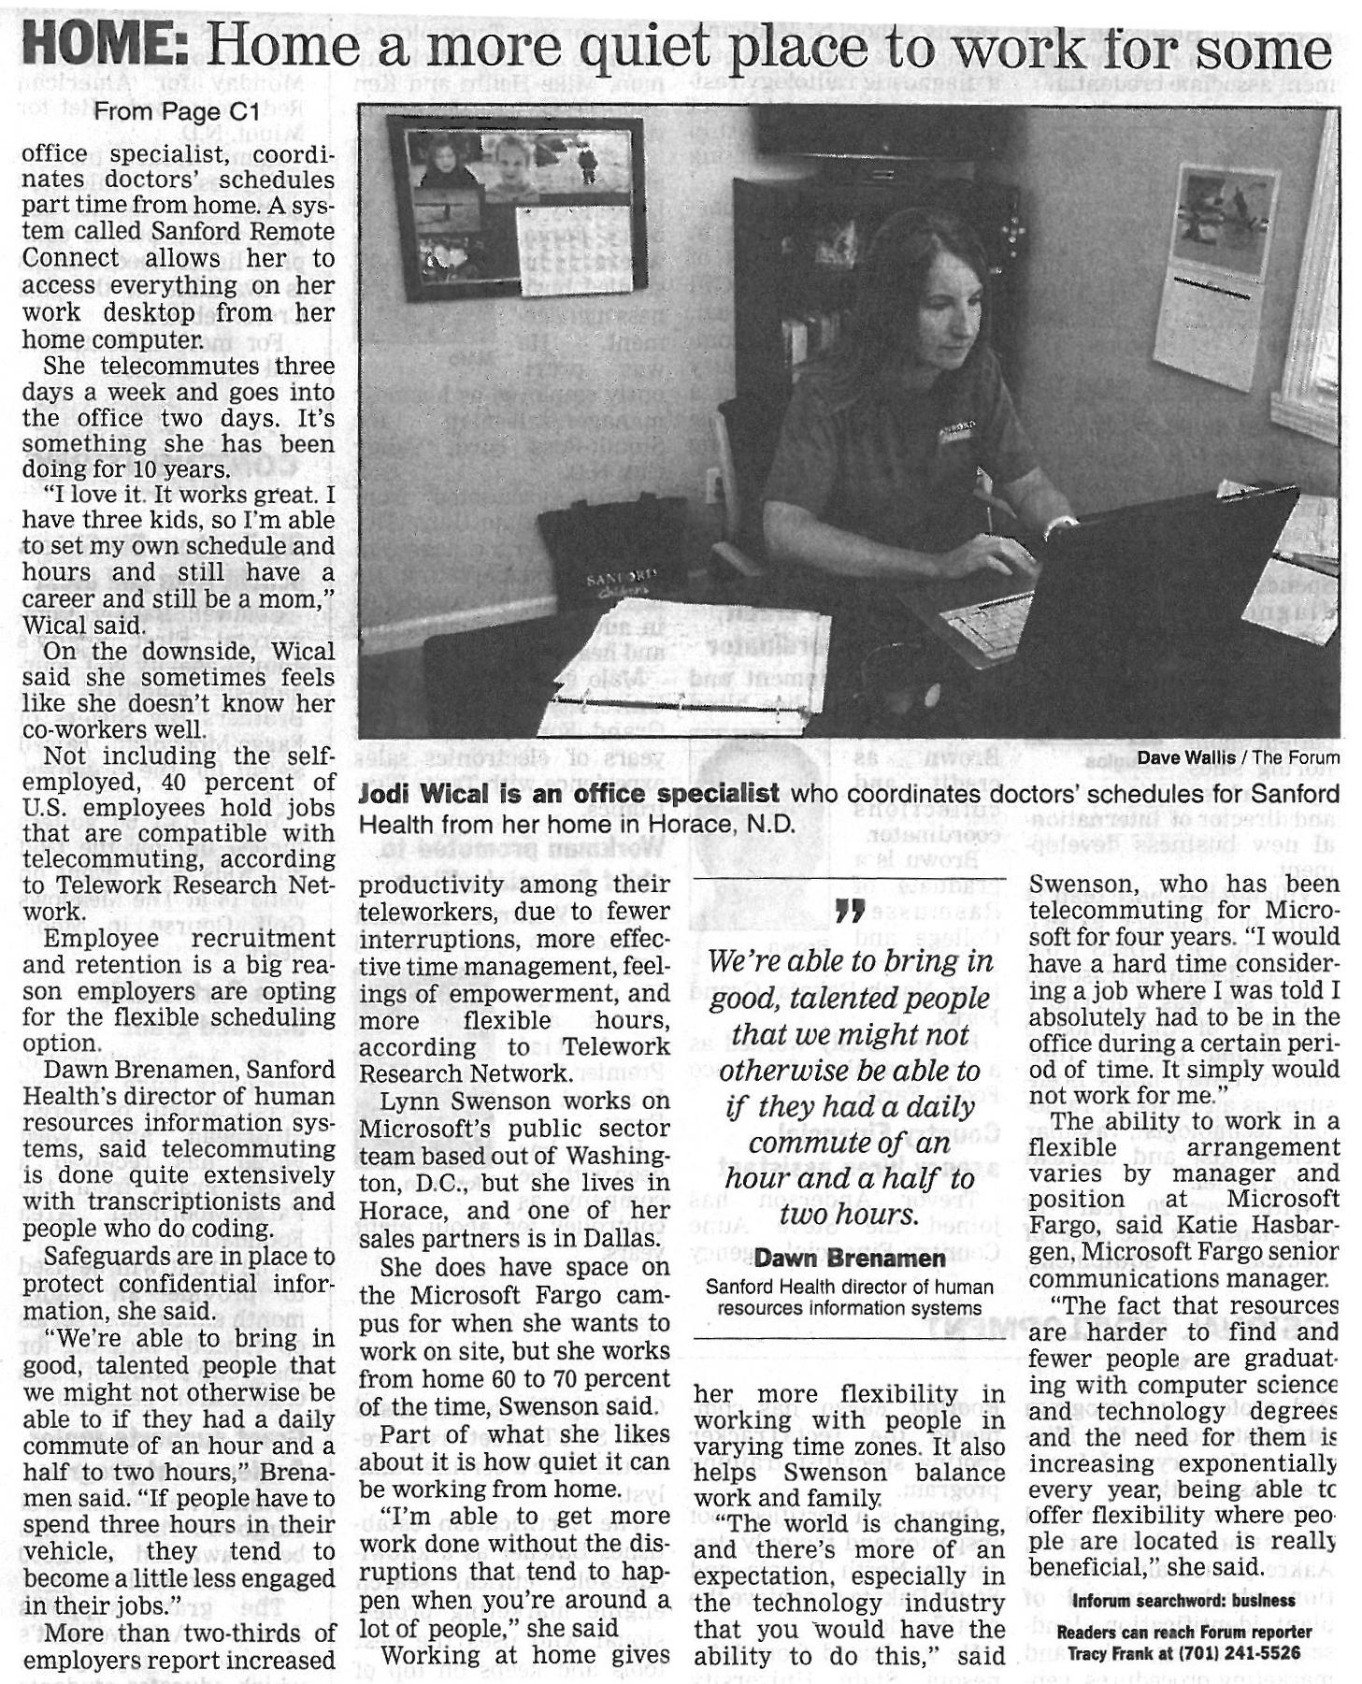

Slide 14
Fergus Falls Telework Initiative Handbook
Possible through Blandin Grant
Currently in production, 40 pages & counting! Final booklet & online product due in March
Provides blueprint for other towns
Mid April, Telework Conference will be held in Fergus Falls.

Slide 16
QUESTIONS & DISCUSSION
Can/Should “telework” be a statewide economic development strategy? If so, how would that look?
THANK YOU!

