Slide 1
Active Citizenship – How A Coalition of
St Louis County Townships is
Addressing Broadband Needs
Scott Mead, Pequaywan Town Board
and CVII Steering Committee

Slide 2
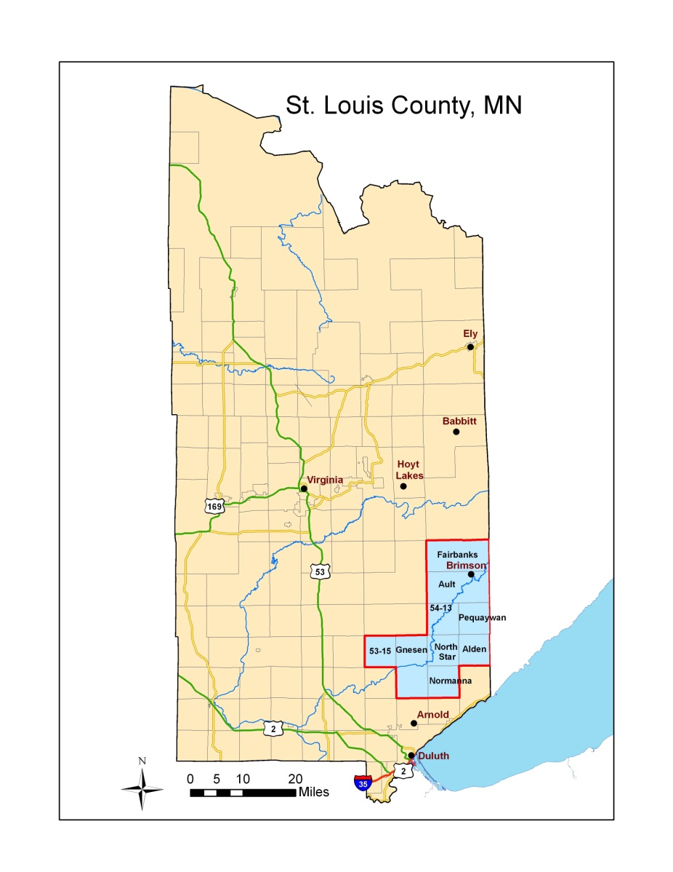
Cook County
Fiber Optic
Project
Northeast
Services
Coop
Fiber Optic
Project
Lake County
Fiber Optic
Project
Broadband Development All Around Us - But No Plans for Development in Our Townships !

Slide 3
A Grass-Roots Team Was Formed
NORTH STAR, NORMANNA AND PEQUAYWAN TOWNSHIPS
started a Committee of Interested Citizens to develop a strategy
Consulting Support from the Blandin Foundation (Thank you!)
Citizens developed Community Outreach / Education Materials and distributed them
at picnics, lake association meetings, mailings, emailings, newsletters
Citizens developed a Questionnaire to determine level of satisfaction with current
Internet sources and interest in improvements “would you pay?”
Blandin consultants supported an on-line questionnaire
Briefings to surrounding townships – Alden, Ault, Fairbanks, and Gnesen- joined the CVII
St. Louis County added two unorganized townships
Collected responses from > 500 households (residents and seasonals)

Slide 4
What did our questionnaire find?
The most common sources of internet were Satellite > Cellphone > DSL > Dial up
18% use Dial-up access!
70% rated current service “fair – to – poor”
19% rated current service “good – to – excellent”
11% do not use the internet
95% “somewhat likely or very likely” to pay for high-speed broadband i
(85% “very likely”)
Needs: On-line education (teaching/learning), telecommuting, small businesses,
on-line health care, communications (Skype,email,etc.), entertainment,shopping.
Township needs – Fire dept/EMT training and coverage, business transactions,
communications

Slide 5
We set a Goal of 10 Mbps down and 5 Mbps up (= State of MN Broadband Goal)
Joint Powers Agreement for the CVII Steering Committee
Approved and joined by 7 townships plus 2 unorganized
Each township contributed $$
New organization demonstrates a coordinated effort and a larger market

Slide 6
Feasibility Studies to Make Us “Shovel Ready”
CVII did a preliminary feasibility study and a full feasibility study
2 studies to demonstrate opportunities for broadband and the cost and design needed to implement fiber optic and DSL – to make us “shovel-ready”
Comparison of opportunities, pros and cons across all potential providers
2) Engineering, Market and Cost analysis of fiber optic

Slide 7
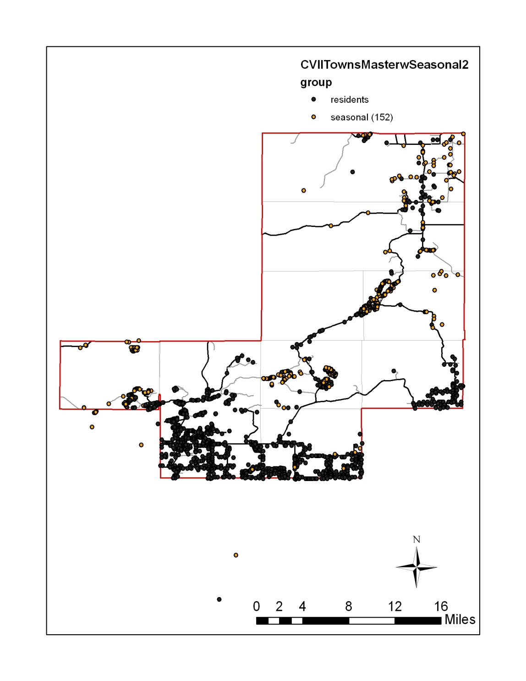
We developed additional materials
County Assessor’s office shared public data on Residential and Seasonal property
Friends at Univ. MN turned the addresses into a map
Shows that residents and Seasonals are distributed along Corridors….
Routes for Broadband?

Slide 8
More Homework
Cloquet Valley Internet Initiative
2010-11 Population Summary (From US Census and St Louis Co Assessor)
TOWNSHIP | 2010 Population (US Census) | 2011 Residential units (SLC data 201-203)* | 2011 Seasonal Units (SLC data 152)*
Alden | 213 | 81 | 23
Ault | 109 | 54 | 24
Fairbanks | 63 | 45 | 47
Gnesen | 1683 | 720 | 157
Normanna | 796 | 268 | 6
North Star | 190 | 99 | 118
Pequaywan | 130 | 80 | 140
53-15 (Island Lake) | ? ** | 115 | 134
54-13 (Little Pequaywan) | ? ** | 34 | 17
TOTAL | >3184 | 1496 | 666
** US Census does not display populations for un-organized townships
*Data for homestead property and seasonal property obtained from St Louis County Assessor’s Office in 2011

Slide 9
We will use our study results to leverage providers
We will maintain a goal for 10 Mbps down and 5 Mbps up and communicate it!
(State of MN border-to border-target)
Do we need state and federal assistance $/grants/loans?

Slide 10
Coop Light and Power Wireless
CLP installed a tower in Normanna Twnshp as a test site
Normanna tower - 7mbps capability
Testing shows very favorable results
Each tower has 10+ miles radius
Additional towers are being planned

Slide 11
THANK YOU!
St Louis County Commission
Coop Light and Power
ARDC – Pat Henderson
Blandin Foundation and Their Consultants
AgStar Financial Services
Town Boards for Alden, Ault, Fairbanks
Gnesen, North Star, Normanna, Pequaywan
Connect Minnesota
Lake Connections
and many town residents

