Slide 1
Local Governments Expand Broadband by Investing and Partnering
Christopher Mitchell
Director, Telecommunications as Commons Initiative
Institute for Local Self-Reliance
February 5, 2014
@communitynets
www.MuniNetworks.org
Notes:
Start with a question

Slide 2
Institute for Local Self-Reliance
Formed in 1974
Focuses
Local Banking
Decentralized Energy
Main Street Businesses
Recycling – Waste to Wealth
Telecommunications as Commons Initiative
MuniNetworks.org
Notes:
ILSR!
Recognize that some communities are well served, often by locally rooted companies.

Slide 3
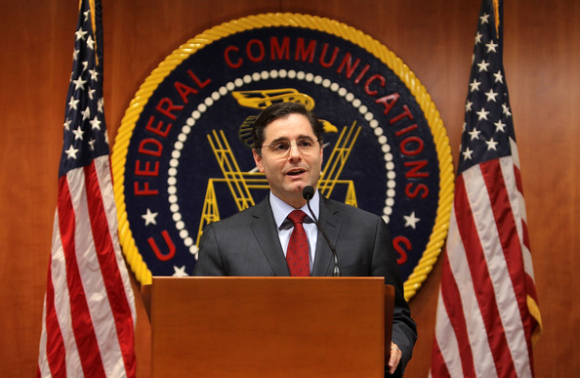
… 1 Gigabit Networks …
Notes:
We need better networks, but don’t expect help from the feds. Private companies aren’t investing.

Slide 4
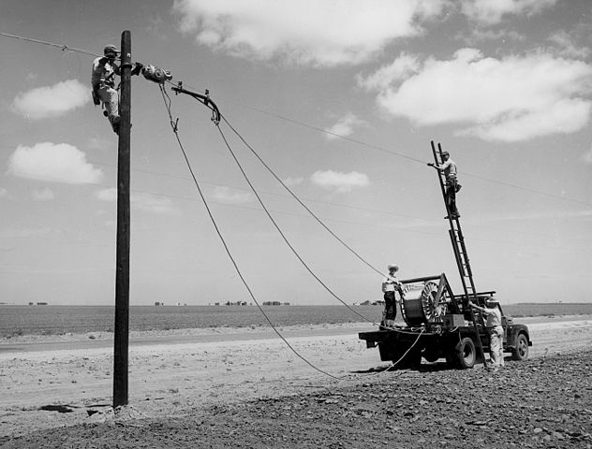
Notes:
Some context.
This is NOT pie in the sky.
Take comfort from history – we ran a wire to every last person in the country during Great Depression and World War II.
DOES ANYONE KNOW where the largest FTTH network in the world is? The Dakotas. Over 10K sq mi
We can connect everyone. The question is how.

Slide 5
Notes:
Reasonable rates

Slide 6
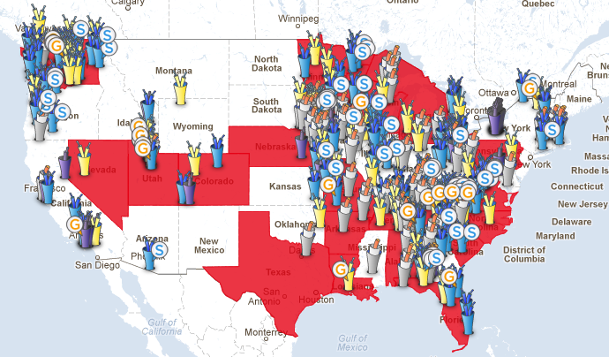
MuniNetworks.org/communitymap
Notes:
And yet hundreds have made investments to serve others aside from themselves
150 offering citywide triple play,
another 200 making some partial investment
Some just connect a business district or offer dark fiber

Slide 7
Notes:
2012 report from the State Educational Technology Directors Association recommends 1 Gbps connections between school district facilities by 2014-15 and 10 Gbps by 2017-18
Leasing these connections from some providers could bankrupt local budgets

Slide 8
Notes:
Conduit

Slide 9
Notes:
For the most part, local governments expect networks to pay for themselves entirely.
Most networks funded with revenue bonds purchased by private investors

Slide 10
Approaches Already in Minnesota
Partnerships with Coops
Multi-town and Townships Joint Efforts
Rings and Backbones
Schools and Community Anchors
Multiple Wireless Approaches
Fiber to Businesses
Full Fiber to the Home

Slide 11
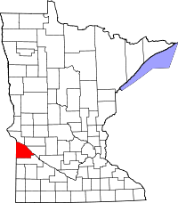
Lac qui Parle

Slide 12
Cook County

Slide 13
Sibley County (and Neighbors)

Slide 14
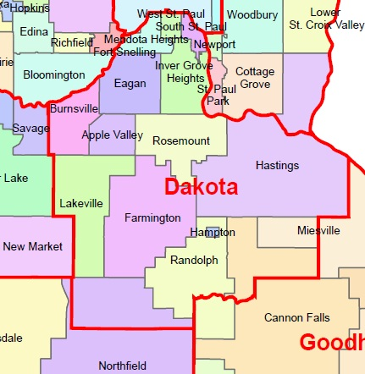
Fiber to Anchors, Businesses

Slide 15
Fiber to the Business

Slide 16
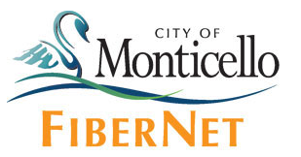
Municipal Fiber to the Home

Slide 17
Notes:
We should stick with what works. Embracing public and private sector investment
We’ll have private companies, coops, and munis investing in networks for a long time.
Communities should decide locally which strategies make sense for their situation.

Slide 18
Thank you
Christopher Mitchell
christopher@newrules.org
MuniNetworks.org
@communitynets
Sign up for a once-per-week e-mail digest of Community Network News at MuniNetworks.org

