Slide 1
Lessons from Rural Minnesota Broadband Feasibility Studies
Ann Treacy
atreacy@treacyinfo.com
http://blandinonbroadband.org

Slide 2
Communities with Studies
City of Staples/ Todd County
City of Winthrop (Renville County)
Cloquet Valley
Cook County
Kanabec County
Lac qui Parle EDA
Lakefield
Northfield
Red Wing
Redwood Falls/ Redwood County
SouthWest Central Service Cooperative

Slide 3
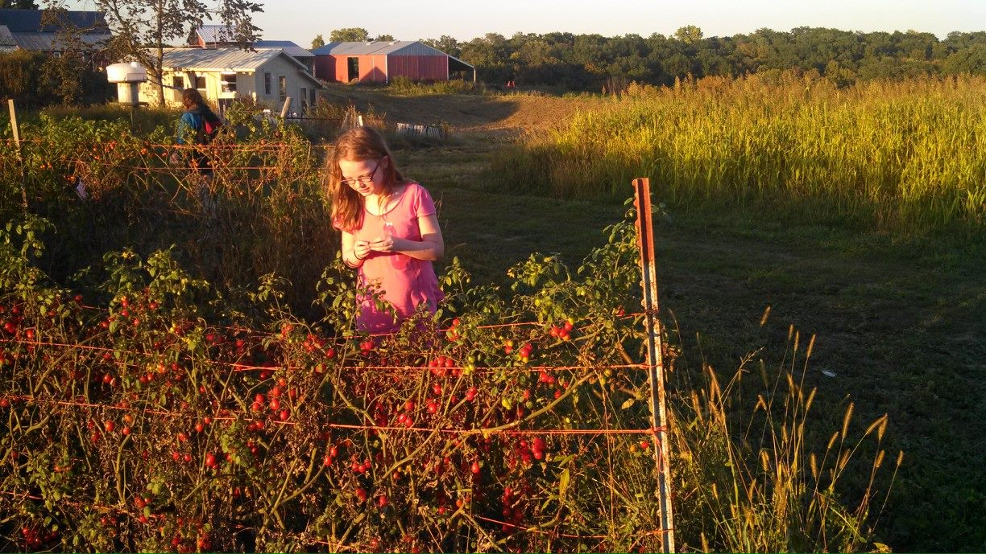
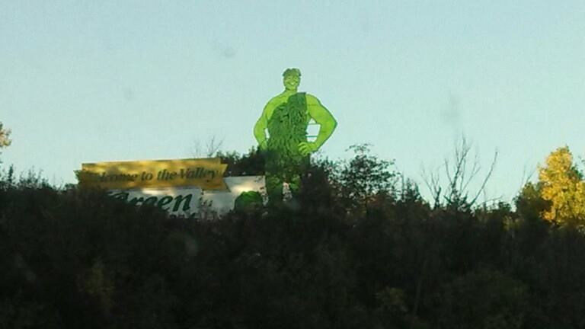
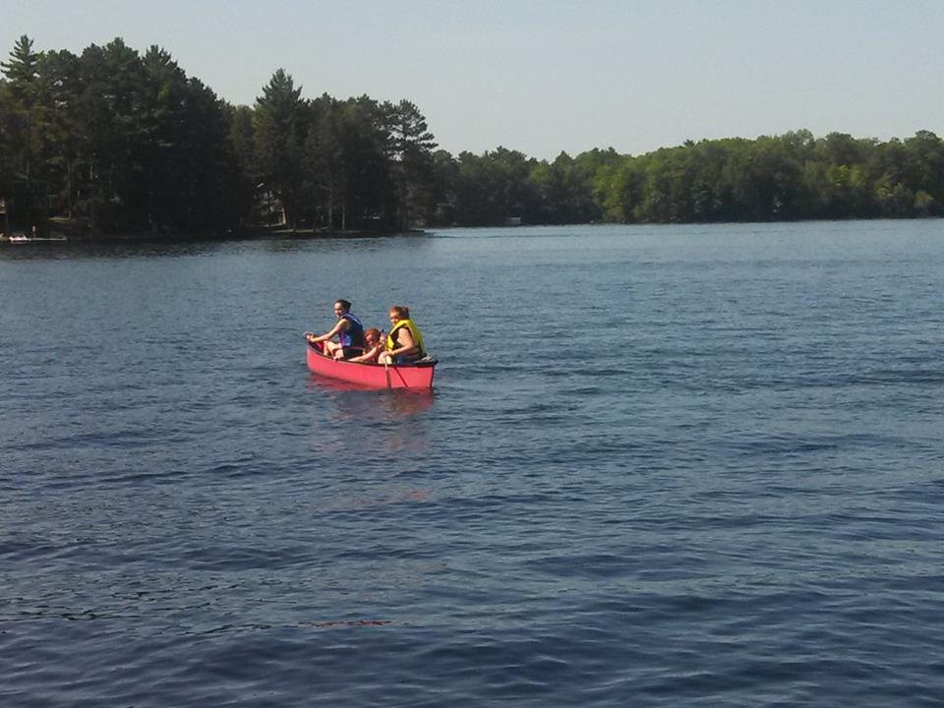
Each Community is Different!

Slide 4
Investigated
Business Basics: Cost versus Revenue
Keys to Success (ARRA)
Public Private Partnerships
Technology Scenarios
Local Champions

Slide 5
Financial Components
Business Case Projections of Costs and Revenues
Balance Sheets
Income Statements
Cash Flow Statements
Capital and Operational Breakeven Analysis
Sensitivity Analysis for Competitive Responses

Slide 6
Costs
Planning and Engineering
Construction
Equipment
Backbone Access
Operations (Marketing, customer support, technology management)
Fiber to the Farm is expensive!

Slide 7
Financing & Revenue
State Grants and Loans
Federal Grants and Loans
Municipal General Obligation Bonding
Revenue Bonds
Residential Customers
Business Customers
Anchor Tenants
Wholesale Model Open Access Network
Money saved
Notes:
Dakota County went from $700,000 to $15,000

Slide 8
Public Private Partnership
Is there one obvious potential partner?
Are there several partners?
Open Access Network
Is there no likely partner?
Look to area providers
Make the business case better
Consider a Cooperative Approach

Slide 9
Technology Scenarios
FTTP (Fiber to the Premise)
FTTN (Fiber to the Node/Neighborhood)
Open Access Fiber Network
Open Access Network with wireless overlay
Open Access Network that serves community anchor institutions
Phased is OK just make sure you’re going forward

Slide 10
Local Champion
Leadership: You Have to do it yourself but you can’t do it alone.

Slide 11
Robust Broadband Networks Feasibility Grants
$25,000 for community study
$40,000 county or multi-community study
1:1 match
Next deadline April 4, 2014
http://tinyurl.com/BFfeasibility

Slide 12
Thank you! Ann Treacy atreacy@treacyinfo.com

