Slide 1

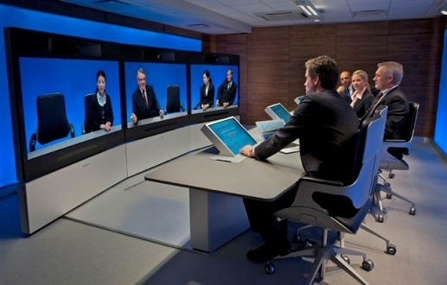


Video Conferencing Overview
Today’s Applications

Slide 2
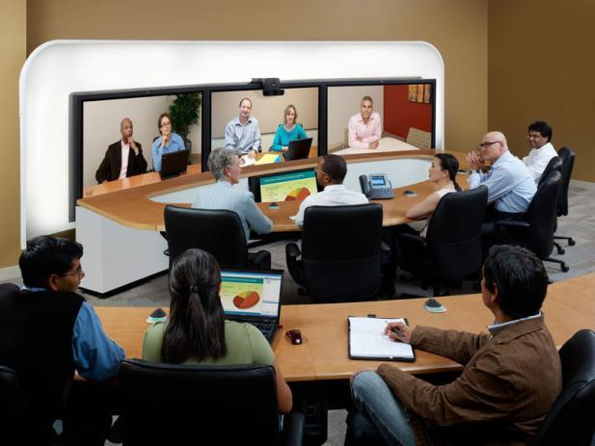



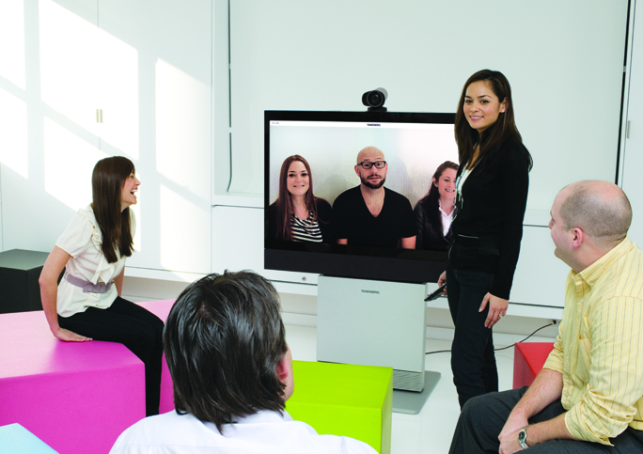
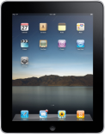




The Drivers of Visual Communications
are Changing
  Mobile Device
  Proliferation
  High Def & Network Readiness
  Cloud Delivery
  Collaboration & Social Networks
  Generation Raised on Video
  70M
  Tablets Today
  HD / IP
  $41B
  Today
  $16B
  UC By 2014
  4B
  Videos
  viewed daily on YouTube
  3G / 4G
  320M
  Tablets
  by 2015
  $241B
  By 2020
  1B+
  Users on Facebook
  WiFi
  66%
  Mobile
  Traffic 2015

Slide 3


Video Conferencing is Changing
Conference room
Full Service
Premise-based Hardware
Dedicated app
Travel savings
Desktop & mobile
Self Service
Cloud-based
Software
Browser & UC-based
Innovation, decision making & retention
Deployments
Technology
Customer Focus

Slide 4
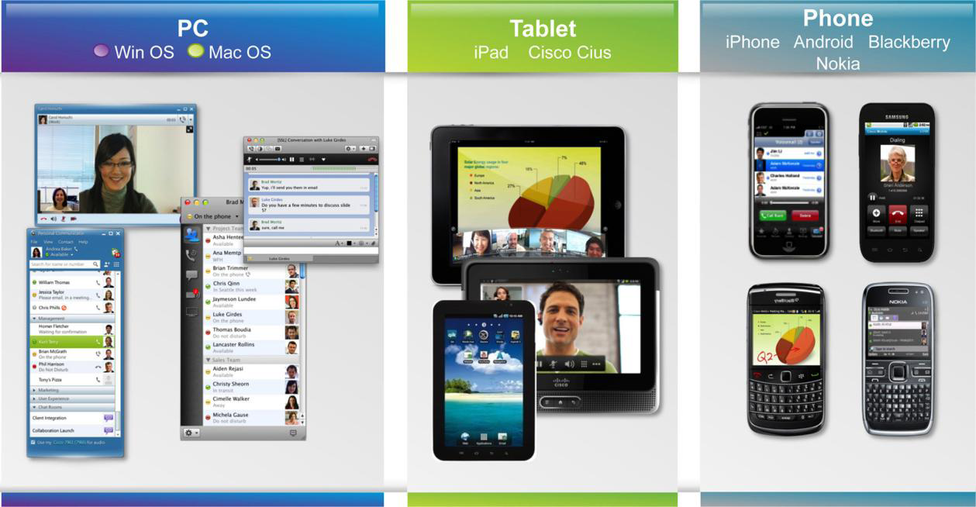
Visual Collaboration is expanding to
PCs, Tablets and Phones
The conference room and desktop model is being replaced by a model where the workspace uses communications and collaboration software that runs on any device, any place, and any network.

Slide 5
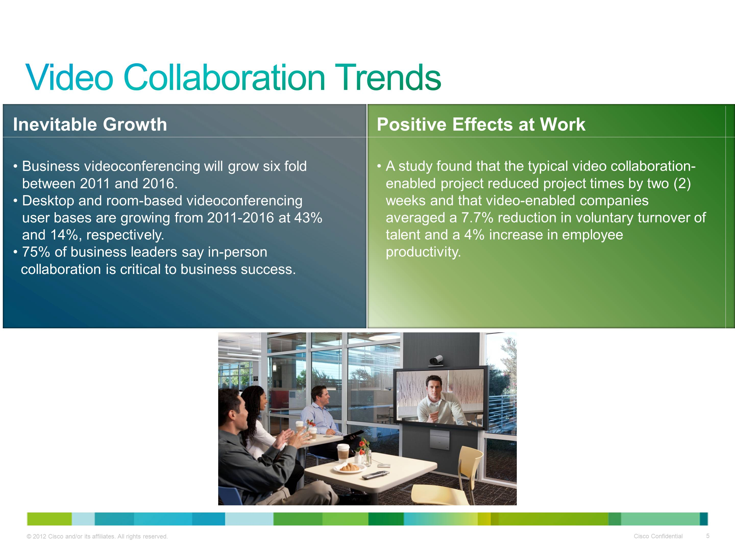
Notes:
INEVITABLE GROWTH
Business videoconferencing will grow six fold over the forecast period.
Additional Context: Business videoconferencing traffic is growing significantly faster than overall business IP traffic, at a CAGR of 48 percent between 2011 and 2016.
SOURCE
Cisco Visual Networking Index: Forecast and Methodology, 2011-2016 http://www.cisco.com/en/US/solutions/collateral/ns341/ns525/ns537/ns705/ns827/white_paper_c11-481360_ns827_Networking_Solutions_White_Paper.html
Globally, the desktop videoconferencing and room-based videoconferencing user bases are growing from 2011-2016 at 43 percent and 14 percent CAGRs, respectively
SOURCE
Cisco Visual Networking Index Services Adoption Forecast: 2011 – 2016
http://www.cisco.com/en/US/solutions/collateral/ns341/ns525/ns537/ns705/ns1186/Cisco_VNI_SA_Forecast_WP.html
In-person communications matter to business leaders, with 75 percent indicating in-person collaboration as critical to business success, affecting business outcomes more than other forms of communication.
SOURCE
Economist Intelligence Unit Study, December 2011
https://www.cisco.com/web/telepresence/pro/eiu-research-whitepaper.pdf
POSITIVE EFFECTS AT WORK
SOURCE
Aberdeen Group Research Brief: The ROI of Video Collaboration
http://www.cisco.com/en/US/solutions/collateral/ns1168/roi_of_video_collaboration.pdf

Slide 6
New Standard in Communication?
340%
50%
Increase in active video soft client users¹
Of information workers will have video solutions by 2016²
84 100
94%
out of
Of the “Best Companies to Work for 2013” list telecommuting benefits for employees³
Agree that video conferencing improves efficiency/productivity⁴
  Source: Gartner, “Market Trends: Videoconferencing Worldwide 2011,” April 28, 2011.
  Source: Forrester - Preparing for Uneven Corporate Adoption of Video Communications, May 9, 2011
  Source: Fortune Magazine “100 Best Companies to Work For” list
  Source: End-User Survey: The “Real” Benefits of Video’, February 2013
Notes:
Before we get into Video Smart Start offers, lets give context to the market forces that are driving video collaboration for everyone, everywhere. We are laser-focused on what our customers need. THIS SLIDE SHOWS WHAT IS HAPPENING AND WHY NEW Solutions are NEEDED TO SOLVE THESE PROBLEMS!!
In the mobile, global, social world, video is the new standard in communication. Your business can’t afford to be left behind.
The explosive growth in video-enabled workforce has created both opportunities and challenges for companies looking to take advantage of video collaboration solutions. Let’s look at some of the stats that show this growth:
Starting with the upper left hand corner –
By 2015, there will 132 million active video soft client users and an expected increase in excess of 340% in soft-client deployments across all business sectors and company sizes between 2010 and 2012 alone.
Source: Gartner, “Market Trends: Videoconferencing Worldwide 2011,” April 28, 2011.
Nearly half of information workers will have some type of personal video solution in 2016, up from just 15% today.
Source: Forrester - Preparing for Uneven Corporate Adoption of Video Communications, May 9, 2011
84 of the “100 Best Companies to Work For 2013” list telecommuting benefits for employees
94% agree that videoconferencing improves efficiency/productivity*
Source: End-User Survey: The “Real” Benefits of Video’, February 2013
These companies are weighing their options considering cost, ease-of-use, reliability, interoperability, scalability.
But interoperability is the key – in fact:
4. More than 58% of IT leaders cite 'Interoperability' as their chief obstacle to UC success (see lower right hand corner)
They are considering video collaboration technology because, simply put, they need an enterprise class solution for multi-party video collaboration that will extend to their existing business applications and process and work with the broadest possible audience, on any device – room, laptop, tablet, etc., without compromising interoperability with existing and future investments. These requirements are rooted in the trends exploding in the industry today including the use of mobile video (desktop, smart phone or tablet) and pitfalls or video collaboration systems, protocols and standards that do not interoperate today.
Polycom is addressing these market forces with our new Video Smart Start Offers

Slide 7

Visual Communications Overview
Where are we going?
Why Video Conferencing and Why Now
Improving your business

Slide 8
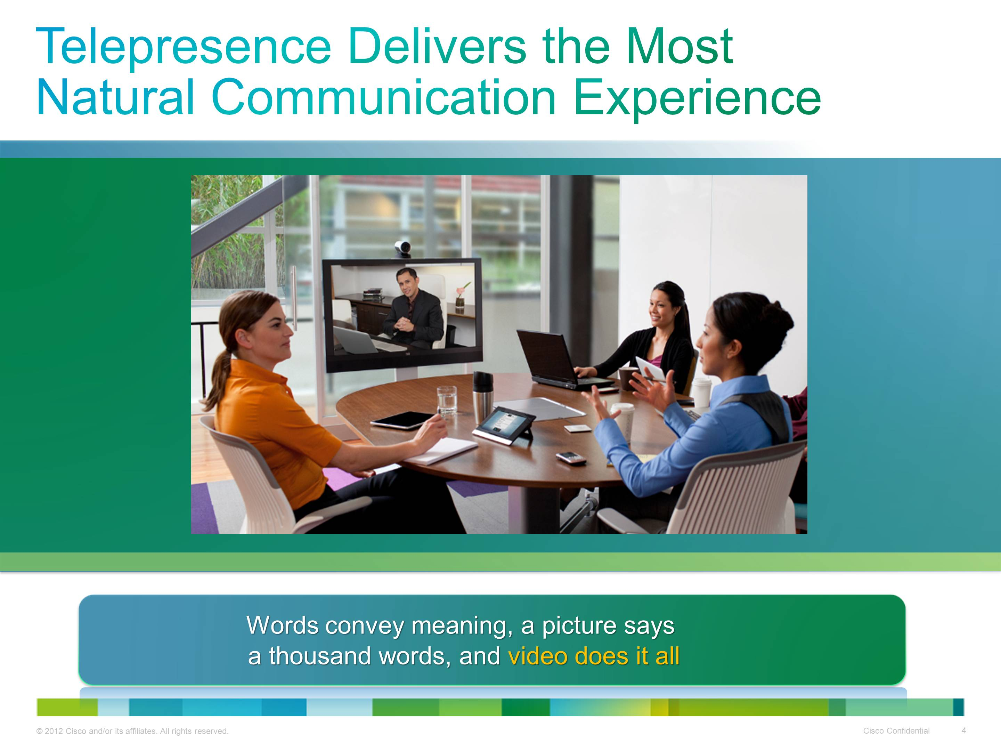
Notes:
Video and the visual medium delivers the most natural collaboration experience possible.
The Benefits of Visual Communication
64% of communication is non-verbal
One third of the human cortex is dedicated to vision
¹ Kandola, Pearn “The Psychology of Effective Business Communications in Geographically Dispersed Teams”, Cisco Systems, September 2006
² Vision Group Research, FMRIB, University of Oxford, UK

Slide 9

Video Conferencing
Why companies are deploying video…
Accelerate sales - Presenting to and meeting with more customers
Improve customer & employee training - Financial benefits of improving reach and frequency of training programs
Enhance employee productivity - Increasing effectiveness of product launches, major project reviews, and inter-office meetings
Improve tele-working – Remote offices. Dramatically improve communications capabilities with staff that work from home and remote offices
Enhance sales and customer service - Kiosks, Visual Contact Centers
Disseminating knowledge and improving collaboration
Vertical applications - Telemedicine, distance learning, video banking, remote interviewing, manufacturing quality control, remote expert, etc.

Slide 10
Visual Communications Overview
Where are we going?
A Few Vertical Market Applications

Slide 11


Today’s Banking Solutions
Demand staffing: Since it is difficult to have all experts in all branches.
Human Resources : Are conducting remote interviews and recruiting, employee training and performance reviews.
Branch offices : Are dealing with loans and business services.
Virtual Banker Concept: Is providing two-way audio and video conferencing between consumers and advisors.

Slide 12

Today’s Banking Solutions continued
Video terminals: Are outfitted in branches providing customers access to remote experts.
Customer Information: Providing customers the latest in product and services while they are within the bank.
Training: Providing staff education.
Executives: Are delivering board meetings and leadership announcements.

Slide 13
Today’s Healthcare Applications
Patient Rooms
Telepharmacy
Emergency Medicine
Remote Dermatology
Remote Pathology
Medical Training
Continuing Education
Remote Surgery
Remote Psychology
Remote Triage
Remote Treatment

Slide 14

Today’s Healthcare Applications
Patient Care Application
Reduce suffering associated with separation
  Parent – Child, Parent – Parent , Child – Sibling/Peer/School
Enable presence of off-site parent. Family caregiver in medical discussions.
Empower patients to remain connected with school
Engage outside provider in medical discussions.
Provide interactive patient and
family preparation and education
prior to visits

Slide 15







Today’s Education Applications
Next Generation Learning
Formal Learning (scheduled, instructor-led)
Virtual Classrooms
Video Portals
Video (live and on-demand)
Field Trips
Class Flipping
Informal Learning (anywhere, anytime, team-based)
CoSpace Meeting Centers
Streaming
Notes:
The ability to collaborate and work together is becoming increasingly important as students enter the workforce.
In fact, here at Cisco, our culture is built around collaboration and our ability to use technologies to work better together, in a more seamless way, regardless of time or location.
Collaborative learning takes many shapes in schools.
It can be formal learning, which is scheduled and instructor-led, and could be based on a solution such as our WebEx Training Center Virtual Classroom, our Show-and-Share Video portal, or TelePresence.
Collaborative learning could also take place using either live or on-demand video, again with Show-and-Share, WebEx, TelePresence, and Flip Video cameras. Imagine students recording themselves for a class project, and then posting these videos to a video portal or to their learning portfolios.
Finally, collaborative learning can take place informally, anytime, anywhere based on Unified Communications and WebEx. Students can work in groups over WebEx from their homes after school, or they can connect via IM and share folders and files through WebEx Connect.

Slide 16
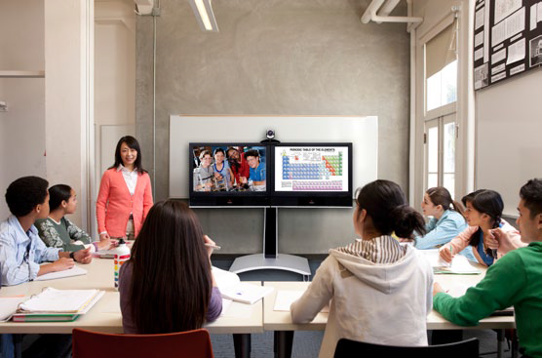
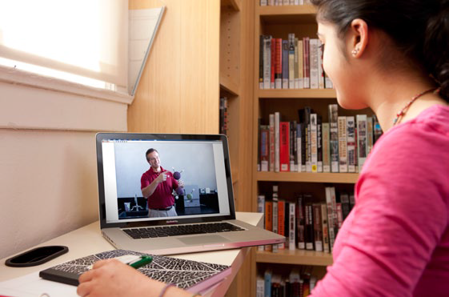
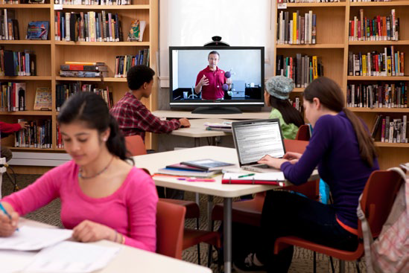
Today’s Education Applications
Next Generation Learning
Classrooms Remote Students Remote Teachers
  Video conferencing helps institutions deploy interactive video communication to:
    Utilize remote experts and content from anywhere in the world
    Improve professional development and teacher training
    Support extended office hours and off-campus teaching
    Enable interactive distance learning
    Utilize lecture capture for synchronous, asynchronous and blended courses

Slide 17
Visual Communications Overview
Where are we going?
Many Options are Available

Slide 18
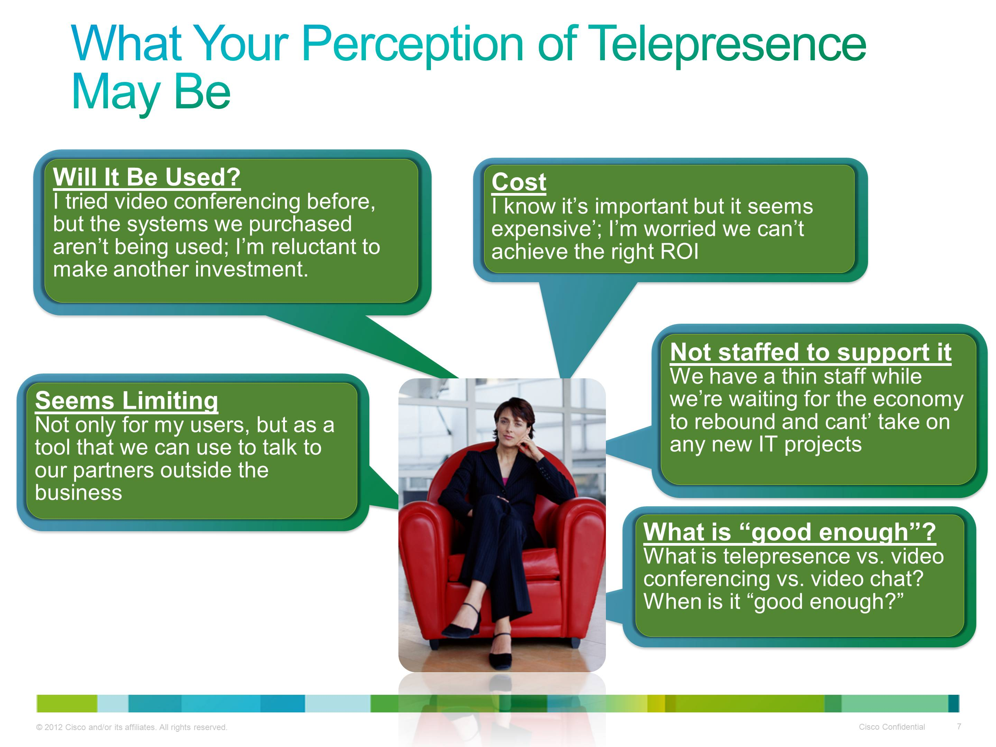
Notes:
Note to SPEAKER: It’s important you pause and take time to explain this slide. The customer will identify with at least one of these bullets; ask them to elaborate on their past experiences to help transition to subsequent the offer slides.
How many of you have ever:
Had a limited experience with telepresence, not being able to talk to external participants?
Had hard-to-use or ineffective equipment/systems and use cases before?
Had issues or perceive issues with managing costs to deploy and manage?
Had issues or perceive issues with staffing/support for it?
Don’t know how to value telepresence vs. video conferencing vs. video chat?

Slide 19
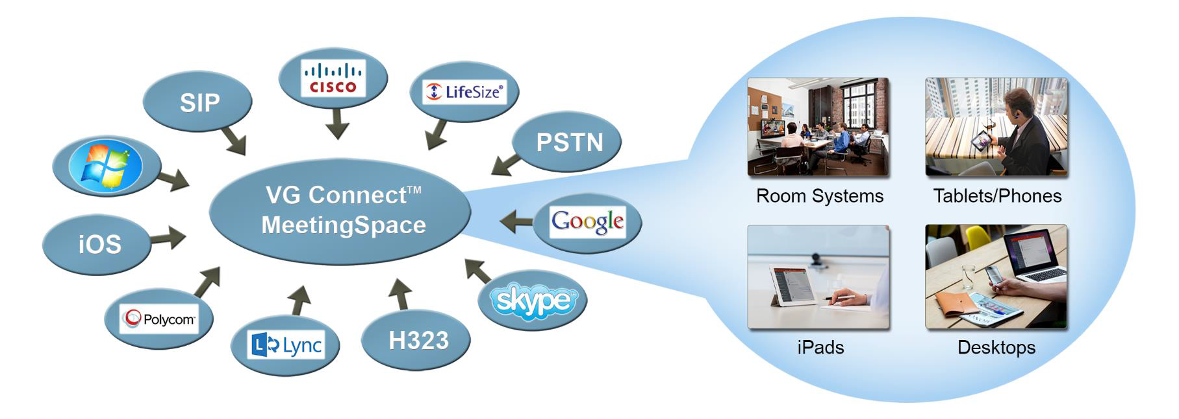
An Option to Consider
Cloud-based Video Collaboration
Ad hoc “In-person” meetings
Select endpoints that are right for you
A fully managed service that includes a user adoption program
Affordable - Monthly pricing model
Feature rich – User controlled
Supports WebRTC

Slide 20

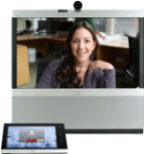


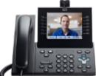

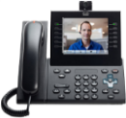
Cloud-based Architecture
Tablet
Mobile Phone
Desk
Phone
Laptop / Desktop
Video Endpoint
IM Client
Web Client
Lync Client
WebRTC
Productivity Applications
Personal Files
User Interface
ONE USER EXPERIENCE
Audio Conferencing
Video Conferencing
Web
Conferencing
Dynamic Desktop/Content
Foundation
INTEGRATION
VCS
Lync
CUCM
IP-PBX
Transport/
Routing
Directory
Infrastructure

Slide 21
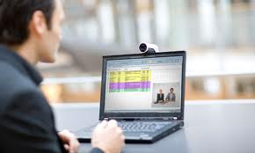

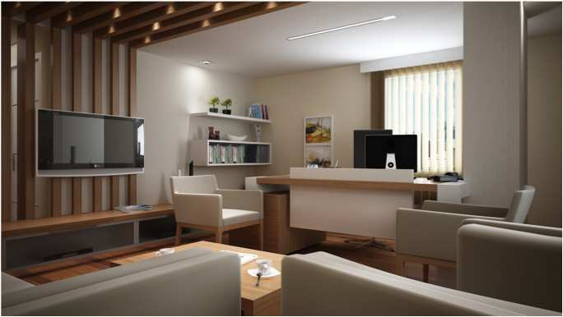






Introducing coSpaces
Virtual meeting rooms accessible from any device
PC client
Tablet
Mobile
WebRTC
always available
Personal
Endpoint

Slide 22
Best Practices to Consider
Ensure your success
  No video for video sake - Applications
  It is OK to start small – Cloud-based solutions
  Indentify internal video champions
  Seek input from IT department
  Set metrics for success from the start
  Get executive sponsorship
  Communicate your video initiatives
  Take advantage of video adoption programs

Slide 23
Grants
The Grant Funding programs targets include:
  Education: Public and private K-12 schools, colleges & universities
  Health Care: Nonprofit hospitals and public health departments
  Government: Local, state and federal agencies
  Economic Development: Workforce development and job creating.
Learn about how we can help —
  Identify funding opportunities that specifically target your needs
  Assist with determination of grant application specifics and program eligibility for targeted application
  Leverage our network of grant writers and funding specialists

Slide 24
Video Guidance
Focus – Visual communication is our only business!
  Consultative approach (business and technology)
Solution Provider using industry-leading vendors
  Multiple vendor experience including Cisco, Polycom and LifeSize
Video Guidance “Cloud-based” services “Video as a Service”
  VG Connect™ - A comprehensive, outsourced solution to ensure burden-free video conferencing
Video Guidance ONE CALL philosophy & program
  Video Guidance understands that conferencing technologies are vital communication tools essential to the success of your business
Consultative A/V Integration services
  Our integration teams will formulate optimized solutions that exceeds your immediate needs.

Slide 25
Questions

